Slide 1
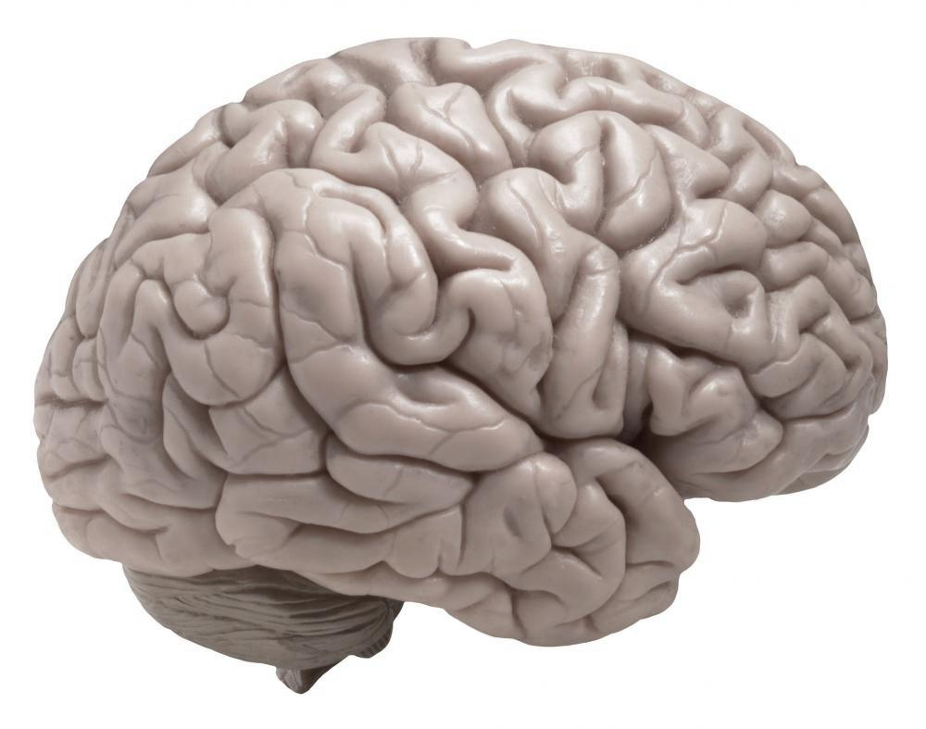
Fun with the Brain
THE BRAIN
Notes:
This lesson was developed by Alexis Hill (alexis.s.hill@gmail.com) and Laura Englehardt.
Presented to 3rd and 4th graders at Washington Heights Academy in Feb 2013. Went really well!
Timing: 15 mins for intro and background (slides 1-10)
15 mins for group activities (slides 11-26)
15 mins to show brains.
We’re here today to talk to you about the brain! We are scientists. What do you think a scientist does? What makes us scientists?

Slide 2
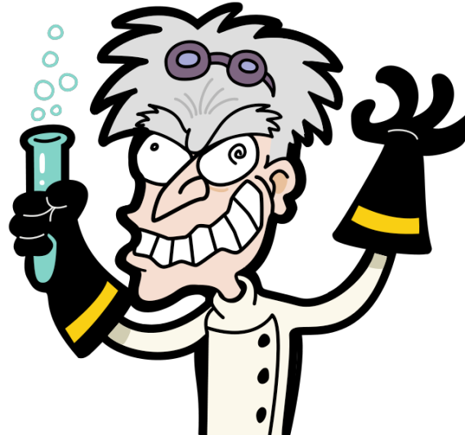
We are all scientists
Notes:
Introduce lesson teachers by first name, then state that they are all scientists.
“Scientists study the world around them and try to figure out how it works.”
“That means everyone—including kids—can be a scientist.”
Point 2: There are lots of different types of scientists, we are ‘neuroscientists’ because we study the brain. Has anyone heard of the word neuro or neuron before?

Slide 3
Fun with the Brain
How do you use your brain?
Notes:
How do you use your brain?
Ask participants to say a few things they use their brains for, maybe write these out on smart board

Slide 4
5 Senses
Notes:
Ask children to name the 5 senses. Help if necessary.
“Are our senses important? Why?” → They help us to understand what’s going on around us.
“Which sense do you think you could live without? Why?”

Slide 5
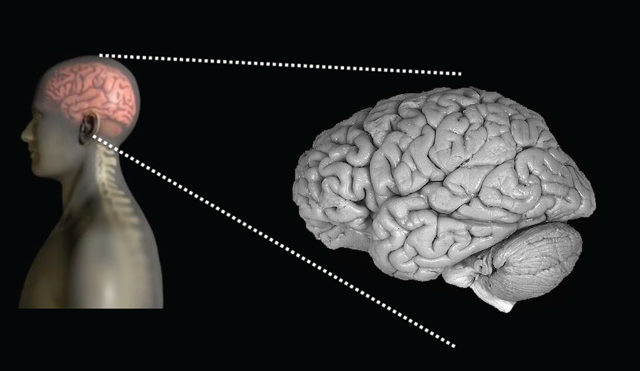
The Brain
Notes:
“Everything about us—including our senses—is controlled by the brain.”
“Where is your brain? What does it look like?...It’s actually gray!”

Slide 6
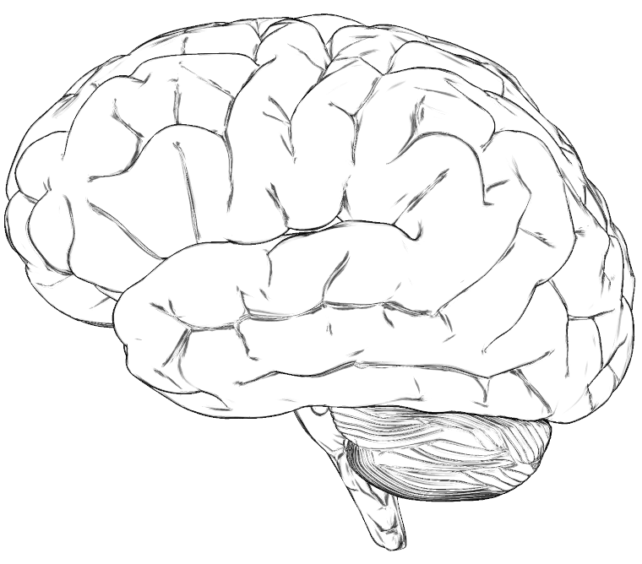
Sight
Notes:
Encourage the class to describe what the brain looks like.
“That’s right, all of those squiggly lines divide the brain into many different parts.”
“Different parts of the brain control each of our senses.”
SIGHT
**for each sense, ask the class/describe what type of things one wouldn’t be able to do without this sense
http://www.google.com/imgres?hl=en&sa=X&tbo=d&rlz=1C1CHMO_enUS497US497&biw=1040&bih=823&tbm=isch&tbnid=irbc7y1r2J-irM:&imgrefurl=http://spinacare.wordpress.com/category/pain-and-the-brain/&docid=ntin1BWcG5U2BM&imgurl=http://spinacare.files.wordpress.com/2007/02/homunculus.jpg&w=845&h=1050&ei=E0D0UOeyLujD0AHn0IBo&zoom=1&iact=hc&vpx=4&vpy=137&dur=3401&hovh=250&hovw=201&tx=87&ty=97&sig=108571637925046185366&page=1&tbnh=143&tbnw=115&start=0&ndsp=24&ved=1t:429,r:0,s:0,i:99

Slide 7
Touch
Notes:
TOUCH

Slide 8
Hearing
Notes:
HEARING

Slide 9
Taste
Notes:
TASTE

Slide 10
Smell
Notes:
SMELL

Slide 11
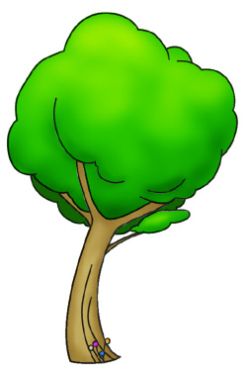
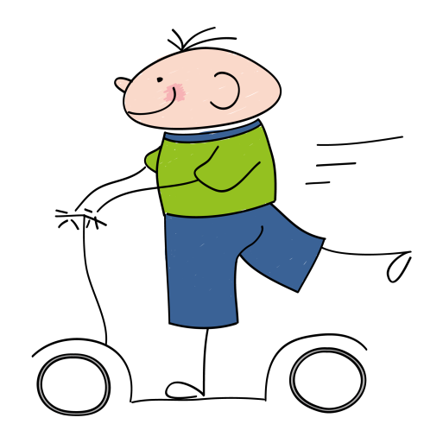
Notes:
Scenario 1: John is riding his scooter down the street, when he bumped into a tree. He fell off his scooter and hit his head on the ground. His parents took him to the doctor’s office. When the doctor looked at his brain, he saw which part of the brain was hurt. Each group will have a different scenario of a different part of the brain being hurt. If that part of John’s brain was hurt, which of his senses would be affected? What types of activities would he have trouble with?

Slide 12
Group 1
Which sense will be damaged?
What activities will be affected?
Notes:
Use this one as an example, pass the other ones out to groups of students.

Slide 13
Your Turn!
Notes:
Put up this slide during group activities.
Have each group present their answers (from their seats) as you go through the following 5 slides

Slide 14
Group 1

Slide 15
Group 2

Slide 16
Group 3

Slide 17
Group 4

Slide 18
Group 5

Slide 19
Notes:
After all groups have gone, discuss ways that we can keep these injuries from occurring.

Slide 20
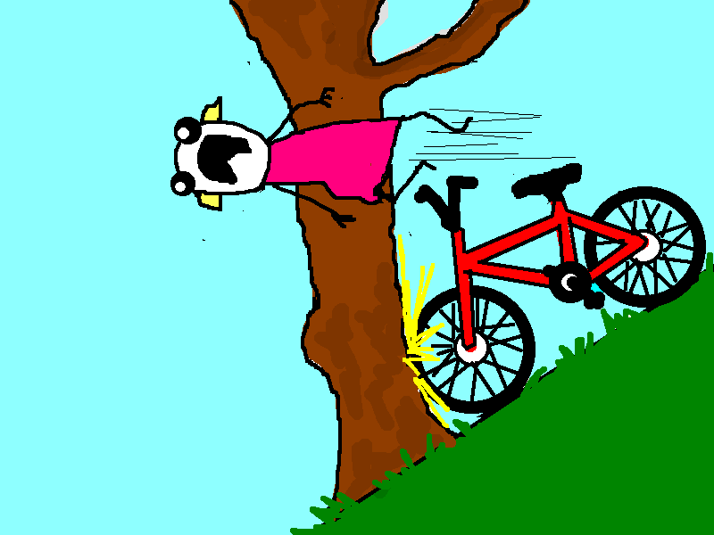
Notes:
Images from http://hyperboleandahalf.blogspot.com/2010/07/bicycle.html
Scenario 2: Jane is riding her bike too fast down the hill. She crashes into a tree, falls from her bike and hits her head. Her parents bring her to the doctor. The doctor notices that she is having problems with one of her senses, and from that, figures out what part of the brain was most likely damaged from the accident. Based on her symptoms, which sense is damaged? Shade in the part of the brain that was probably damaged.

Slide 21
Your Turn!
Notes:
Put up this slide during group activities.
Have each group present their answers (from their seats) as you go through the following 5 slides

Slide 22
Group 1
Everything looks blurry to Jane.
Which sense was affected?
Notes:
Vision (don’t need to do an example for this exercise)

Slide 23
Group 2
When Jane’s family got to the doctor’s office there was a baby crying so loudly that Jane’s brother covered his ears, but Jane didn’t even notice!
Which sense was affected?
Notes:
Hearing

Slide 24
Group 3
On the way to the hospital, Jane’s parents gave her one of her favorite candy bars as a treat, but as she put it in her mouth, it wasn’t even good.
Which sense was affected?
Notes:
Taste

Slide 25
Group 4
When Jane went to open the car door, it felt weird, it was like she couldn’t even feel the door!
Which sense was affected?

Slide 26
Group 5
When Jane’s family got out of the car at the doctor’s office, Jane’s brother scrunched up his nose because he smelled a skunk, but Jane didn’t even notice!
Which sense was affected?

Slide 27
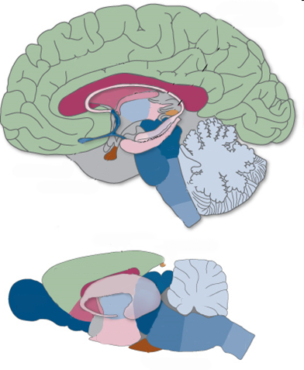
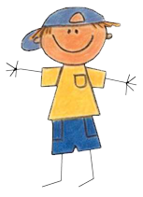
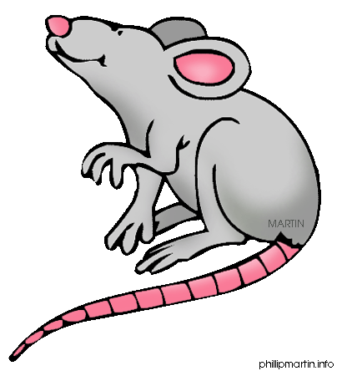
Notes:
This and the next slide are extras if have left over time.
“All animals need a brain to survive.”
“Are all animal brains the same?”
Talk about how different animals use their brains for different things.
Ask students how the human and rat brains are the same and different.

Slide 28
Notes:
Ask students how the human and rat brains are the same and different.
“Why do you think the part that controls smell is bigger in the rat?”

Slide 29
Questions??

Slide 30
Pictures courtesy of communication4all.co.uk (senses), wikipedia.org (mad scientist), cliparts101.com (man at desk), science.phillipmartin.info (woman with microscope), clipartof.com (girl at desk), 4chandata.com (boy with pitchfork), 123rf.com (boy with book)
wisegeek.org (real brains), builttosell.com (black and white brain outline), lifehacker.com (pink cartoon brain), learn.genetics.utah.edu (human & rat comparison)

