Slide 1
Handouts for Elementary Lesson Plan

Slide 2
Scenario 1:
John is riding his scooter down the street, when he bumped into a tree. He fell off his scooter and hit his head on the ground. His parents took him to the doctor’s office. When the doctor looked at his brain, he saw which part of the brain was hurt. Each group will have a different scenario of a different part of the brain being hurt. If that part of John’s brain was hurt, which of his senses would be affected? What types of activities would he have trouble with?

Slide 3
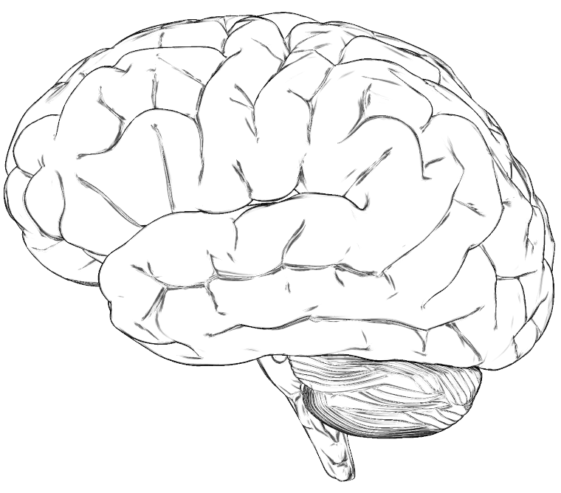
Group 1
Which sense will be damaged?
What activities will be affected?

Slide 4
Group 2
Which sense will be damaged?
What activities will be affected?

Slide 5
Group 3
Which sense will be damaged?
What activities will be affected?

Slide 6
Group 4
Which sense will be damaged?
What activities will be affected?

Slide 7
Group 5
Which sense will be damaged?
What activities will be affected?

Slide 8
Scenario 2:
Jane is riding her bike too fast down the hill. She crashes into a tree, falls from her bike and hits her head. Her parents bring her to the doctor. The doctor notices that she is having problems with one of her senses, and from that, figures out what part of the brain was most likely damaged from the accident. Based on her symptoms, which sense is damaged? Shade in the part of the brain that was probably damaged.

Slide 9
Group 1
Everything looks blurry to Jane.
Which sense was affected?
Shade in the part of the brain that is damaged:
Notes:
Vision

Slide 10
Group 2
When Jane’s family got to the doctor’s office there was a baby crying so loudly that Jane’s brother covered his ears, but Jane didn’t even notice!
Which sense was affected?
Shade in the part of the brain that is damaged:
Notes:
Hearing

Slide 11
Group 3
On the way to the hospital, Jane’s parents gave her one of her favorite candy bars as a treat, but as she put it in her mouth, it wasn’t even good.
Which sense was affected?
Shade in the part of the brain that is damaged:
Notes:
Taste

Slide 12
Group 4
When Jane went to open the car door, it felt weird, it was like she couldn’t even feel the door!
Which sense was affected?
Shade in the part of the brain that is damaged:

Slide 13
Group 5
When Jane’s family got out of the car at the doctor’s office, Jane’s brother scrunched up his nose because he smelled a skunk, but Jane didn’t even notice!
Which sense was affected?
Shade in the part of the brain that is damaged:

