Slide 1
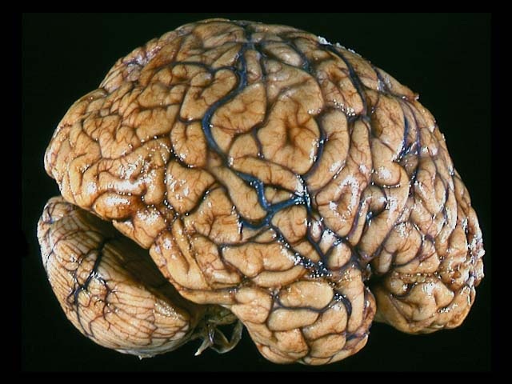
Neuroscience Workshop
With
Cate and Raven

Slide 2
Today
Brain basics
Real brains
When brains process differently
Real neuroscience: our research

Slide 3
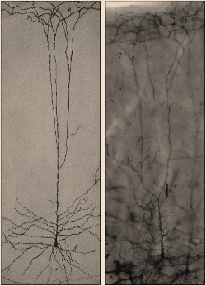
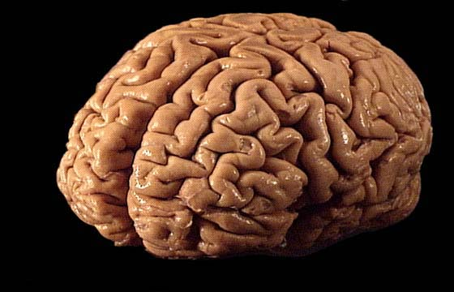
Tell us what you know about neurons and the brain!
Parts of the brain?
Parts of neurons?

Slide 4
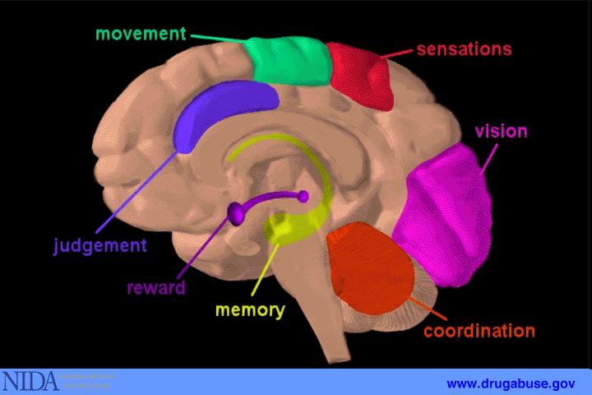
Many of the brain’s functions are “localized”
Notes:
‹#›
Dendrites receive inputs from other neurons
Soma - coordinates those inputs
Axon - carries the electrochemical message away from the cell body and to synapse so it can be transmitted to the next neuron.

Slide 5
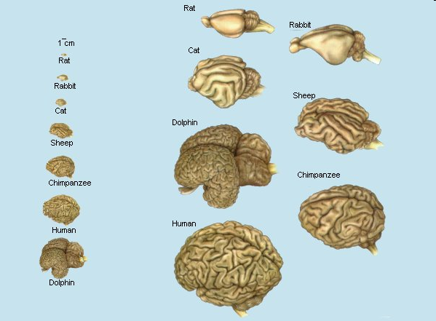
Animal Brains
thebrain.mcgill.ca

Slide 6

Neurons
cell body
axon
dendrites
axon
terminals
Animals may have different looking brains that do different things, but all brains are made of neurons

Slide 7
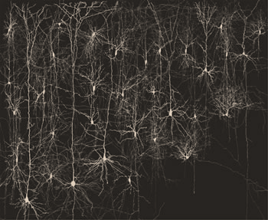

Neurons need to communicate

Slide 8






















The Synapse
Neurotransmitters
Receptors
Signal!
Signal!
Neuron 1
Neuron 2
Vesicles

Slide 9
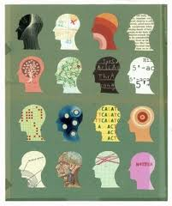
When brains process differently
What are some things you know about the brain and:
  Epilepsy
  Autism
  Dyslexia
  Tourette Syndrome
  ADD, ADHD
Are these diseases or disorders? What’s the difference?

Slide 10

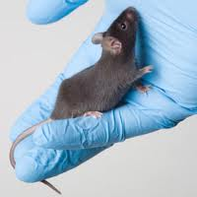
Scientific Understanding
As scientists, we like to know:
  Characterization- how can we identify a disorder?
    Differences in behavior and other symptoms
    Progression over time, course or “prognosis”
  Cause, or “etiology”
  Mechanism of change, or “pathogenesis”
    Often studied at a cellular level
  Possible treatments
Sometimes we need to study these parts in different orders
We can study diseases in humans, or “model” diseases in animals

Slide 11
Tourette Syndrome:
Characterization
  Tics: simple or complex
Course
  Often improves in late teen years and early adulthood, but not always
Cause/ Etiology
  Unknown. Possibly genetic?
Hypothesized development/ pathogenesis
  Abnormal development of certain brain circuits: basal ganglia, frontal lobes, and cortex
  Abnormal neurotransmitter signaling (dopamine, serotonin, and norepinephrine) responsible for communication among nerve cells
Possible treatments
  Often no treatment necessary
  Medication, such as neuroleptics (haloperidol, risperidone); alpha-adrenergic agonists (guanfacine);

Slide 12
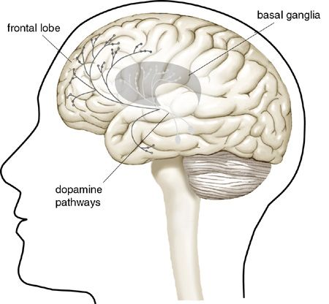
Tourette Syndrome:
The dopamine hypothesis
Dopamine is a neurotransmitter
  One chemical neurons use to communicate
Main brain regions that communicate via dopamine:
  Motor control centers
  Executive function & emotion centers
Frontal lobe/
executive control center
Motor control centers
Limbic/ emotion center
Dopamine
origins

Slide 13
Tourette Syndrome:
The dopamine hypothesis
Dopamine is a neurotransmitter
  One chemical neurons use to communicate
Main brain regions that communicate via dopamine:
  Motor control centers
  Executive function & emotion centers
Drugs that affect dopamine signaling between neurons are sometimes effective in limiting tics
  Dopamine receptor “antagonist” medications, such as haloperidol
  If haloperidol limits involuntary movement, can you think of what too much drug might do?
  If dopamine is also involved in emotion, what else might haloperidol do?

Slide 14
What parts of the synapse might be different with Tourette Syndrome?
Neurotransmitters
Receptors
Neuron 2
Neuron 1
Vesicles

Slide 15
ADD & ADHD
Characterization (often mistaken for other things!)
  Predominately hyperactive-impulsive
  Predominately inattentive
  Combined hyperactive-impulsive and inattentive
Course
  Often improves in late teen years and early adulthood, but not always
Cause/ Etiology
  Largely unknown. Likely genetic and environmental contributions
Hypothesized development/ pathogenesis
  Abnormal development of the frontal lobe and decreased neuron activity
  Abnormal dopamine signaling
Possible treatments
  Behavioral therapy
  “Stimulant” medications, such as Adderall, Dexedrine, Ritalin, etc

Slide 16
ADHD: The dopamine hypothesis
Back to dopamine!
Main brain regions that communicate via dopamine:
  Executive function & emotion centers
  Motor control centers
Frontal lobe/
executive control center
Motor control centers
Limbic/ emotion center
Dopamine
origins

Slide 17
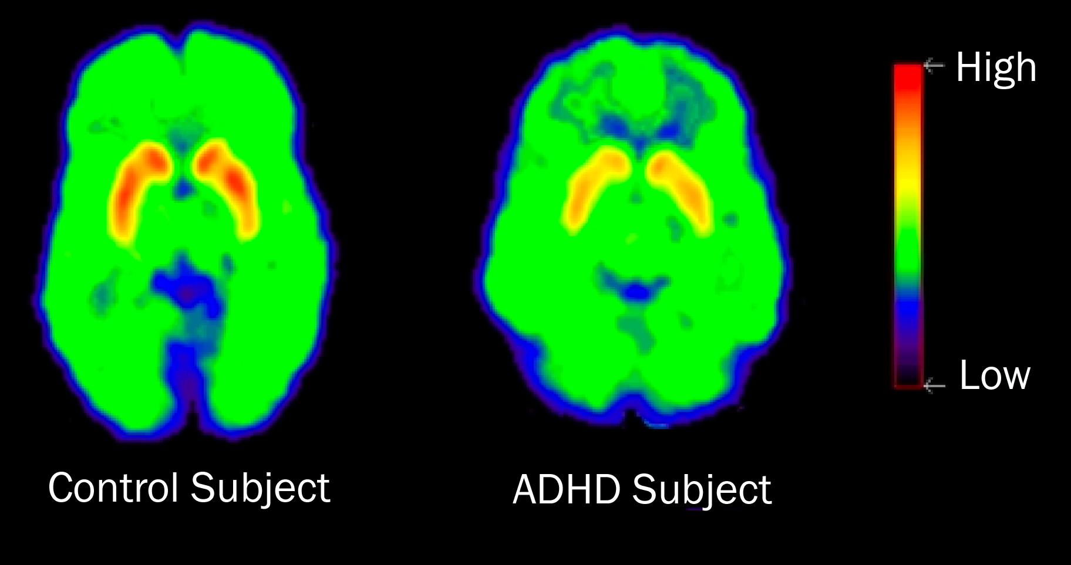
ADHD: The dopamine hypothesis
Back to dopamine!
Main brain regions that communicate via dopamine:
  Executive function & emotion centers
  Motor control centers
Human brain imaging studies found:
  No difference in dopamine receptors
  Lower levels of dopamine in the synapse
    What might cause less dopamine in the synapse?

Slide 18
ADHD: The dopamine hypothesis
Back to dopamine!
Main brain regions that communicate via dopamine:
  Executive function & emotion centers
  Motor control centers
Human brain imaging studies found:
  No difference in dopamine receptors
  Lower levels of dopamine in the synapse
    What might cause less dopamine in the synapse?
Why isn’t ADHD treated with the same medications as Tourette Syndrome if dopamine is disregulated in both?
What do stimulant medications do?
  Help increase neuron activity, which is suppressed in the frontal lobe/ executive function center

Slide 19
What parts of the synapse might be different with ADHD?
Neurotransmitters
Receptors
Neuron 2
Neuron 1
Vesicles

Slide 20
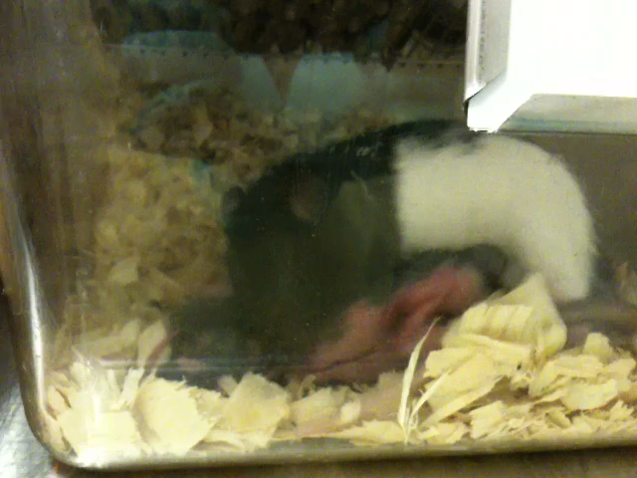
Cate’s Research

Slide 21
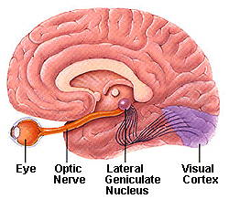
Raven’s Research
How Does the Eye Connect to the Brain?
Using Neurons and Molecules!!!!

Slide 22
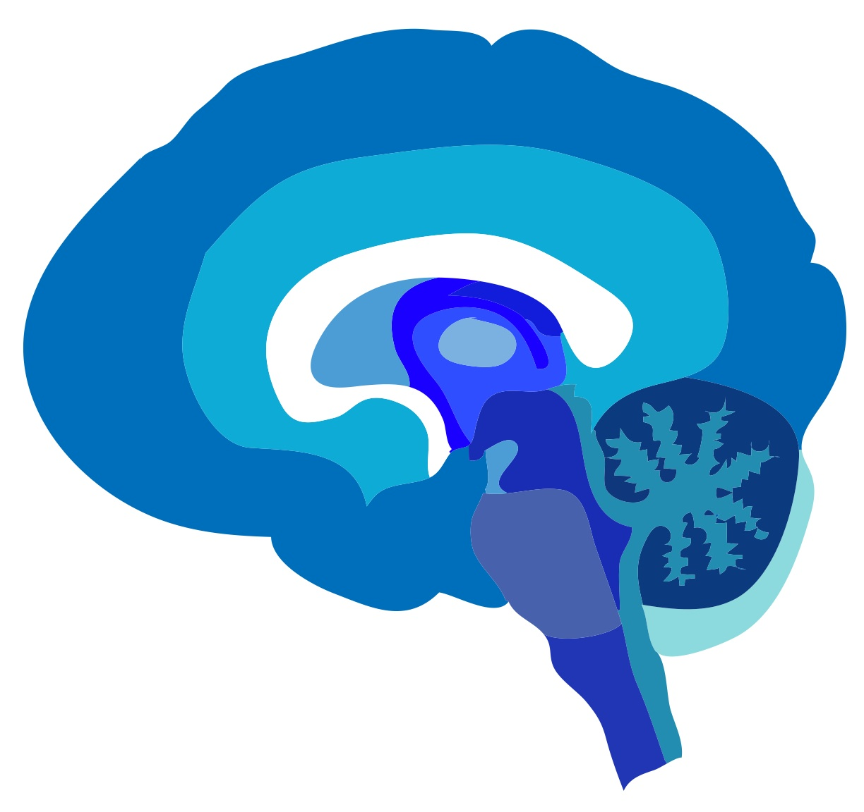
Thank you!
Columbia University Neuroscience Outreach

Slide 23
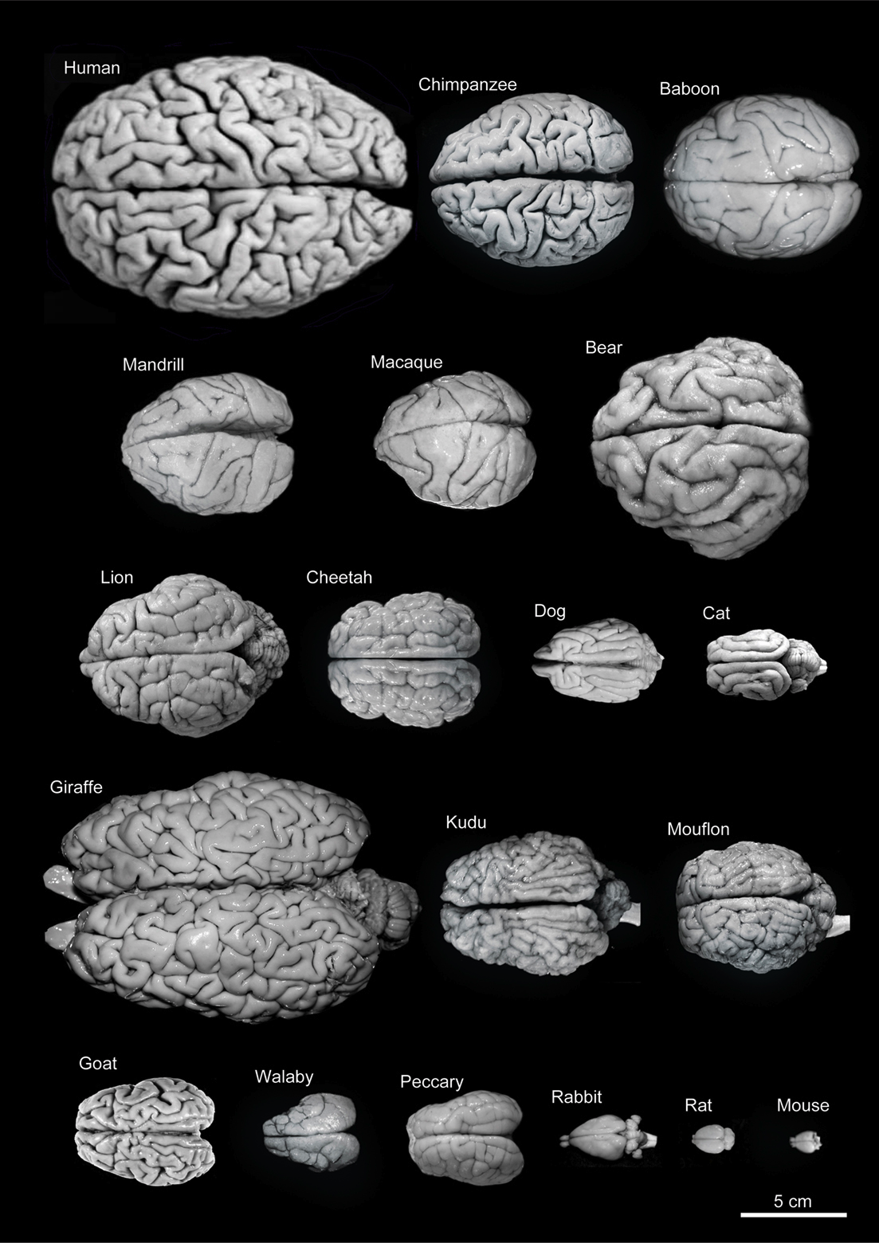
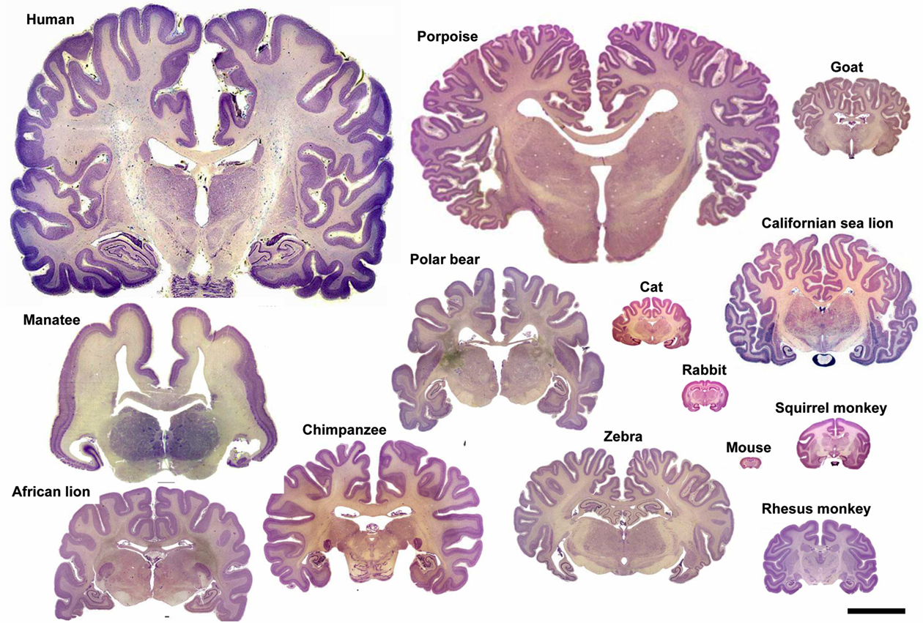

Slide 24
