Slide 1
Anatomy of the Human Brain
Rebecca Martin and Josh Merel
9/27/2012
Notes:
overview/lobes (Rebecca)
sensory regions (might be a few slides) (Josh)
motor humunculi (Josh)
spine, peripheral ns (Josh)
nerves (Rebecca)
subcortical structures (thalamus, hypothalamus, hippocampus if we can see it) (Josh)
brainstem structures (Josh)
CSF/ventricles (Rebecca)
bloodflow (Rebecca)
fmri demo (Osirix maybe?) (talk about BOLD response and capillary beds, arteries, etc) (Rebecca)

Slide 2
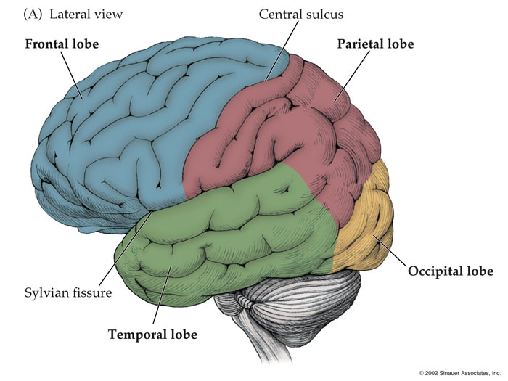
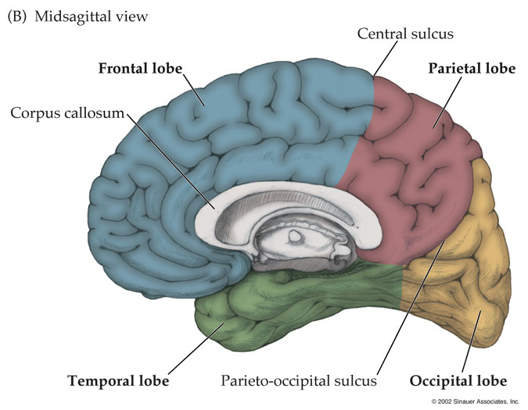
Notes:
Lobes

Slide 3
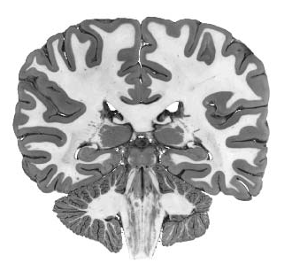
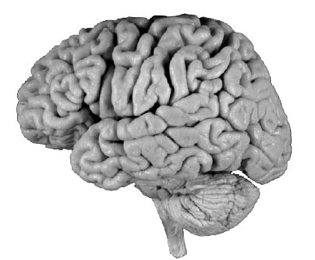

Slide 4
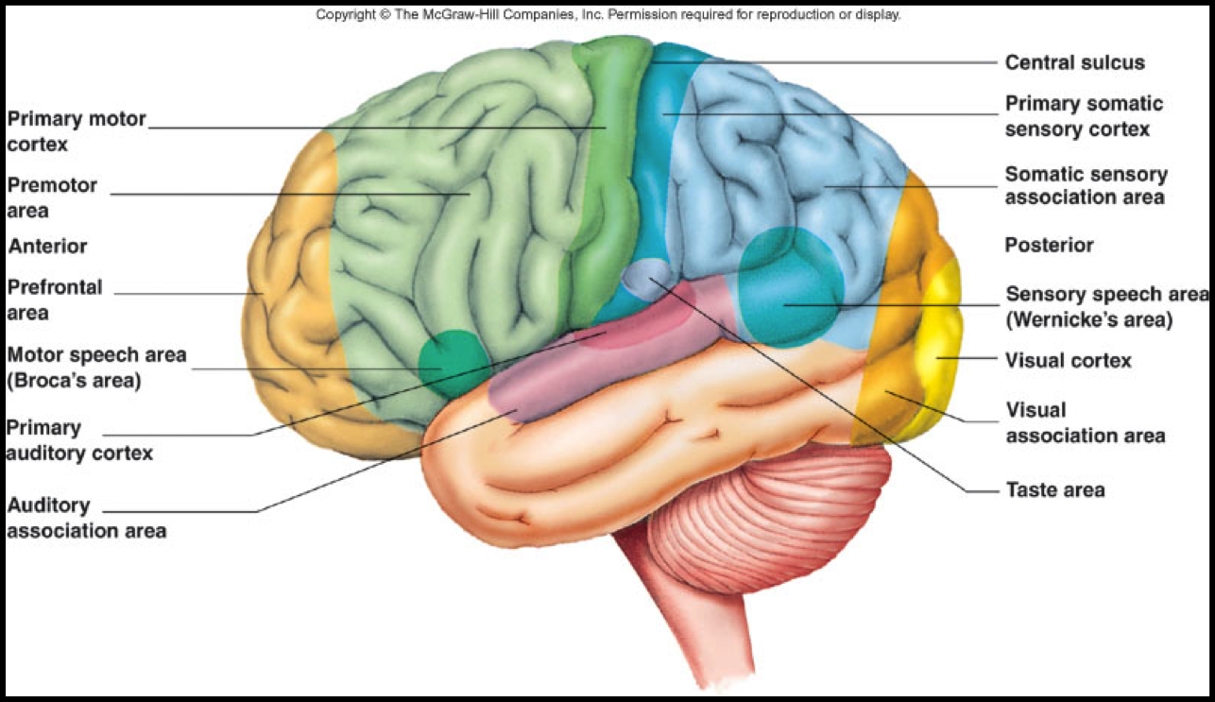

Slide 5
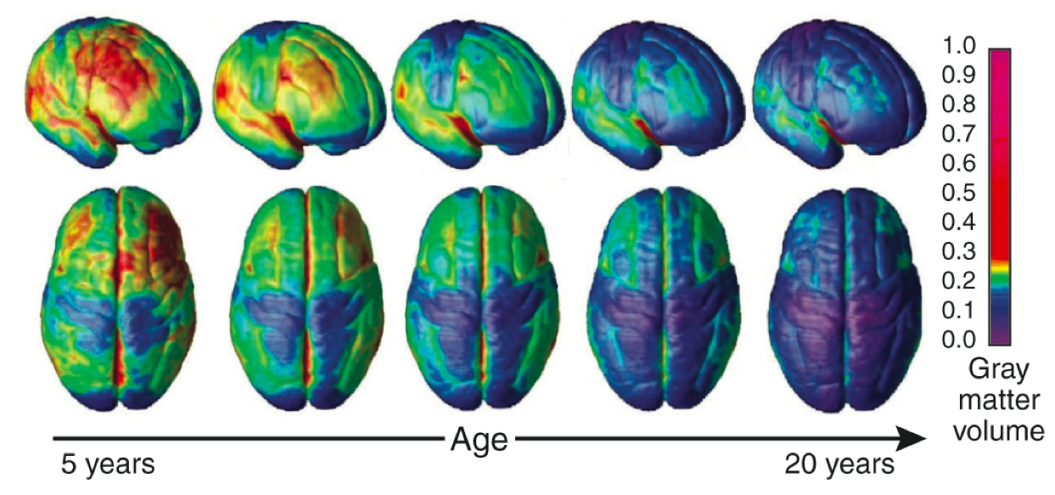
Cortical Thinning Across Development

Slide 6
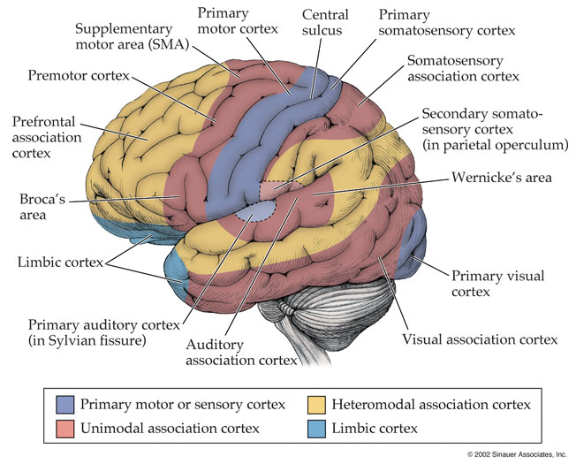

Slide 7
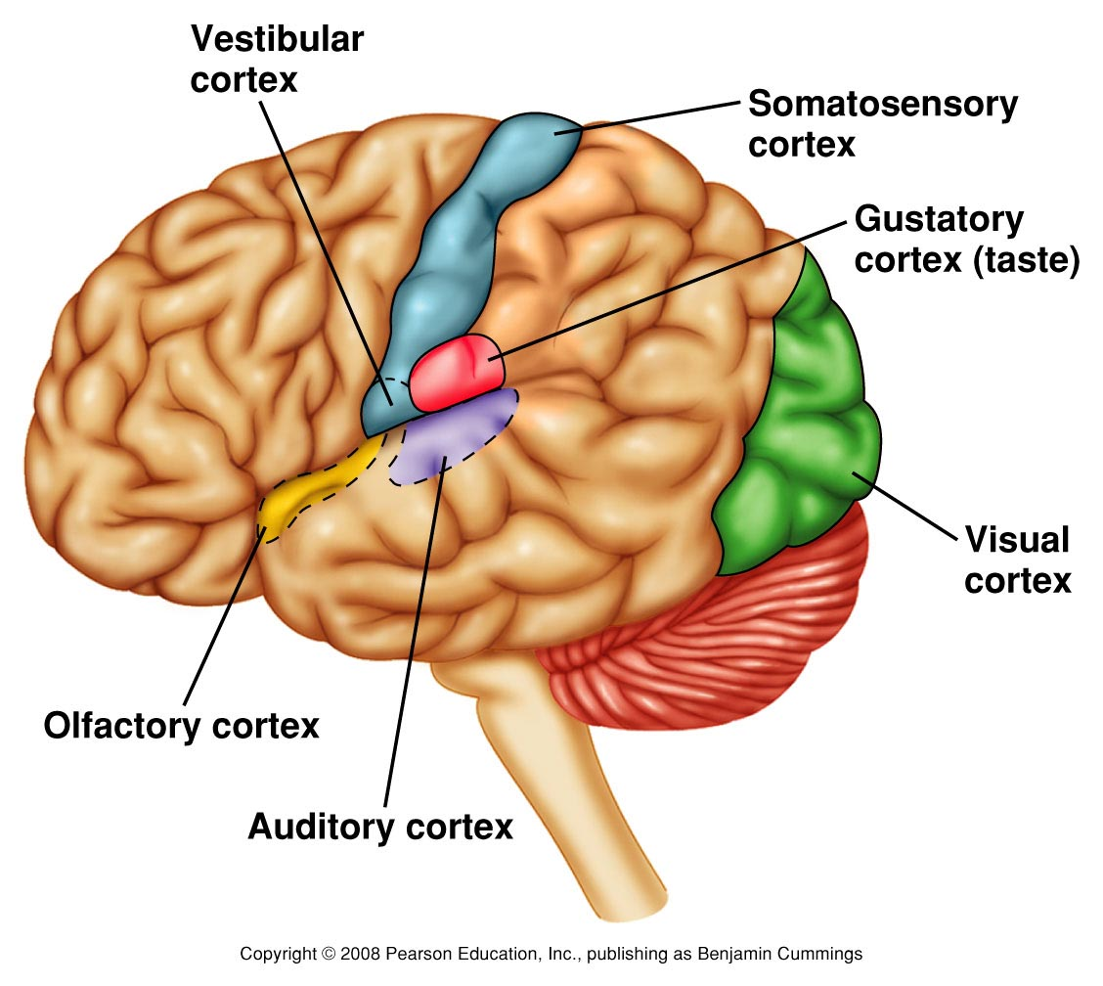
Sensory Cortex

Slide 8
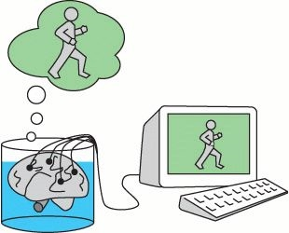
Brain in a Vat

Slide 9
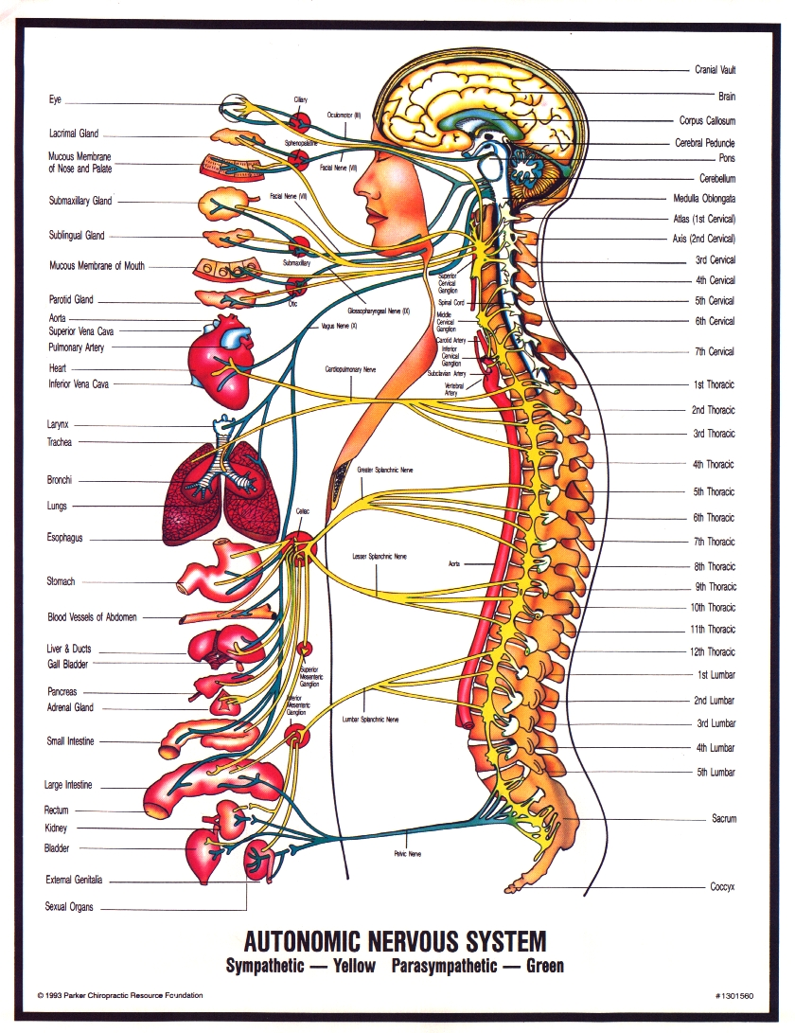
Not a brain in a vat – a lot of peripherals

Slide 10
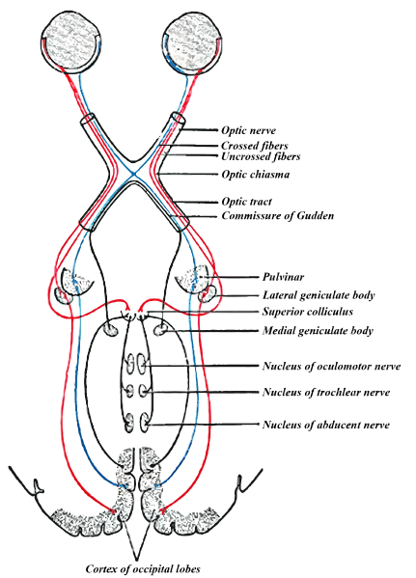
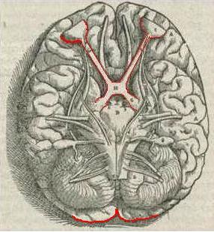
The Visual System

Slide 11
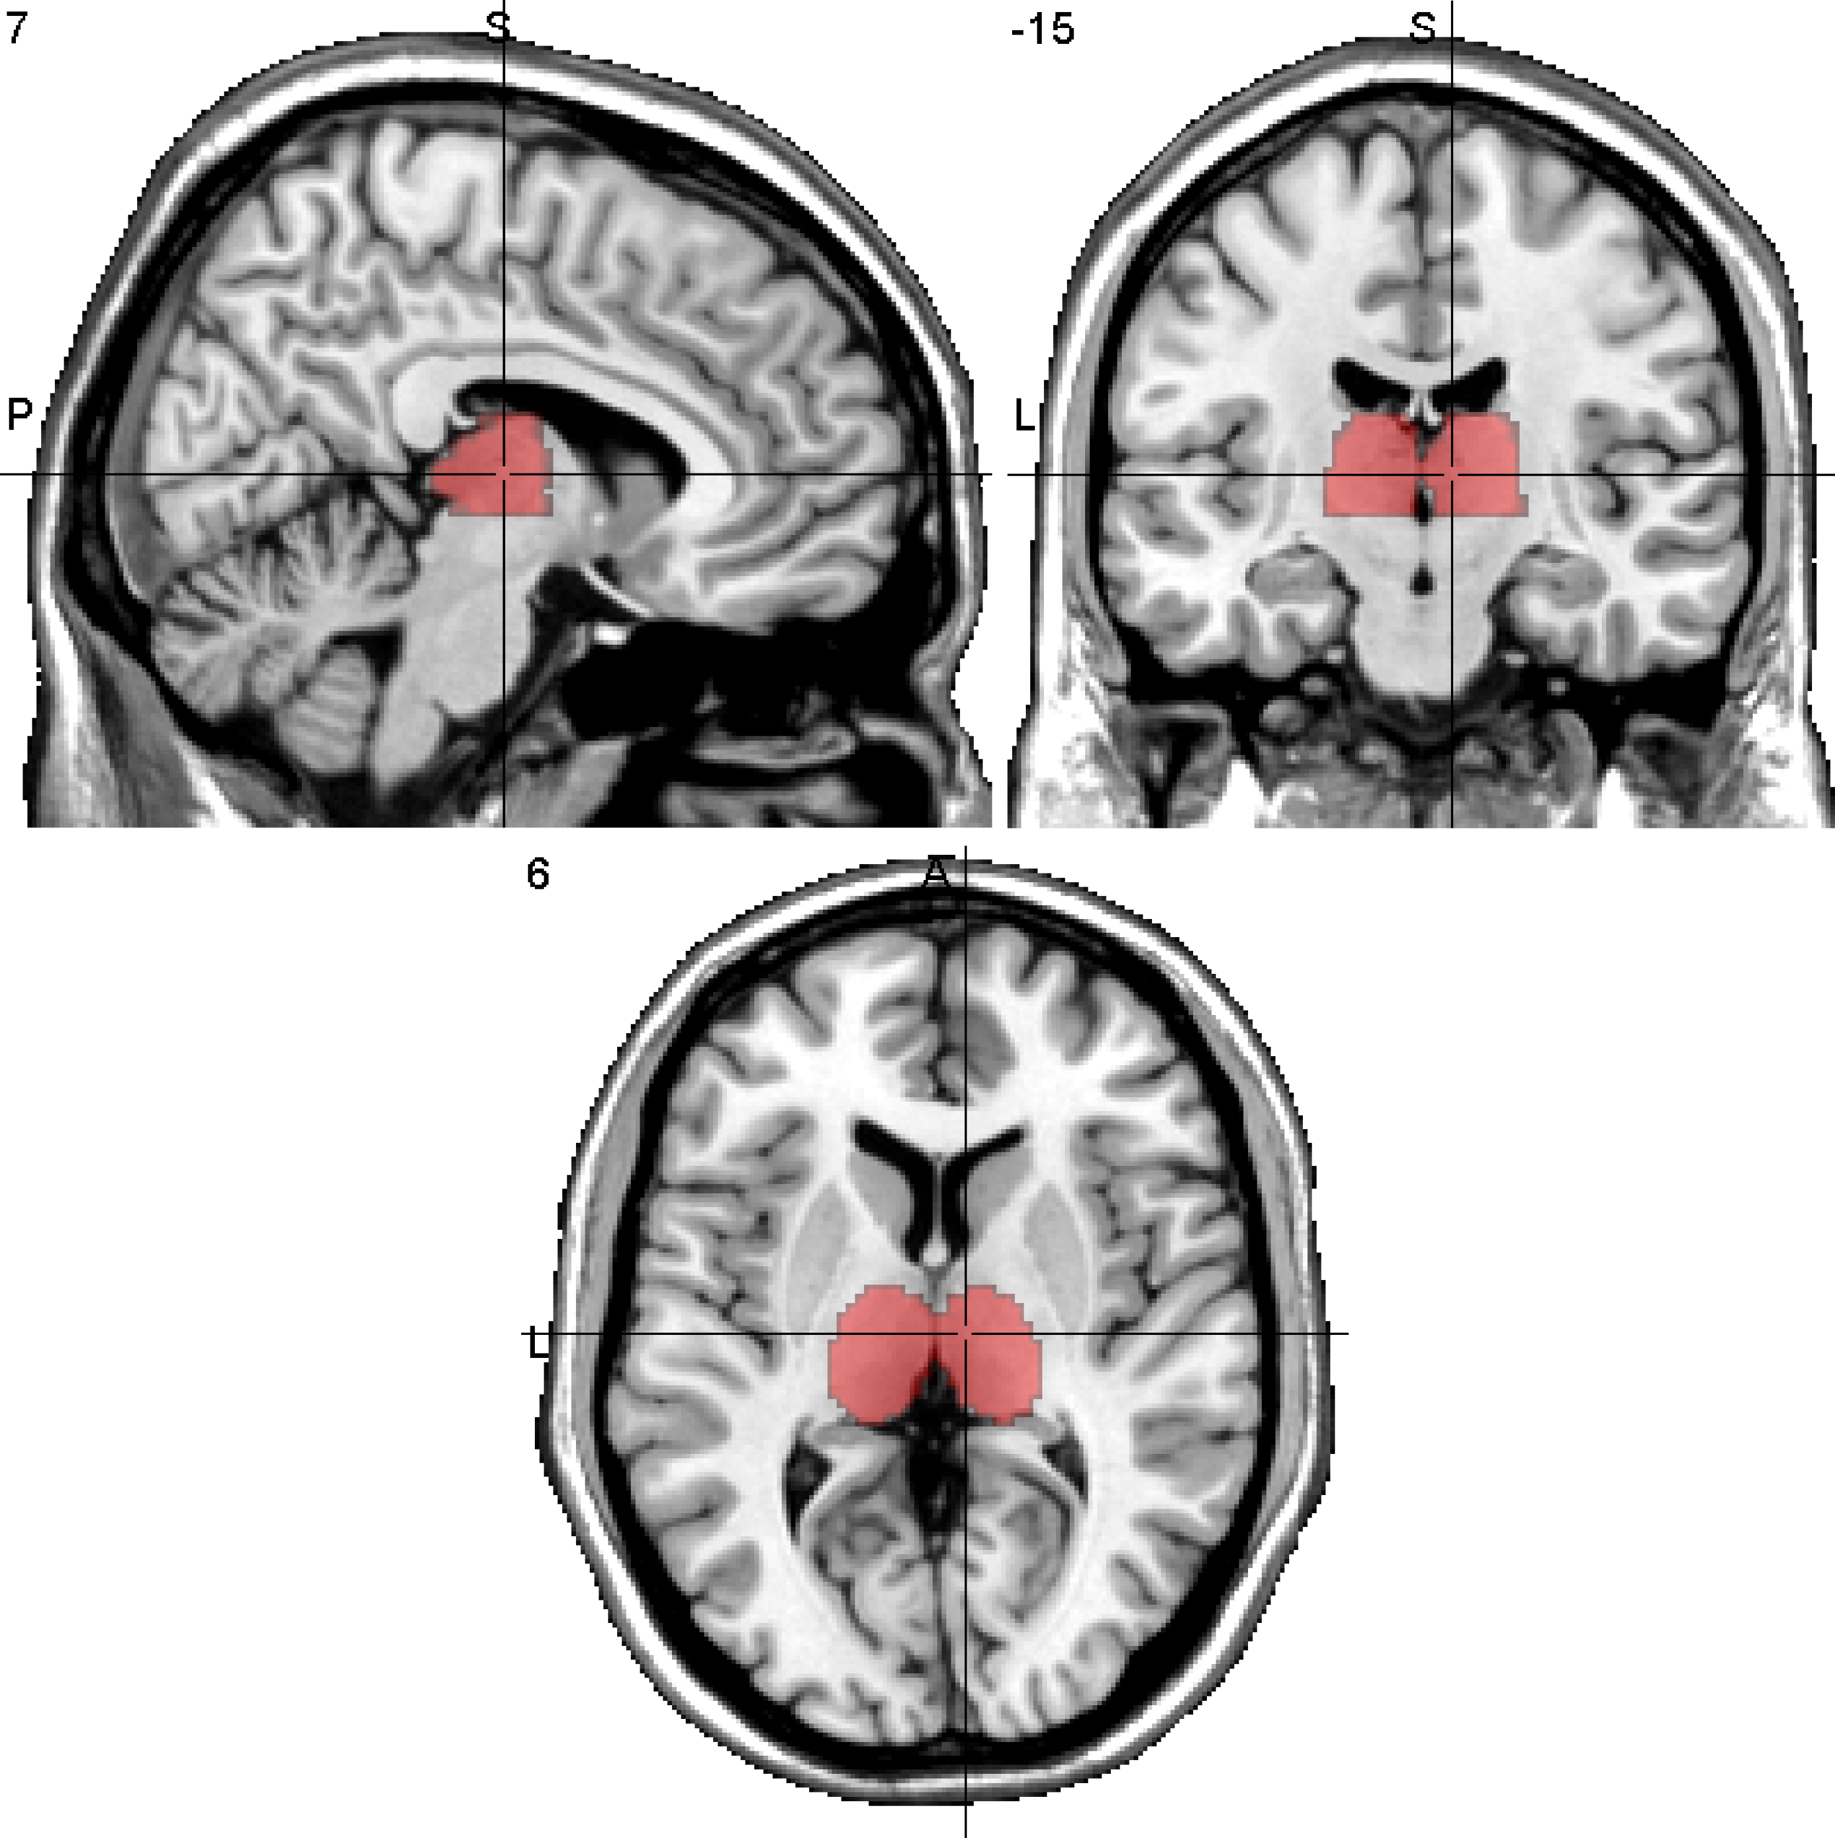

Slide 12
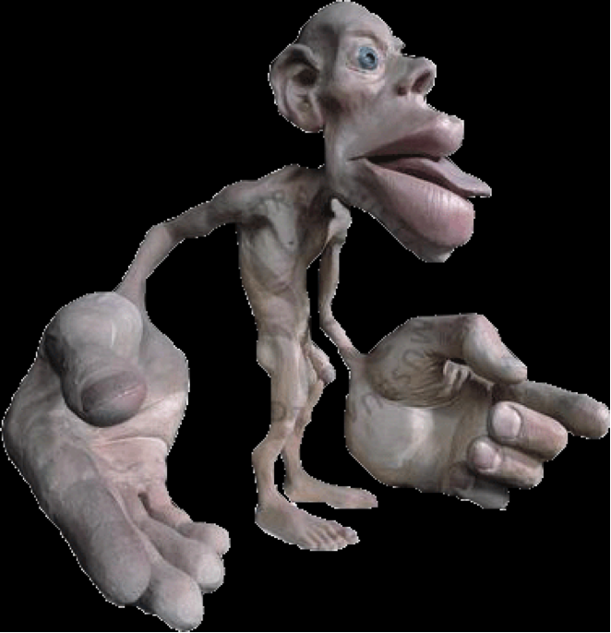
Somatotopy

Slide 13
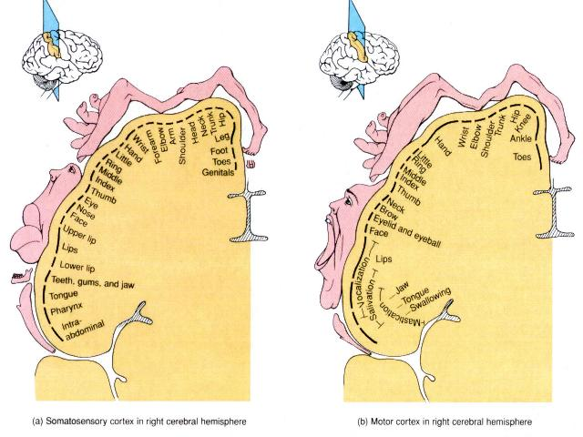
Somatotopy

Slide 14
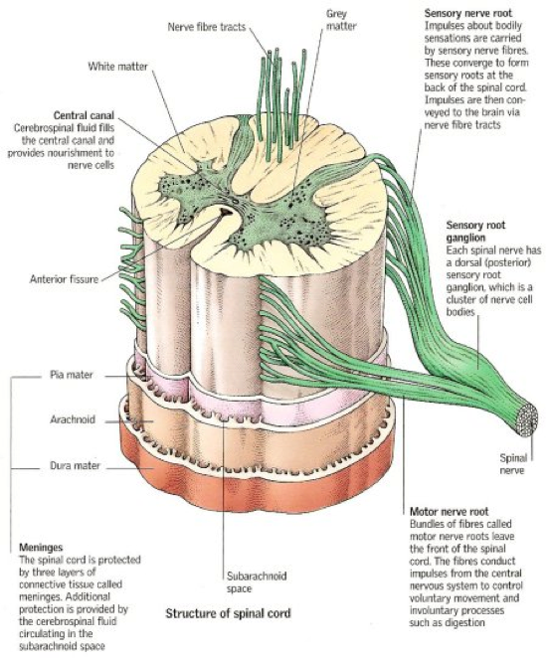
Spine

Slide 15
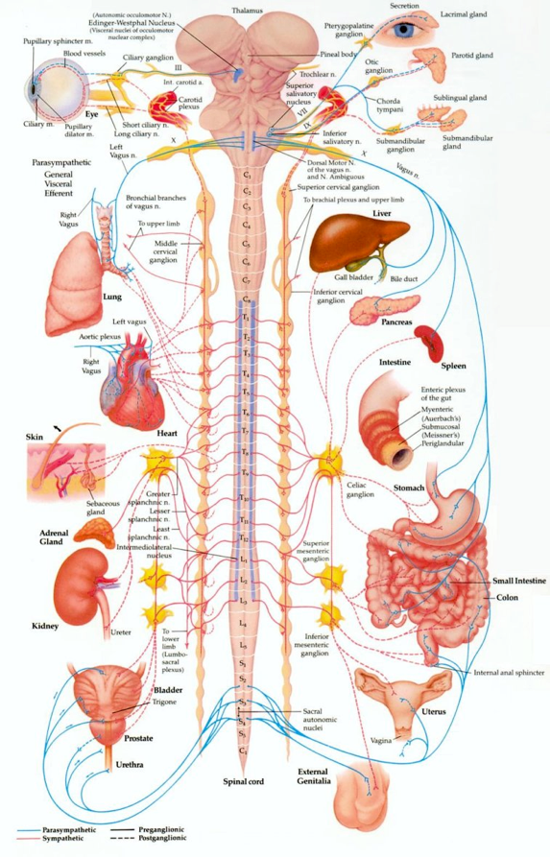

Slide 16
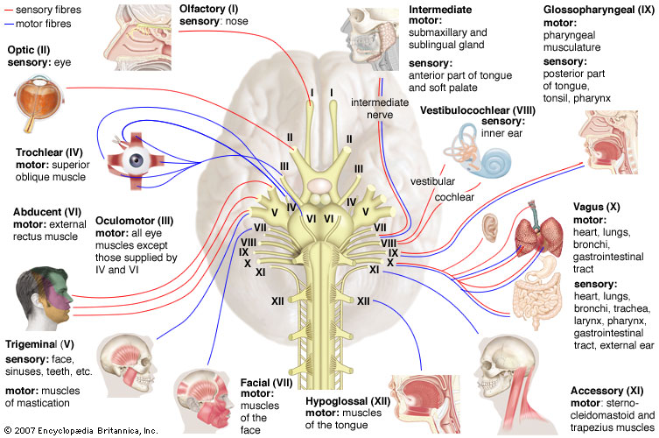
Nerves

Slide 17
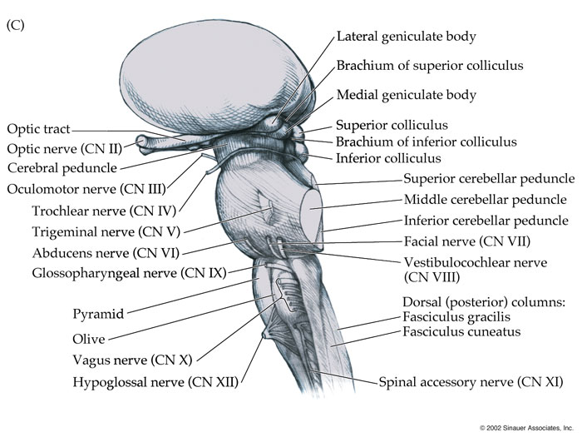

Slide 18
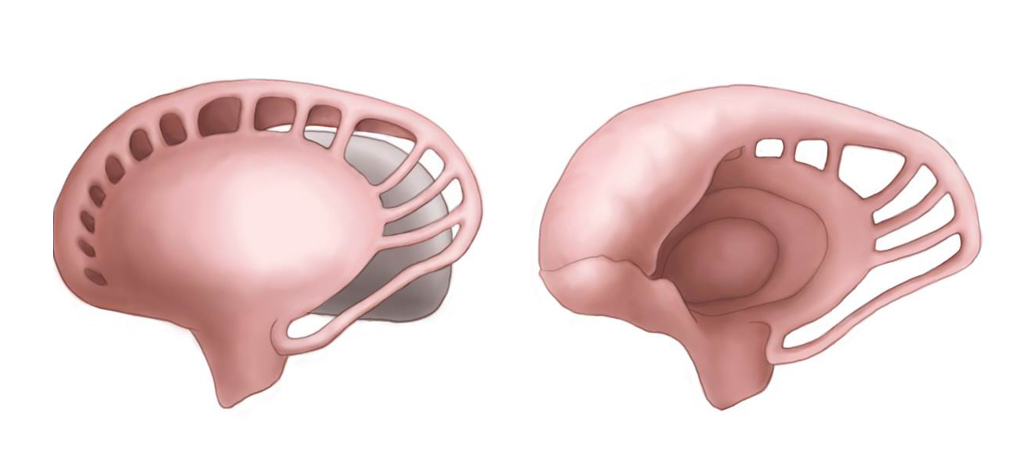
Basal Ganglia

Slide 19
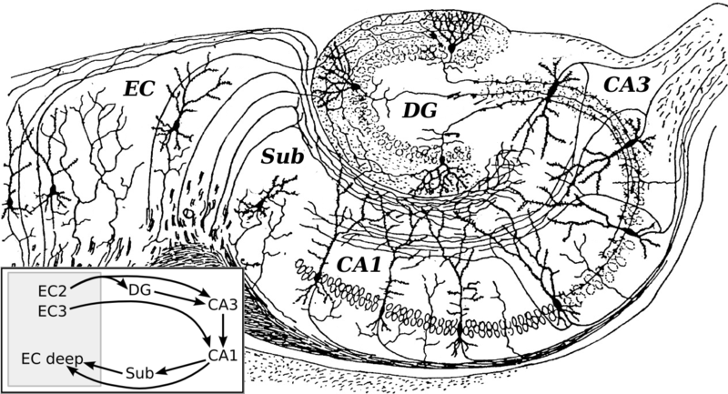
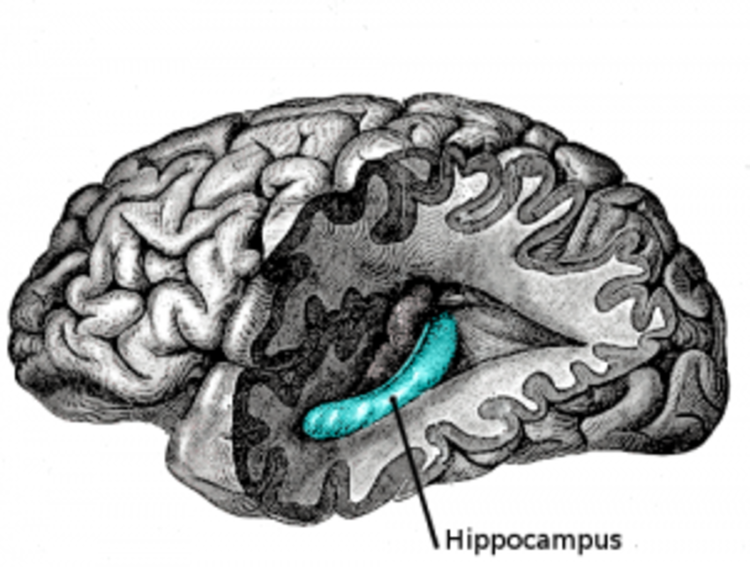
Hippocampus

Slide 20
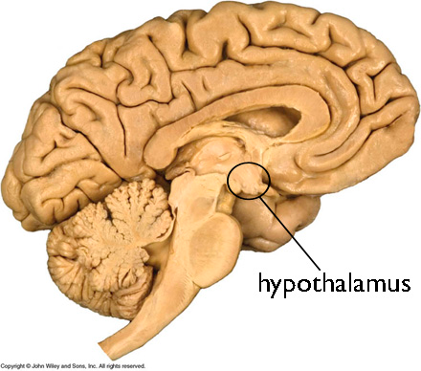
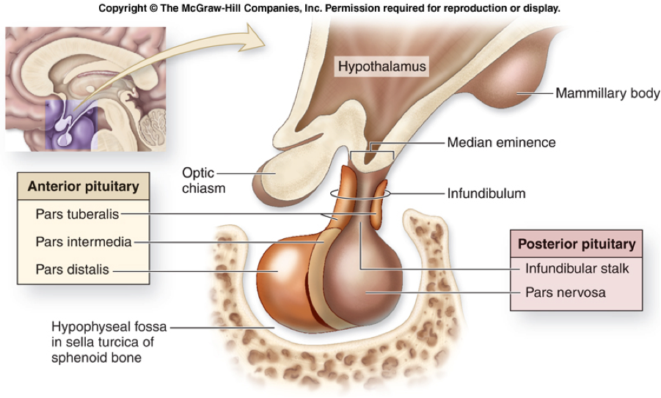
Hypothalamus

Slide 21
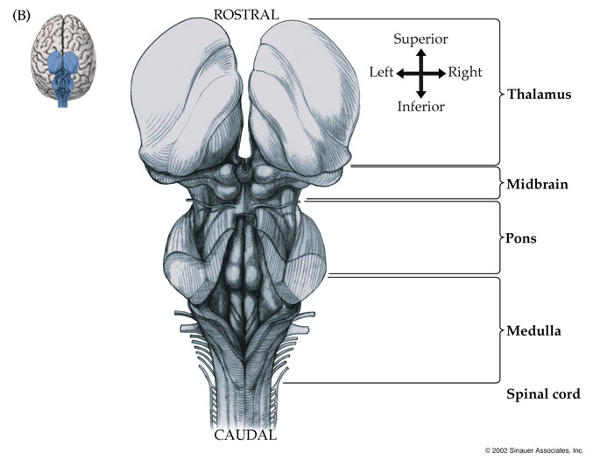

Slide 22
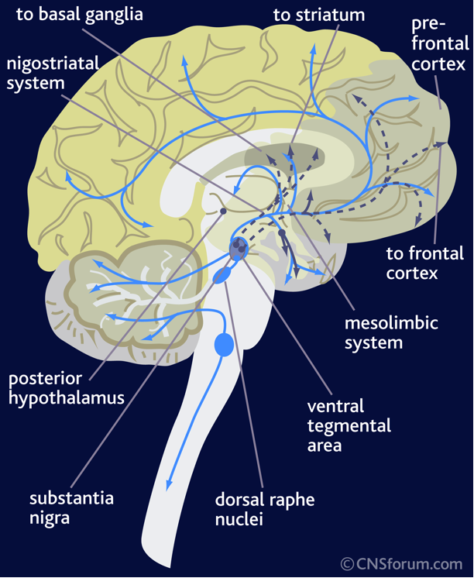
Brainstem Structures

Slide 23
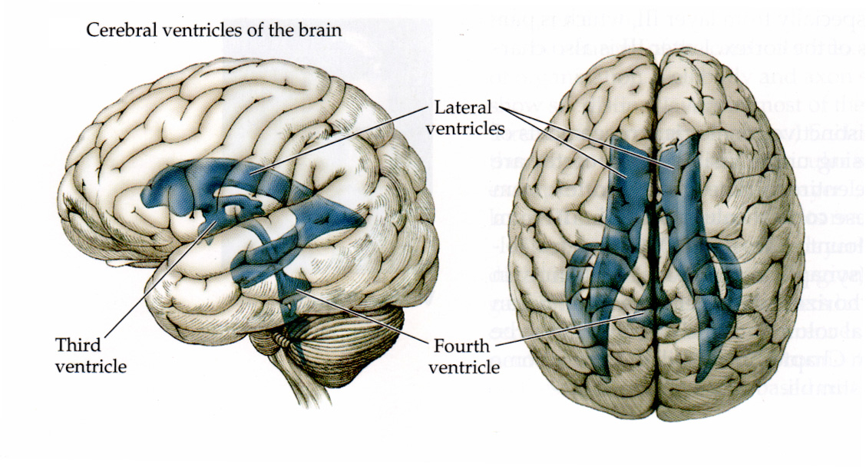
Ventricles and CSF

Slide 24
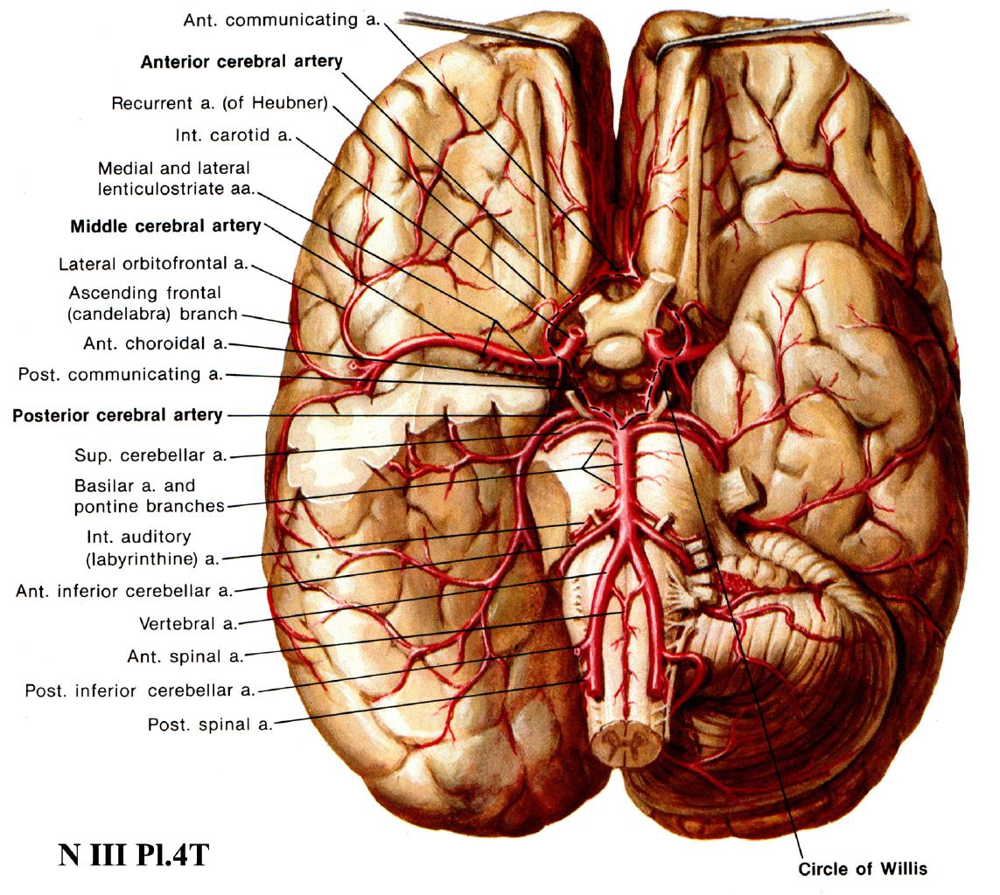

Slide 25
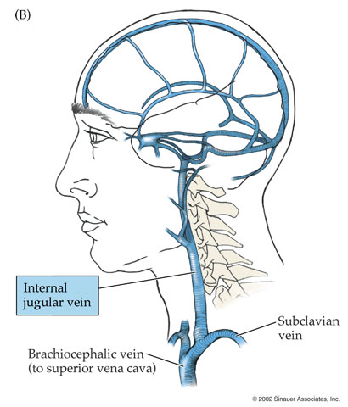

Slide 26
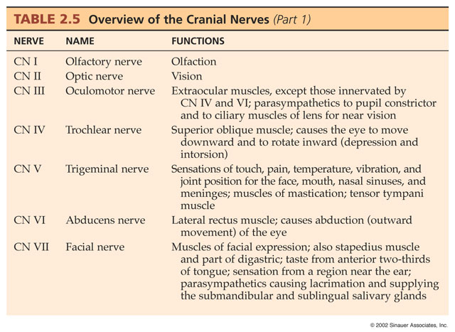

Slide 27
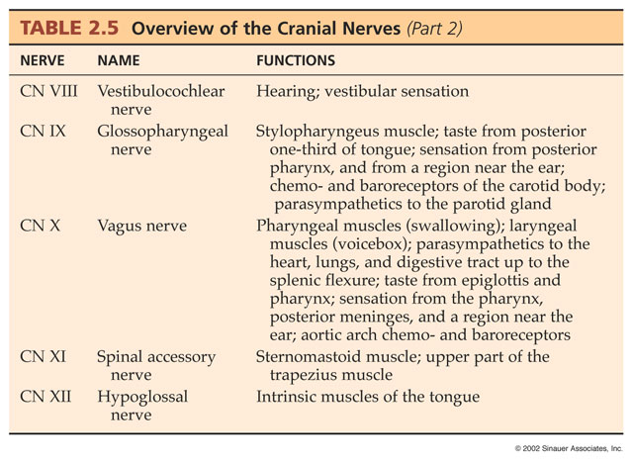

Slide 28
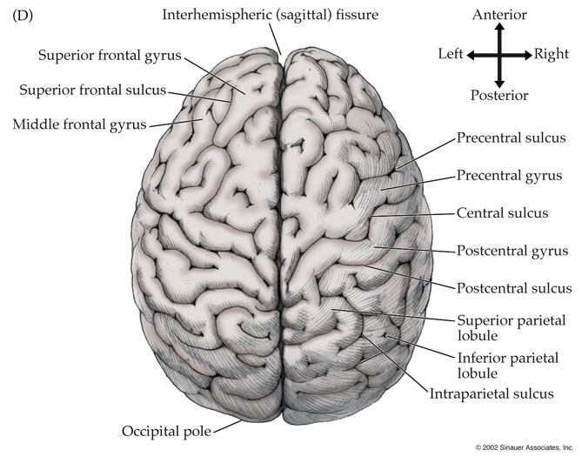

Slide 29
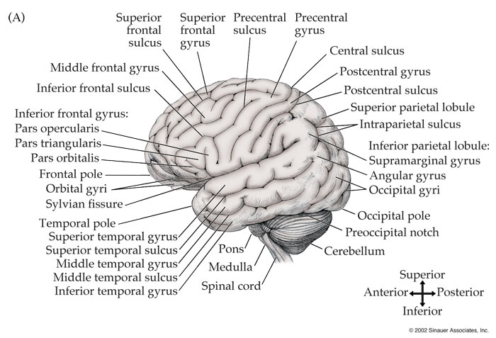

Slide 30
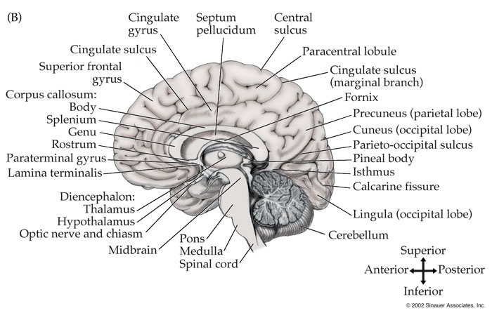

Slide 31
