Slide 2

Trial | #Errors
1
2
3
4
5
6
# Errors
1
2
3
4
5
6
Trial #

Slide 3
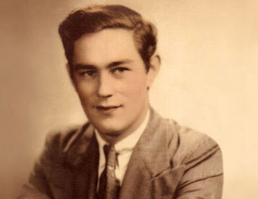
Curious case of H.M.
Have you ever heard of the movie 50 first dates?
Patient H.M had his temporal lobe removed due to severe epilepsy in 1953
Doctors found that he could no longer form new memories
The temporal lobe contains the hippocampus. Together this region of the brain is involved in forming new memories and moving memories from short term to long term memory
http://thebrainobservatory.ucsd.edu/hm
http://www.guardian.co.uk/science/blog/2010/oct/18/brain-memory-neuroscience
Notes:
Due to a severe case of epilepsy, patient HM had part of his temporal lobe removed. 27 years old, 1953
The temporal lobe contains the hippocampus
He was no longer able to form new memories, but was able remember his life before the surgery and procedural memories.
----- Meeting Notes (4/2/12 13:18) -----
TODO: Animate temporal lobe question
Ask if anyone has heard of the movie 50 First Dates
----- Meeting Notes (1/28/13 19:22) -----
Put a picture of the brain before, and say "We study the brain. The basic parts of the brain are..."

Slide 4
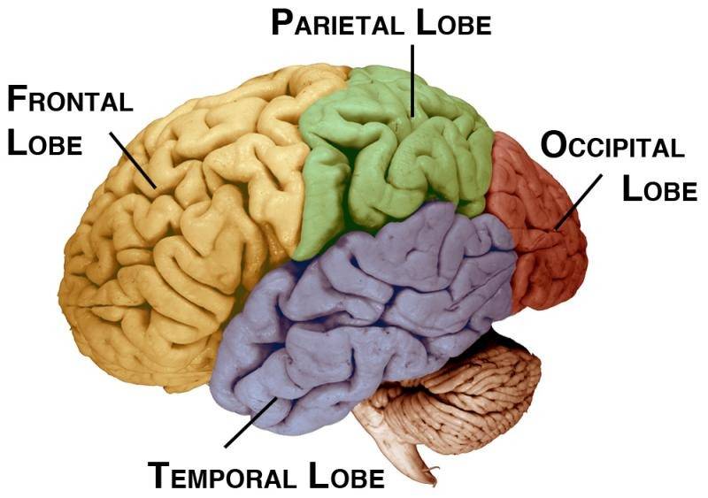
H.M. case told scientists that the temporal lobe has a specialized function
Notes:
----- Meeting Notes (1/28/13 19:38) -----
During hobby activity, could have kids color in areas. Then ask them if HM could do their activity or not.

Slide 5
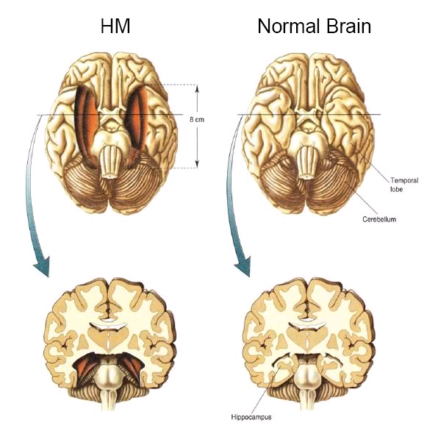
The temporal lobes are involved in learning and memory
http://www.nytimes.com/2008/12/05/us/05hm.html
http://thebrainobservatory.ucsd.edu/hm
Notes:
Due to a severe case of epilepsy, patient HM had part of his temporal lobe removed.
The temporal lobe contains the hippocampus
He was no longer able to form new memories, but was able remember his life before the surgery and procedural memories.
USE PLASTINATED BRAIN AND POINT OUT THE TEMPORAL LOBES

Slide 6
Different parts of the brain have different jobs.
Parietal Lobe
touch
language
reading
intelligence
Frontal Lobe
intelligence
judgment
behavior
self-control
planning
Occipital Lobe
vision
Temporal Lobe hearing
memory
speech
Cerebellum
coordination
balance
Brain Stem
blood pressure
breathing
heartbeat
swallowing
Notes:
ask the students to share ideas for common or complex tasks, and see if we can name all the regions that might be involved in the task – let them try first, and then the class and then we can help
(choose 2)
ACTIVITY – hand out this diagram and have them, in small groups, pick a task and try and list all of the brain regions that would be used to do the task
Ask them to keep their task in mind, and raise their hand if their task would be impaired (you wouldn’t be able to do it at all or as well) if a certain part of the brain was damaged
-pick 3-5 brain regions, and ask the hands up to share their task and explain why it would be impaired
----- Meeting Notes (4/2/12 13:18) -----
We'll see if there is time, and try to have our own examples available
----- Meeting Notes (1/28/13 19:27) -----
Have the four lobes, brain stem, and cerebellum. use the picture from the beginning of Anita's handout.

Slide 7
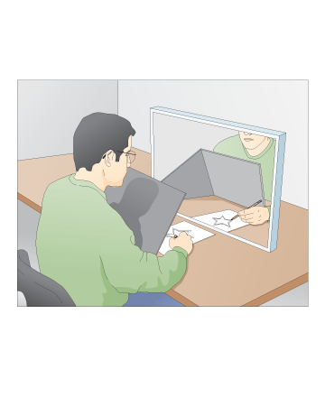
But HM was able to learn some things…
What skill does this require?
What other things do you think HM was able to learn or remember?
Notes:
Llists of things that HM could and could not do, ask them to figure out the difference.
ex: Tower of Hanoi (Procedural memory)
Skill=learning=memory
Put pictures of stuff HM could do
----- Meeting Notes (1/28/13 19:38) -----
Put the activity in different colored letters at the bottom of the slide
Ask them verbally to think about how skills require a learned memory. Have a note in the presenter notes. take Skill = learning = memory.
Put in a "different types of memory" slide.
“motor skill”-ride a bike
“muscle memory” activate prior knowledge—make distinction—its brain

Slide 8
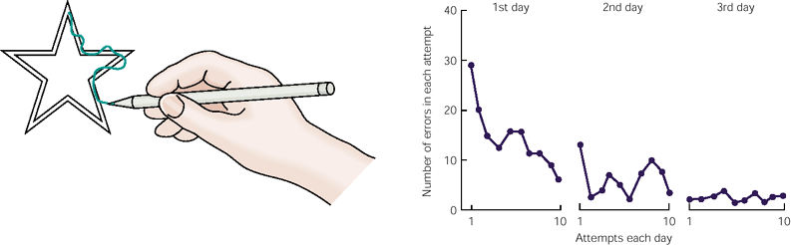
HM got better at tracing every day…
# of ERRORS
Day 1
Day 2
Day 3
Even though he couldn’t remember practicing!

Slide 9
Types of Memory
Declarative Memory
Procedural Memory
Facts
Events
- Usually Aware of It
Actions
Coordination
- Not Always Aware of It
Notes:
----- Meeting Notes (1/28/13 19:39) -----
Skip short term.
For long term,
----- Meeting Notes (1/28/13 19:55) -----
Finish!
Call on them to get examples. Which is “muscle memory?” tie back in. riding a bike

Slide 10
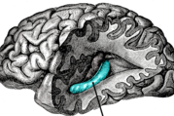
Hippocampus
Temporal Lobe
Make new memories short term memory→long term memory

