Slide 1
Memory and the brain
Columbia Grammar School
With Ms. Katie, Ms. Naomi, and Ms. Jocelyn
Notes:
Things you need for this visit:
Brain bank
Potentially, tracing papers, if there is enough time
TO CATCH ATTENTION
Have you ever met a scientist?
Write down a word that you think of when you hear the word scientist
Do you think you need to be able to make memories/remember in order to learn? (e.g. bike riding, tying a shoe)
(Could hint at or briefly mention different types of memories)

Slide 2
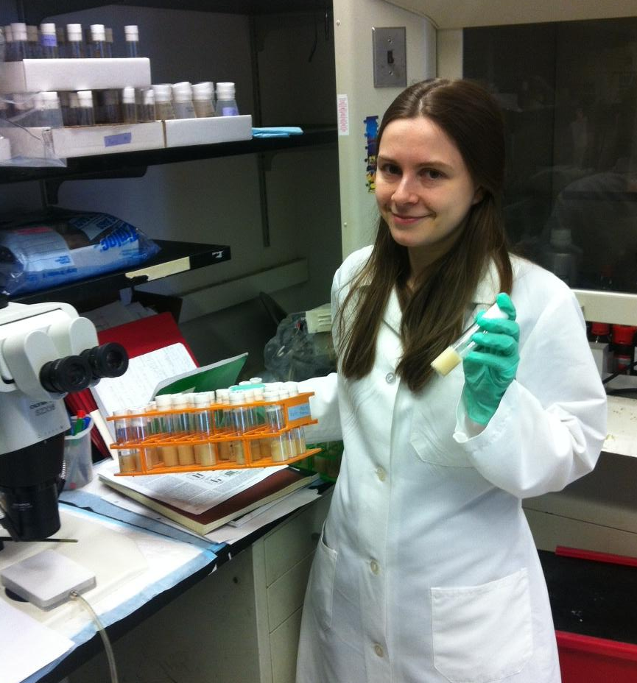

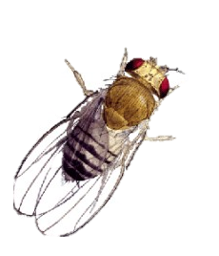
Who are we?
Graduate students who do research in labs
  Scientists!
Katie Shakman
Memory & Behavior in Fruit Flies
Notes:
NANCY WILL PRESENT THIS SLIDE ☺
----- Meeting Notes (4/2/12 13:18) -----
Purpose is for volunteers to introduce ourselves
(Put up a picture of one/both of us in lab)
----- Meeting Notes (1/28/13 19:22) -----
fix animations!

Slide 3
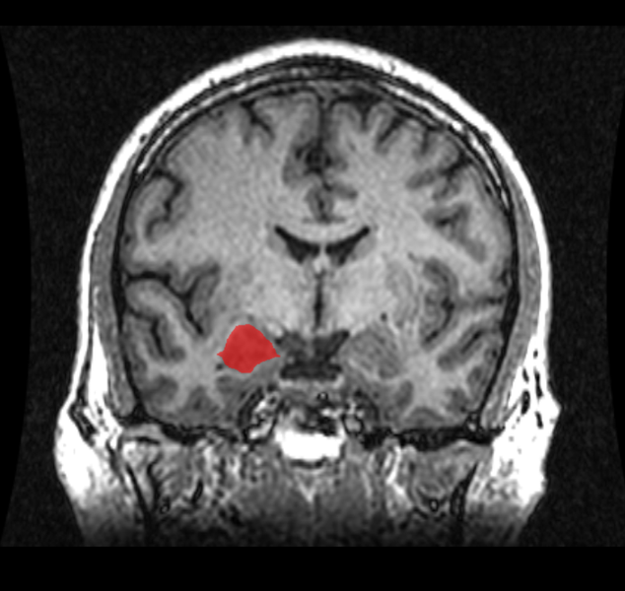
Jocelyn Shu
Fear, Anxiety, and Biosocial Behavioral Lab
What makes us afraid?
Are there different types of fear?
What are the brain areas involved?

Slide 4
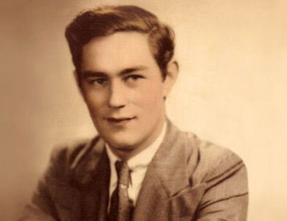
Curious case of H.M.
Severe epilepsy → doctors removed temporal lobe
Couldn’t make new memories (remembered only what happened before the surgery)
What does this mean about the temporal lobe?
http://thebrainobservatory.ucsd.edu/hm
http://www.guardian.co.uk/science/blog/2010/oct/18/brain-memory-neuroscience
Notes:
Due to a severe case of epilepsy, patient HM had part of his temporal lobe removed. 27 years old, 1953
The temporal lobe contains the hippocampus
He was no longer able to form new memories, but was able remember his life before the surgery and procedural memories.
----- Meeting Notes (4/2/12 13:18) -----
TODO: Animate temporal lobe question
Ask if anyone has heard of the movie 50 First Dates
----- Meeting Notes (1/28/13 19:22) -----
Put a picture of the brain before, and say "We study the brain. The basic parts of the brain are..."

Slide 5
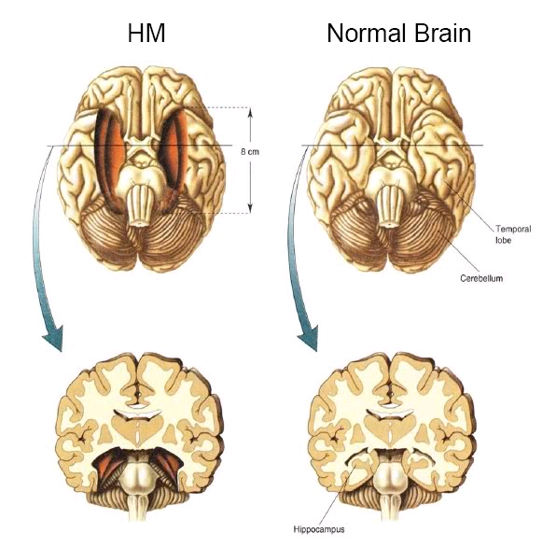
The temporal lobes are involved in learning and memory
http://www.nytimes.com/2008/12/05/us/05hm.html
http://thebrainobservatory.ucsd.edu/hm
Notes:
Due to a severe case of epilepsy, patient HM had part of his temporal lobe removed.
The temporal lobe contains the hippocampus
He was no longer able to form new memories, but was able remember his life before the surgery and procedural memories.
USE PLASTINATED BRAIN AND POINT OUT THE TEMPORAL LOBES

Slide 6
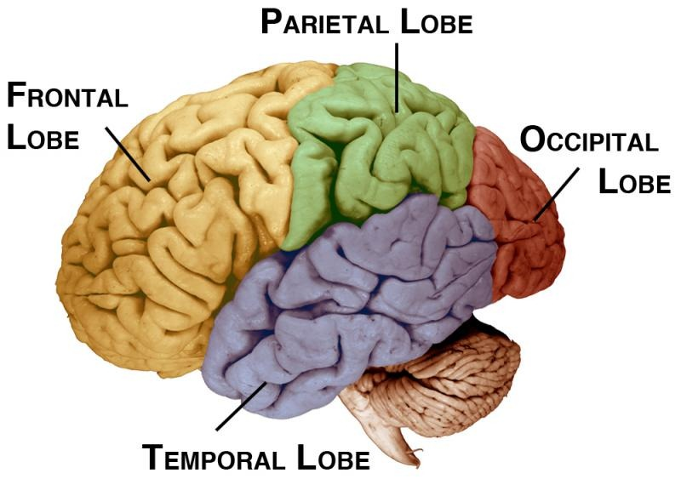
H.M. case told scientists that the temporal lobe has a specialized function
Notes:
----- Meeting Notes (1/28/13 19:38) -----
During hobby activity, could have kids color in areas. Then ask them if HM could do their activity or not.

Slide 7
Different parts of the brain have different jobs.
Parietal Lobe
touch
language
reading
intelligence
Frontal Lobe
intelligence
judgment
behavior
self-control
planning
Occipital Lobe
vision
Temporal Lobe hearing
memory
speech
Cerebellum
coordination
balance
Brain Stem
blood pressure
breathing
heartbeat
swallowing
Notes:
ask the students to share ideas for common or complex tasks, and see if we can name all the regions that might be involved in the task – let them try first, and then the class and then we can help
(choose 2)
ACTIVITY – hand out this diagram and have them, in small groups, pick a task and try and list all of the brain regions that would be used to do the task
Ask them to keep their task in mind, and raise their hand if their task would be impaired (you wouldn’t be able to do it at all or as well) if a certain part of the brain was damaged
-pick 3-5 brain regions, and ask the hands up to share their task and explain why it would be impaired
----- Meeting Notes (4/2/12 13:18) -----
We'll see if there is time, and try to have our own examples available
----- Meeting Notes (1/28/13 19:27) -----
Have the four lobes, brain stem, and cerebellum. use the picture from the beginning of Anita's handout.

Slide 8
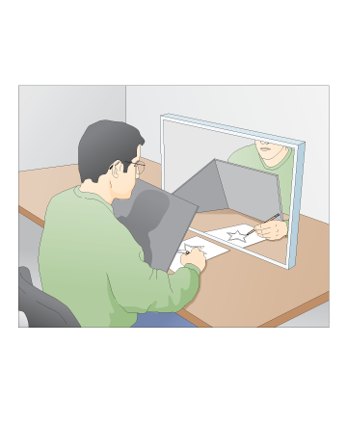
But HM was able to learn some things…
What skill does this require?
What other things do you think HM was able to learn or remember?
Try writing your name with your non-dominant hand – do you get better?
Notes:
Llists of things that HM could and could not do, ask them to figure out the difference.
ex: Tower of Hanoi (Procedural memory)
Skill=learning=memory
Put pictures of stuff HM could do
----- Meeting Notes (1/28/13 19:38) -----
Put the activity in different colored letters at the bottom of the slide
Ask them verbally to think about how skills require a learned memory. Have a note in the presenter notes. take Skill = learning = memory.
Put in a "different types of memory" slide.
“motor skill”-ride a bike
“muscle memory” activate prior knowledge—make distinction—its brain

Slide 9
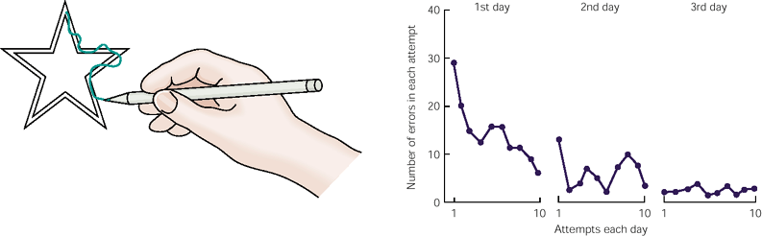
HM got better at tracing every day…
# of ERRORS
Day 1
Day 2
Day 3
Even though he couldn’t remember practicing!

Slide 10
You can try the mirror box at home!
Instructions and star pattern at:
http://www.hhmi.org/biointeractive
/activities/mirror
/mirror-tracing-activity-generic.pdf

Slide 11
Types of Memory
Declarative Memory
Procedural Memory
Facts
Events
- Usually Aware of It
Actions
Coordination
- Not Always Aware of It
Notes:
----- Meeting Notes (1/28/13 19:39) -----
Skip short term.
For long term,
----- Meeting Notes (1/28/13 19:55) -----
Finish!
Call on them to get examples. Which is “muscle memory?” tie back in. riding a bike

Slide 12
Could H.M. do your hobby?
Parietal Lobe
touch
language
reading
intelligence
Frontal Lobe
intelligence
judgment
behavior
self-control
planning
Occipital Lobe
vision
Temporal Lobe hearing
memory
speech
Cerebellum
coordination
balance
Brain Stem
blood pressure
breathing
heartbeat
swallowing
Notes:
ask the students to share ideas for common or complex tasks, and see if we can name all the regions that might be involved in the task – let them try first, and then the class and then we can help
(choose 2)
ACTIVITY – hand out this diagram and have them, in small groups, pick a task and try and list all of the brain regions that would be used to do the task
You can give your own examples if they are having trouble coming up
Ex. Soccer
Ex. Playing piano
ex. Being in a play
Ask them to keep their task in mind, and raise their hand if their task would be impaired (you wouldn’t be able to do it at all or as well) if a certain part of the brain was damaged
-pick 3-5 brain regions, and ask the hands up to share their task and explain why it would be impaired

Slide 13

Clive Wearing
http://www.youtube.com/watch?v=Vwigmktix2Y

Slide 14

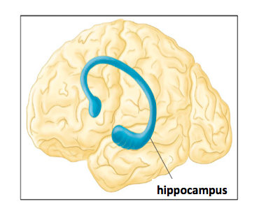
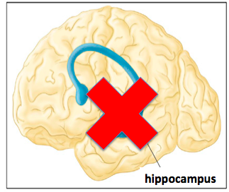
Clive Wearing
1) Amnesia: lost old memories
2) No new memories: damage to hippocampus
Hippocampus
short term memory→long term memory
His memory only lasts between 7s and 30s

Slide 15
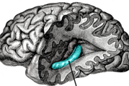
Recall: What does the temporal lobe do?
Hippocampus
Temporal Lobe

Slide 16
Recall: What does the temporal lobe do?
Hippocampus
Temporal Lobe
Make new memories

Slide 17
Recall: What does the temporal lobe do?
Hippocampus
Temporal Lobe
Make new memories short term memory→long term memory

Slide 18
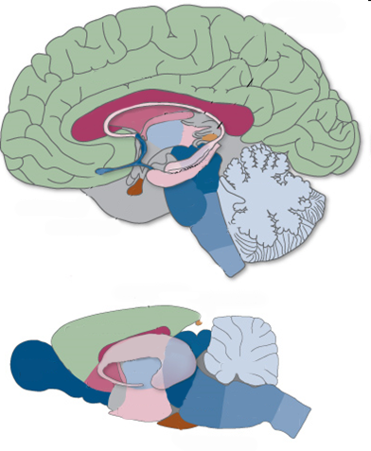

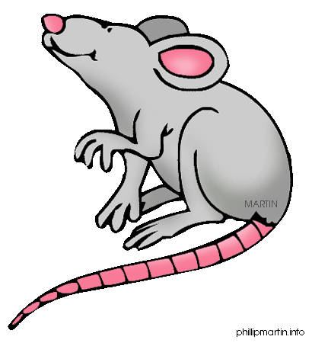

Humans and animals have the same brain parts
Notes:
“All animals need a brain to survive.”
“Are all animal brains the same?”
Talk about how different animals use their brains for different thinks.
Ask students how the human and rat brains are the same and different.
Ex. Olfactory bulb—rats are better at smelling

Slide 19
Now let’s see real brains!
Notes:
Can point out temporal lobe (containing hippocampus), and cerebellum
London Cab drivers – enlarged hippocampus
Two stations: One to look at brains, one to trace out star in mirror box
***Human and mouse brains only?

