Slide 1
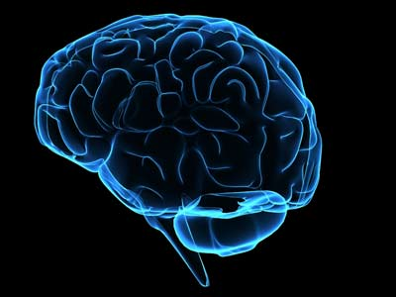
Brain Awareness Week
With
Ms. Cate & Ms. Tessa
Notes:
Things needed for this presentation:
Lab coats
Disposable gown, gloves, mask, hair net,
LOTS of pipe cleaners
‹#›

Slide 2
What is a scientist?
What do they look like?

Slide 3
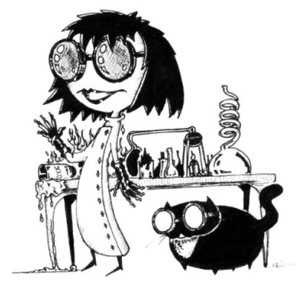
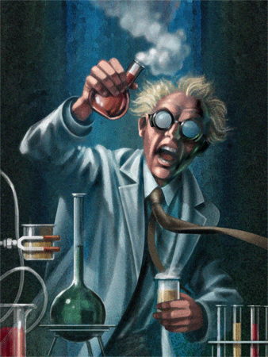

Slide 4
Who wants to dress up like a neuroscientist?

Slide 5
What is a Neuroscientist?
Notes:
BRAIN GUESSING GAME!
‹#›

Slide 6
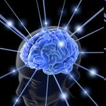
Neuroscientists
study the brain!
Notes:
‹#›
I use this slide to show them how nerves travel throughout our whole body. Here I ask them how does information get from our finger tips to our brain, especially if we can’t use our eyes.

Slide 7
Different parts of the brain have different jobs.

Slide 8
Our brain controls every part of our body—from the head to the toes.
Every part of the body sends information to the brain.
The fibers shown here are just some of the connections of the brain.

Slide 9
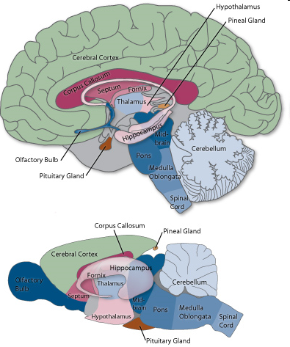
H
U
M
A
N
vs
R
A
T
Notes:
‹#›
Different parts of the brain control different things

Slide 10
1
2
3
4
5
6
7
8
Scientists have studied the brains of many species. Studying the brains of other animals helps us understand our own brains.

Slide 11
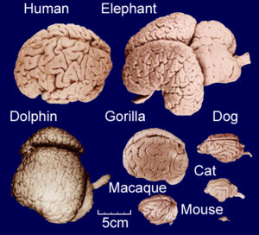
2
3
4
5
6
7
8
Notes:
‹#›

Slide 12
3
4
5
6
7
8

Slide 13
4
5
6
7
8
Notes:
‹#›

Slide 14
5
6
7
8
Notes:
‹#›

Slide 15
6
7
8
Notes:
‹#›

Slide 16
7
8
Notes:
‹#›

Slide 17
8
Notes:
‹#›

Slide 18
Notes:
‹#›

Slide 19
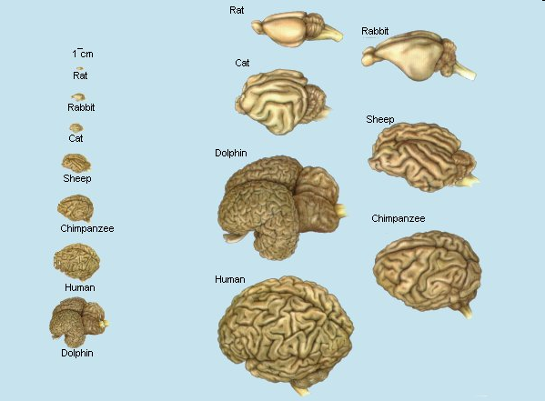
Notes:
‹#›

Slide 20
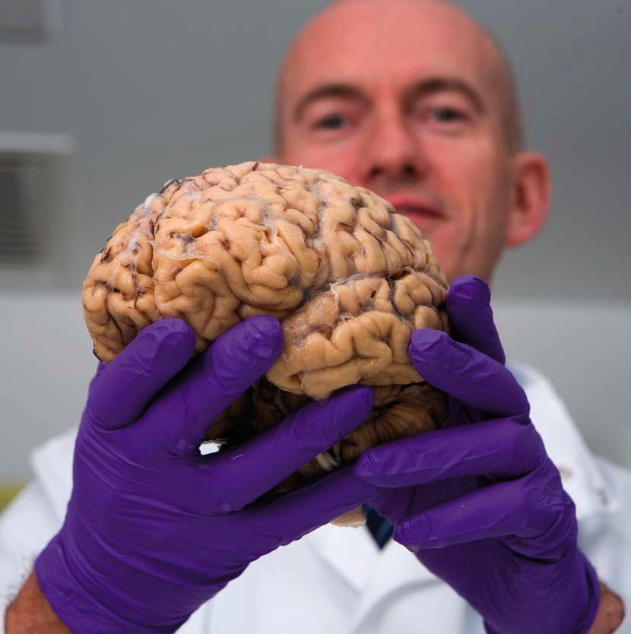
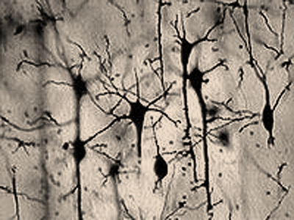
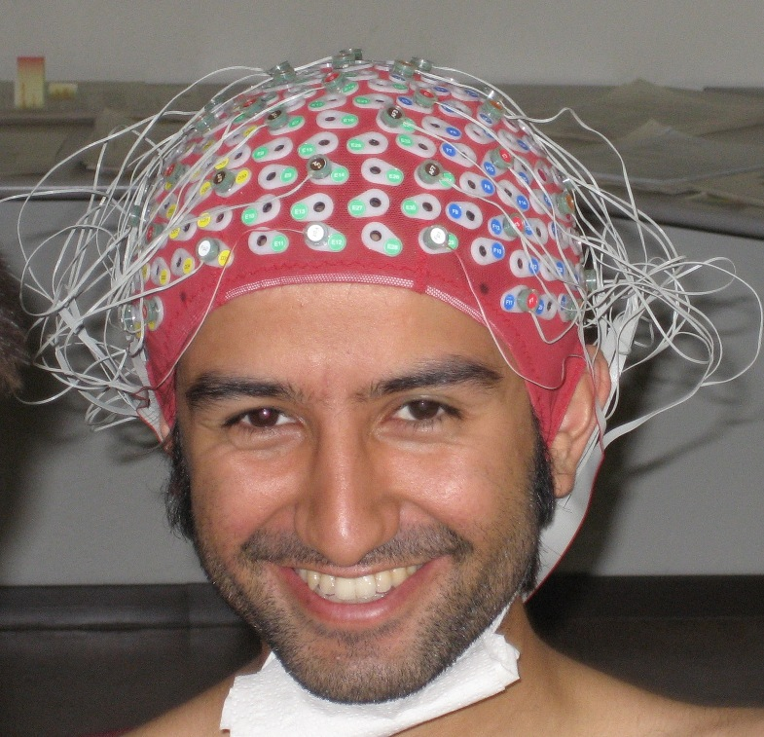
How can we learn about brains?
Looking at them
-outside
-inside
Learning about brain activity
Notes:
‹#›
More examples and nice to show size comparison
What do you notice that’s different about these brains? Texture? Size? Back of the brain/location of cerebellum?
What would a Tiger brain look like? Why?
How about a goldfish? Whale? Bird? Kangaroo? Giraffe? Bear? Turtle?

Slide 21
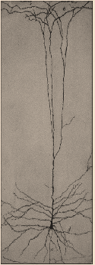
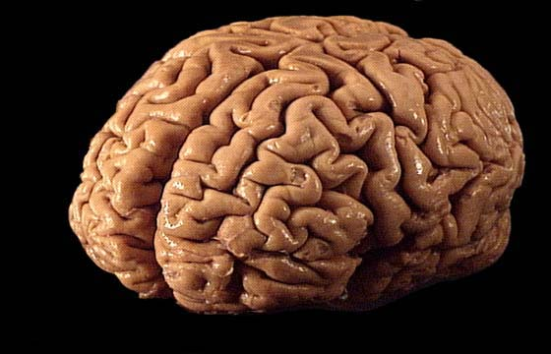
Inside the brain are tiny building blocks called NEURONS!

Slide 22
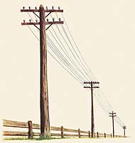
The brain’s building blocks (neurons) connect
and send messages to each other.
These neurons act like telephone lines passing messages from one area of the brain to another.
Notes:
‹#›
Encourage class discussion here. I also remind them that they are all scientists themselves. Explain to them that if they ever figured out (studied) how to fix one of their toys for example they were a scientist and go into detail.

Slide 23
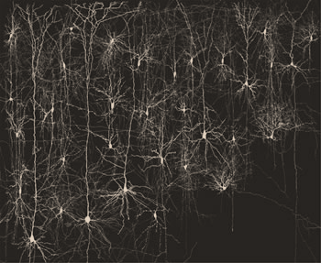
Our brains send a lot of messages!

Slide 24
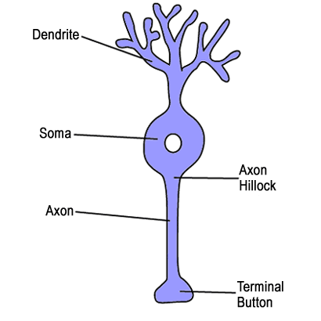
enter
Messages from other neurons are collected here
NEURONS
Messages are
read here
Nucleus
Messages are sent to other neurons through here
exit

Slide 25
IN
Collects messages
Let’s make our own NEURONS!
Reads messages
Nucleus
Sends Messages
OUT

Slide 26
Thank you!

