Slide 1
Drugs in the brain
27 April 2013
Rebecca Martin
Becca Lewis

Slide 2
Why do we drug our brains?
What are some drugs that target the brain?
Why do we use these drugs?
How do they change the brain?
Notes:
mood
consciousness
cognition
perception
behaviour

Slide 3
Different drugs have very different effects
Stimulants
Depressants
Hallucinogens
Some drugs fall into multiple categories – eg marijuana

Slide 4
Message transmission in the nervous system
Two main modes of communication
  electrical (e.g. action potentials)
  chemical (at synapses)
Synapses can be either excitatory or inhibitory
Notes:
Can talk about drugs that act on action potentials…

Slide 5
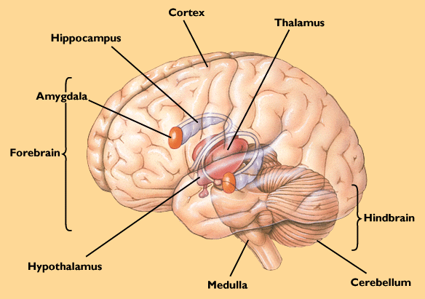
How do drugs cause such varied and specific effects?
Notes:
Do we need this slide?

Slide 6
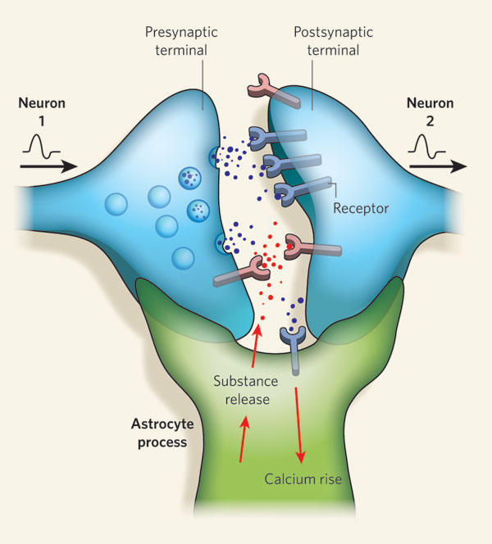
How do drugs cause such varied and specific effects?

Slide 7
How do drugs cause such varied and specific effects?
Different drugs target different:
  brain regions
  neural pathways
  neuron types
  neurotransmitter receptors
Several possible mechanisms of drug action (e.g. agonist versus antagonist)
Notes:
agonist enhances or mimics the effect of the normal NT
antagonist opposes the effect of the normal NT

Slide 8
Drugs of Interest
Caffeine
Alcohol
Marijuana
Changes in behavior
Changes at synapse
Pathways drugs act on
Effects on brain

Slide 9

Stimulants: Caffeine
What are the behavioral changes?
  enhanced
    alertness and wakefulness
    endurance
    productivity and motivation
    increased arousal and locomotion
  decreased
    perception of hunger and fatigue
Examples of other stimulants?

Slide 10



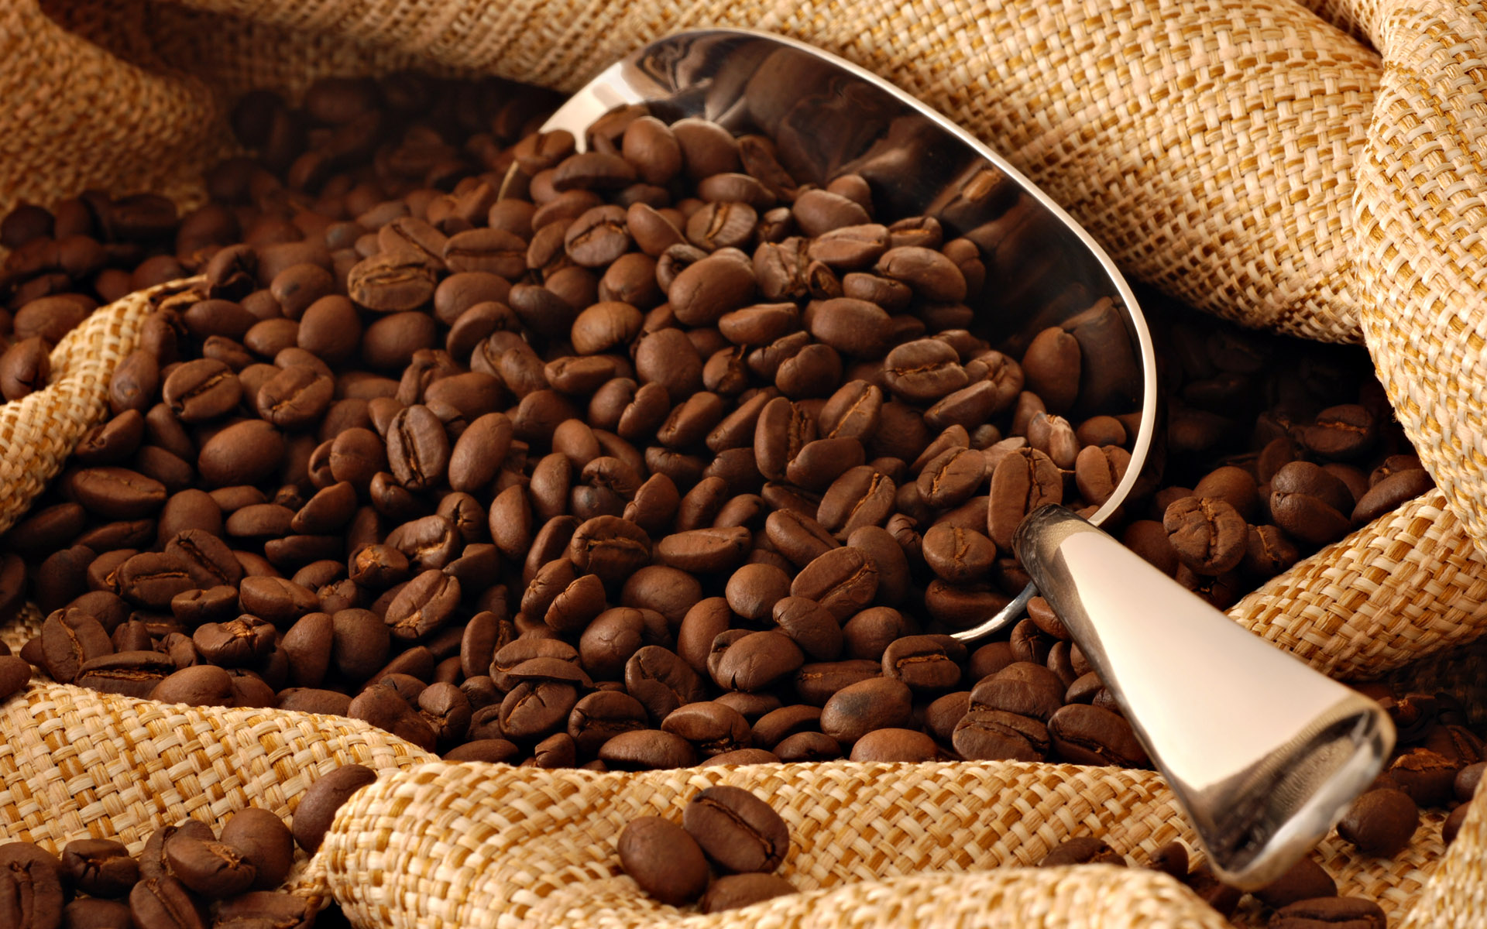
Caffeine

Slide 11
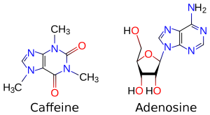
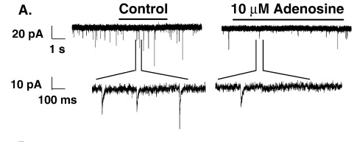
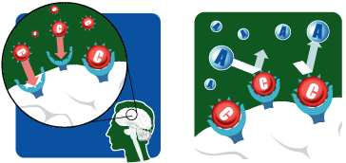
Caffeine increases brain activity
Increased brain activity is detected by the pituitary gland and triggers further effects
Notes:
adenosine levels increase in the brain with prolonged wakefulness - homeostatic mechanism for inducing sleep

Slide 12
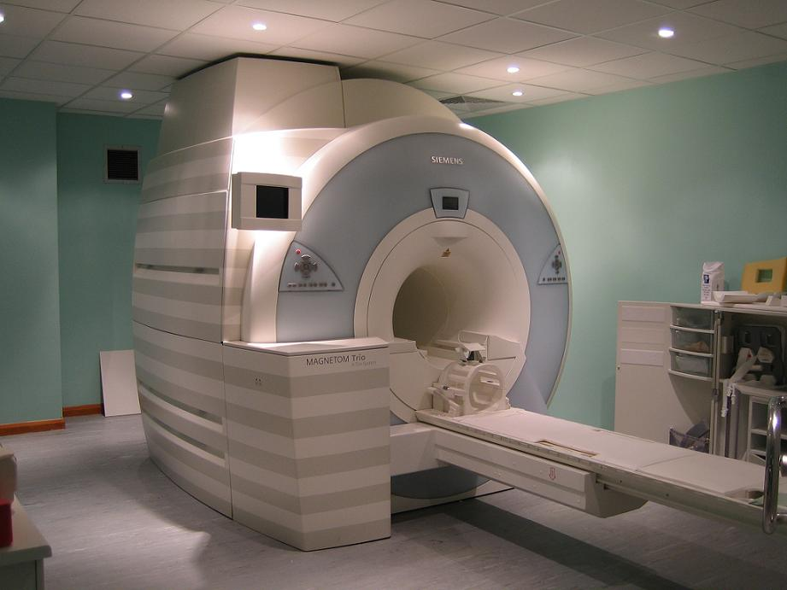
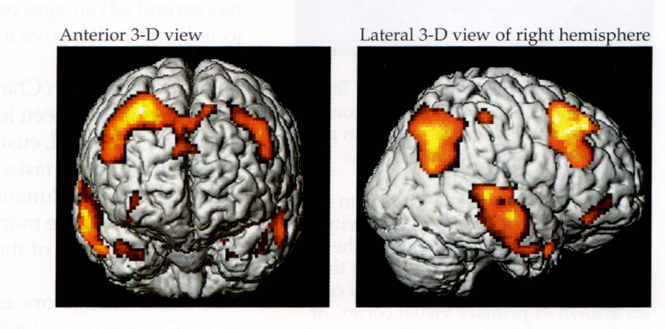
Measuring brain activity: fMRI
Functional magnetic resonance imaging (fMRI)
Notes:
MRI: Uses a magnet and radio frequency. Measures magnetic fields
fMRI: Measures changes in blood flow

Slide 13
Caffeine
Notes:
Fig. 4. Significant BOLD signal changes during the auditory oddball task (target stimulus vs non-target stimulus). a) shows the group mean motor task related activity (positive signal change) for the two baseline scans combined (BP and BC). b) shows the baseline-controlled group difference between caffeine and placebo administration ((DC–BC)–(DP–BP)) indicating an increase in BOLD signal with caffeine. Signal changes were deemed significant at Z > 2.3 with a whole brain cluster based correction at p < 0.05.
Fig. 6. Group mean evoked response waveforms for the auditory target stimulus, P300, recorded during baseline placebo (BP), baseline caffeine (BC), placebo (DP) and caffeine (DC) conditions (left). The dotted vertical line marks stimulus presentation time. The group mean scalp map is shown (right) for the baseline-controlled group difference between caffeine and placebo administration ((DC–BC)–(DP–BP)) at the peak latency of the response on caffeine (DC) (442 ms).
Auditory ‘oddball’ task
A three-stimulus continuous (20 min) auditory ‘oddball’ task was utilised to elicit a cognitive response. The frequent standard auditory stimuli (1 kHz, lasting 100 ms), the rare target auditory stimuli (1.5 kHz, lasting 100 ms) and the novel auditory stimuli consisting of noises (e.g. dog barks, whistle, etc.), were presented randomly via headphones (NordicNeuroLabs electrostatic headphones) with a mean interstimulus interval (ISI) of 2.05 s (randomized in the range 1.8 to 2.3 s). A total of 576 stimuli were delivered. The target and novel stimuli each occurred with a probability of 15% of trials, whilst the standard stimuli occurred with a probability of 70%. Participants were asked to respond quickly and accurately to the target stimuli only by pressing the right index finger button on the MR compatible response device and to ignore standard or novel stimuli. Behavioural measures were assessed during the performance of the auditory oddball task as the time taken to respond to target stimuli (reaction time for correct responses in ms), number of false alarms and missed responses (misses).

Slide 14
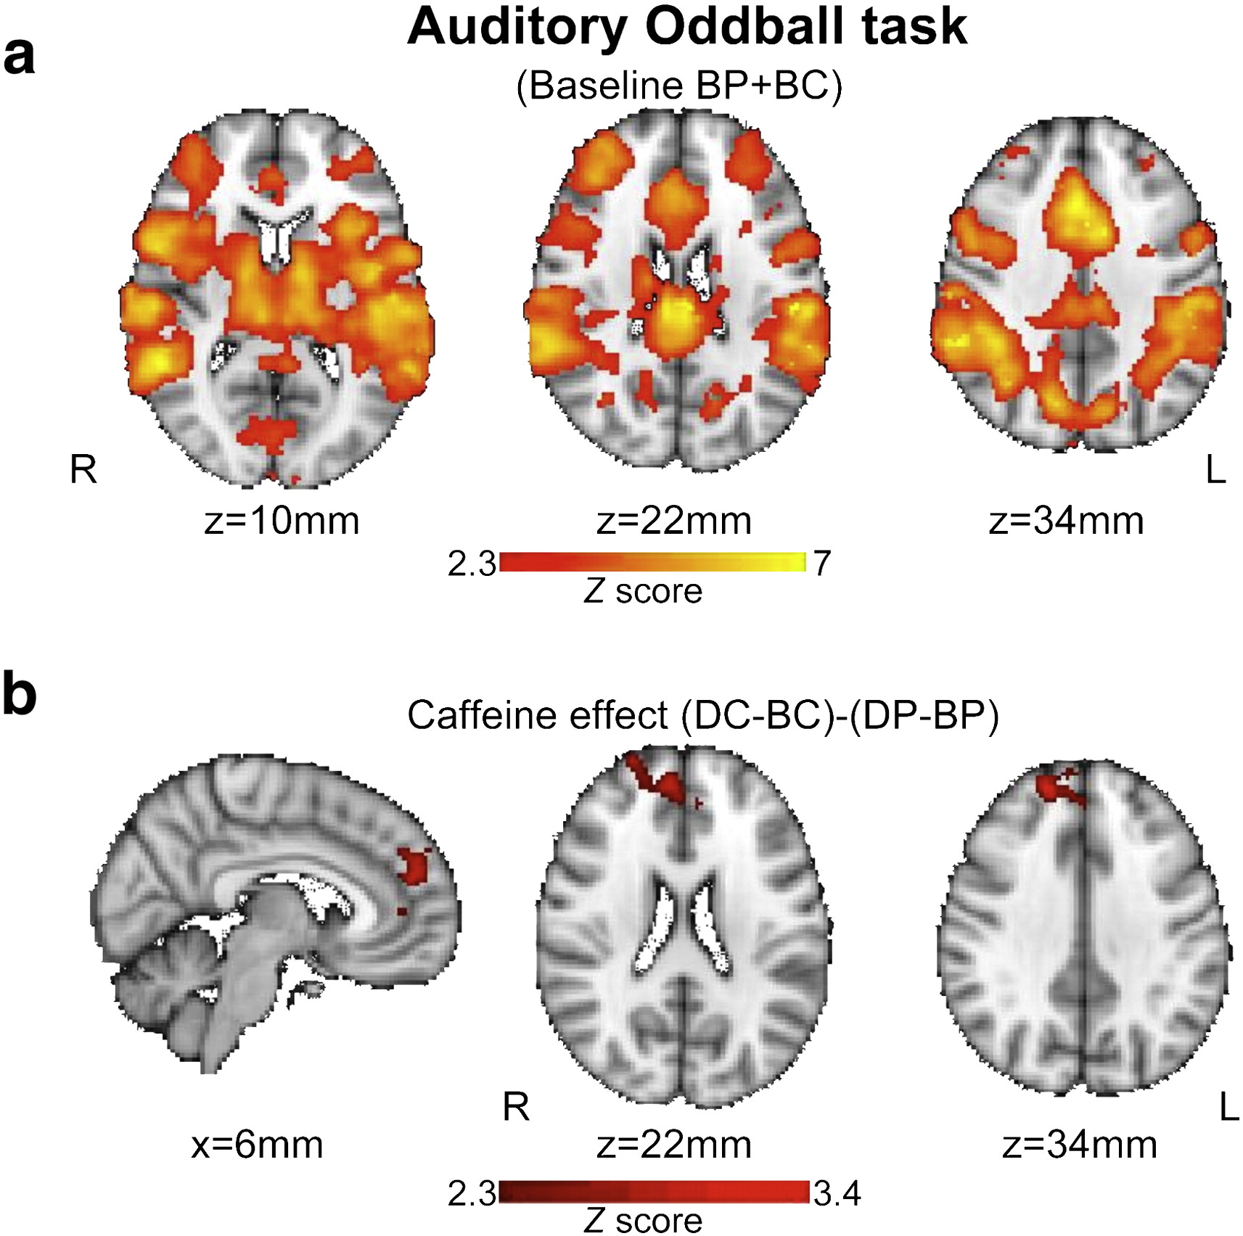
Caffeine
Notes:
Fig. 4. Significant BOLD signal changes during the auditory oddball task (target stimulus vs non-target stimulus). a) shows the group mean motor task related activity (positive signal change) for the two baseline scans combined (BP and BC). b) shows the baseline-controlled group difference between caffeine and placebo administration ((DC–BC)–(DP–BP)) indicating an increase in BOLD signal with caffeine. Signal changes were deemed significant at Z > 2.3 with a whole brain cluster based correction at p < 0.05.

Slide 15
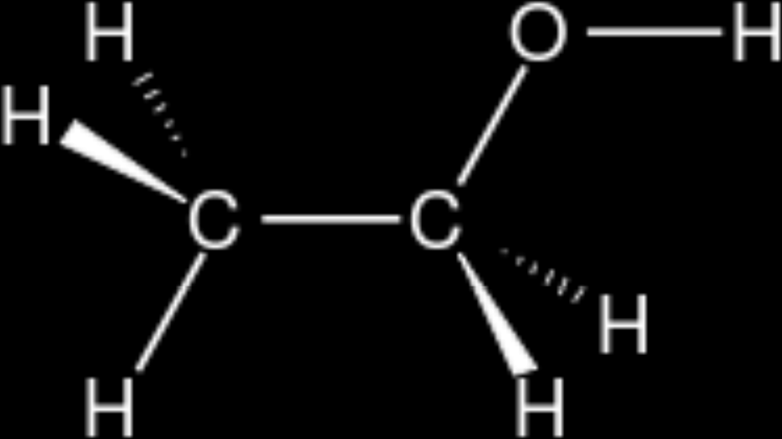

Depressants: alcohol
What are the behavioral changes?
  anxiety reduction
  pain relief
  sedation
  cognitive/memory impairment
  euphoria
  dissociation
  physiological changes
Examples of other depressants?

Slide 16
Depressants
Alcohol (ethanol)
Marijuana
Heroin

Slide 17
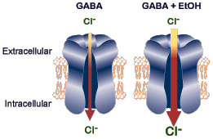
Alcohol - mechanisms of action
Agonist at inhibitory synapses

Slide 18
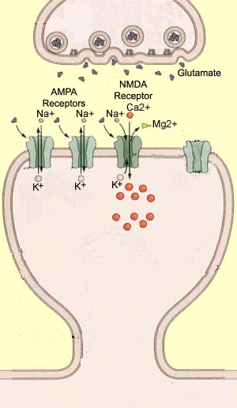
Alcohol - mechanisms of action
Antagonist at excitatory synapses

Slide 19
Alcohol
Notes:
Background: Children and adolescents, family history positive (FH+) for alcoholism, exhibit
differences in brain structure and functional activation when compared to family history negative
(FH)) counterparts. Given that frontal brain regions, and associated reciprocal connections with
limbic structures, undergo the most dramatic maturational changes during adolescence, the objective
of this study was to compare functional brain activation during a frontally mediated test of
response inhibition in 32 adolescents separated into low-risk (FH)) and high-risk (FH+) groups.
Methods: Functional magnetic resonance (fMRI) blood oxygen level–dependent data were
acquired at 1.5 Tesla during performance of Stroop Color Naming, Word Reading, and Interference.
Preprocessing and statistical analyses, covaried for age, were conducted in SPM99 using a
search territory that included superior, middle, and inferior frontal gyri (trigone region), anterior
cingulate gyrus (CG), and left and right amygdala.
Results: Significantly greater activation in the fronto-limbic search territory was observed in
FH+ relative to FH) subjects during Stroop Interference. In addition, a significant regression
between brain activation and family history density was observed, with a greater density being
associated with increased activation in regions including middle frontal gyrus (BA9) and CG
(BA24).
Conclusions: These data demonstrate a significant influence of FH status on brain activation
during the performance of a response inhibition task, perhaps reflecting a neurobiological vulnerability
associated with FH status that may include reduced neuronal efficiency and ⁄ or recruitment
of additional neuronal resources. These findings are important given that the adolescent developmental
period is already associated with reduced inhibitory capacity, even prior to the onset of
alcohol use.

Slide 20
Stroop Effect
RED BLUE YELLOW RED GREEN
PURPLE YELLOW BLUE GREEN ORANGE
GREEN BLUE ORANGE RED PURPLE
Notes:
NAME THE COLOR OF THE WORD

Slide 21
Stroop Effect
RED BLUE YELLOW RED GREEN
PURPLE YELLOW BLUE GREEN ORANGE
GREEN BLUE ORANGE RED PURPLE
Notes:
NAME THE COLOR OF THE WORD

Slide 22
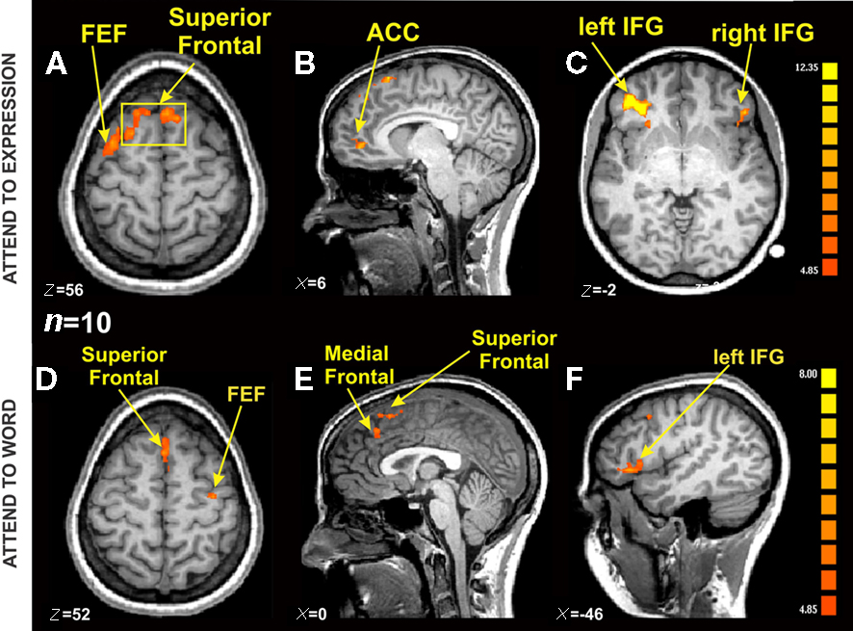
Brain Regions Active During Stroop

Slide 23
Alcohol
Notes:
Background: Children and adolescents, family history positive (FH+) for alcoholism, exhibit
differences in brain structure and functional activation when compared to family history negative
(FH)) counterparts. Given that frontal brain regions, and associated reciprocal connections with
limbic structures, undergo the most dramatic maturational changes during adolescence, the objective
of this study was to compare functional brain activation during a frontally mediated test of
response inhibition in 32 adolescents separated into low-risk (FH)) and high-risk (FH+) groups.
Methods: Functional magnetic resonance (fMRI) blood oxygen level–dependent data were
acquired at 1.5 Tesla during performance of Stroop Color Naming, Word Reading, and Interference.
Preprocessing and statistical analyses, covaried for age, were conducted in SPM99 using a
search territory that included superior, middle, and inferior frontal gyri (trigone region), anterior
cingulate gyrus (CG), and left and right amygdala.
Results: Significantly greater activation in the fronto-limbic search territory was observed in
FH+ relative to FH) subjects during Stroop Interference. In addition, a significant regression
between brain activation and family history density was observed, with a greater density being
associated with increased activation in regions including middle frontal gyrus (BA9) and CG
(BA24).
Conclusions: These data demonstrate a significant influence of FH status on brain activation
during the performance of a response inhibition task, perhaps reflecting a neurobiological vulnerability
associated with FH status that may include reduced neuronal efficiency and ⁄ or recruitment
of additional neuronal resources. These findings are important given that the adolescent developmental
period is already associated with reduced inhibitory capacity, even prior to the onset of
alcohol use.

Slide 24
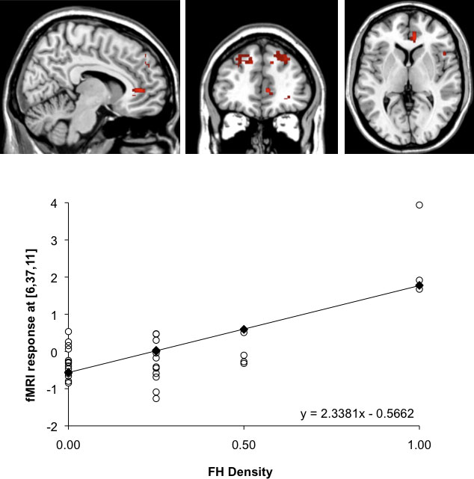
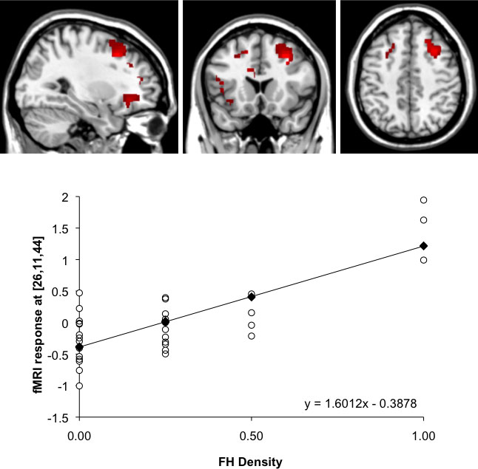
Family History of Alcohol Use and Performance on the Stroop
Notes:
Fig. 1. Illustration of SPM maps demonstrating the significant positive regression (p < 0.05) between greater family history density (FHD) and greater
activation during the Interference condition of the Stroop task [Interference–Word Reading].
Fig. 2. Illustration of SPM maps demonstrating the significant positive regression (p < 0.05) between greater family history density (FHD) and greater
activation during the Interference condition of the Stroop task [Interference–Color Naming].

Slide 25
Question
How might a stimulant affect one’s performance on the Stroop?
Notes:
Talk about brain regions active during stroop

Slide 26
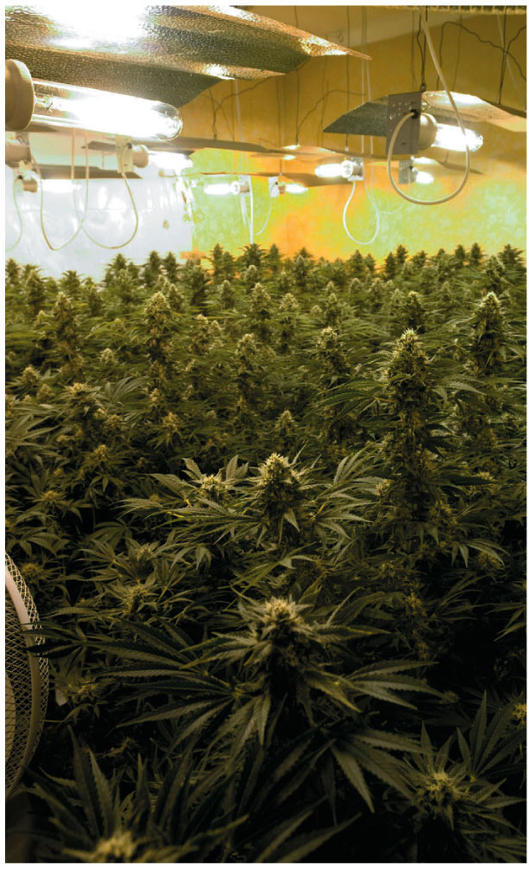
Cannabinoids: Marijuana
Behavioral effect varies
  Relaxation
  Stimulation/hallucination/paranoia
Cannabis
  Marijuana/hashish
  THC
Cannabinoid receptors

Slide 27
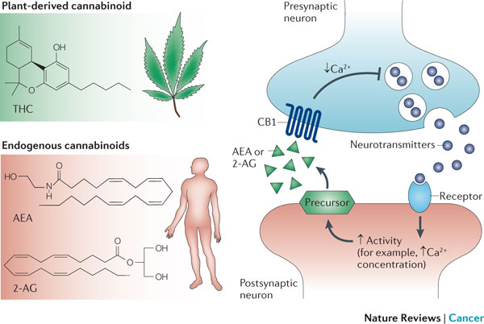
Marijuana activates cannabinoid receptors

Slide 28
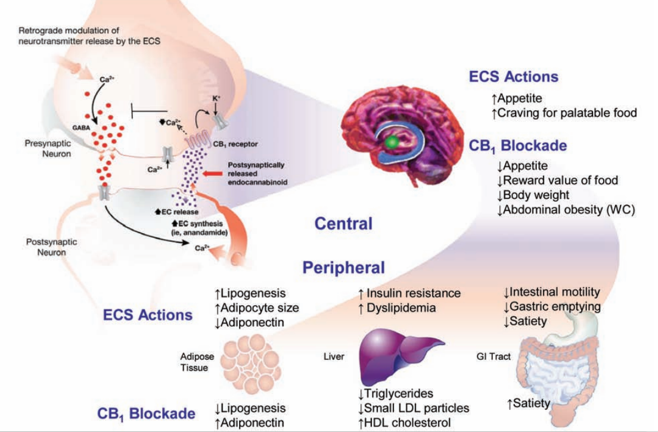
Some side effects of cannabinoids
Cannabinoid receptor activation
Cannabinoid receptor inhibition
Cannabinoid receptor activation
Fat tissue
Liver
GI tract
Cannabinoid receptor inhibition

Slide 29
Marijuana
Notes:
Marijuana smokers demonstrated significantly lower anterior cingulate activity in focal areas of the anterior cingulate
cortex and higher midcingulate activity relative to controls, although both groups were able to perform the task within normal limits.
Normal controls also demonstrated increased activity within the right dorsolateral prefrontal cortex (DLPFC) during the interference condition, while
marijuana smokers demonstrated a more diffuse, bilateral pattern of DLPFC activation.
Similarly, although both groups performed the task well, marijuana smokers made more errors of commission than controls during the interference condition, which were associated with different brain regions than control subjects.
These findings suggest that marijuana smokers exhibit different patterns of BOLD response and error response during the Stroop interference condition compared to normal controls despite similar task performance.
Furthermore, although chronic marijuana smokers were able to perform the task reasonably well, the functional activation findings suggest they utilize different cortical processes from the control subjects in order to do so. Findings from this study are consistent with the notion that substance abusers
demonstrate evidence of altered frontal neural function during the performance of tasks that involve inhibition and performance monitoring, which may affect the ability to make decisions.

Slide 30
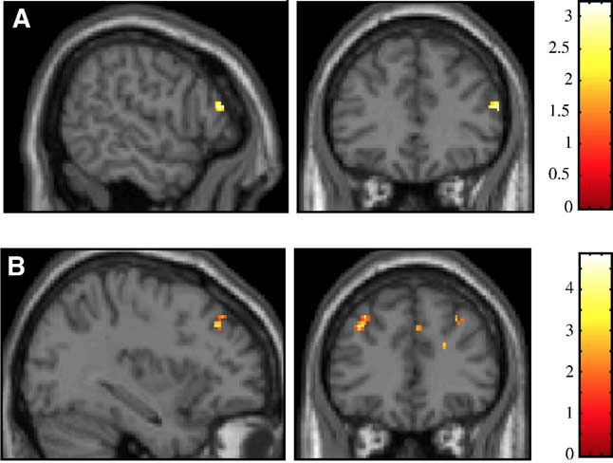
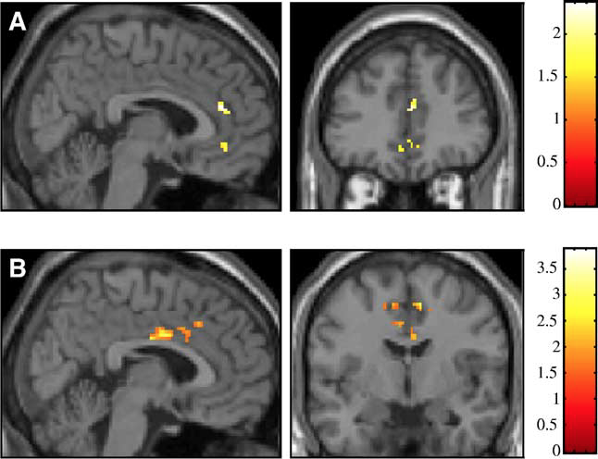
Stroop performance in marijuana smokers versus non-smokers
Notes:
Fig. 2. comparisons between control subjects and marijuana smokers within the DLPFC for (A) controls versus marijuana smokers and (B) marijuana smokers versus controls.
Control subjects demonstrate more focal right sided activity while
marijuana smokers display more diffuse, bilateral activity during the task.
Fig. 1. comparisons between
control subjects and marijuana smokers within the ACC for (A) controls
versus marijuana smokers and (B) marijuana smokers versus controls.
Control subjects demonstrate more anterior cingulate activity while
marijuana smokers display more midcingulate activation during the task.
Images are in neurological orientation, i.e., left = left and right = right; the
color bar at the right of each figure reflects the suprathreshold value of the
SPM{t} statistic for the analysis.

Slide 31
Take-home messages
Most drugs targeting the nervous system act by changing synaptic transmission
  can reduce or increase transmission
  can act at excitatory or inhibitory synapses
Drug use can alter how brain regions and networks operate

Slide 32
Questions?
Rebecca: rmartin@psych.columbia.edu
Becca: rel2139@columbia.edu

