Slide 1
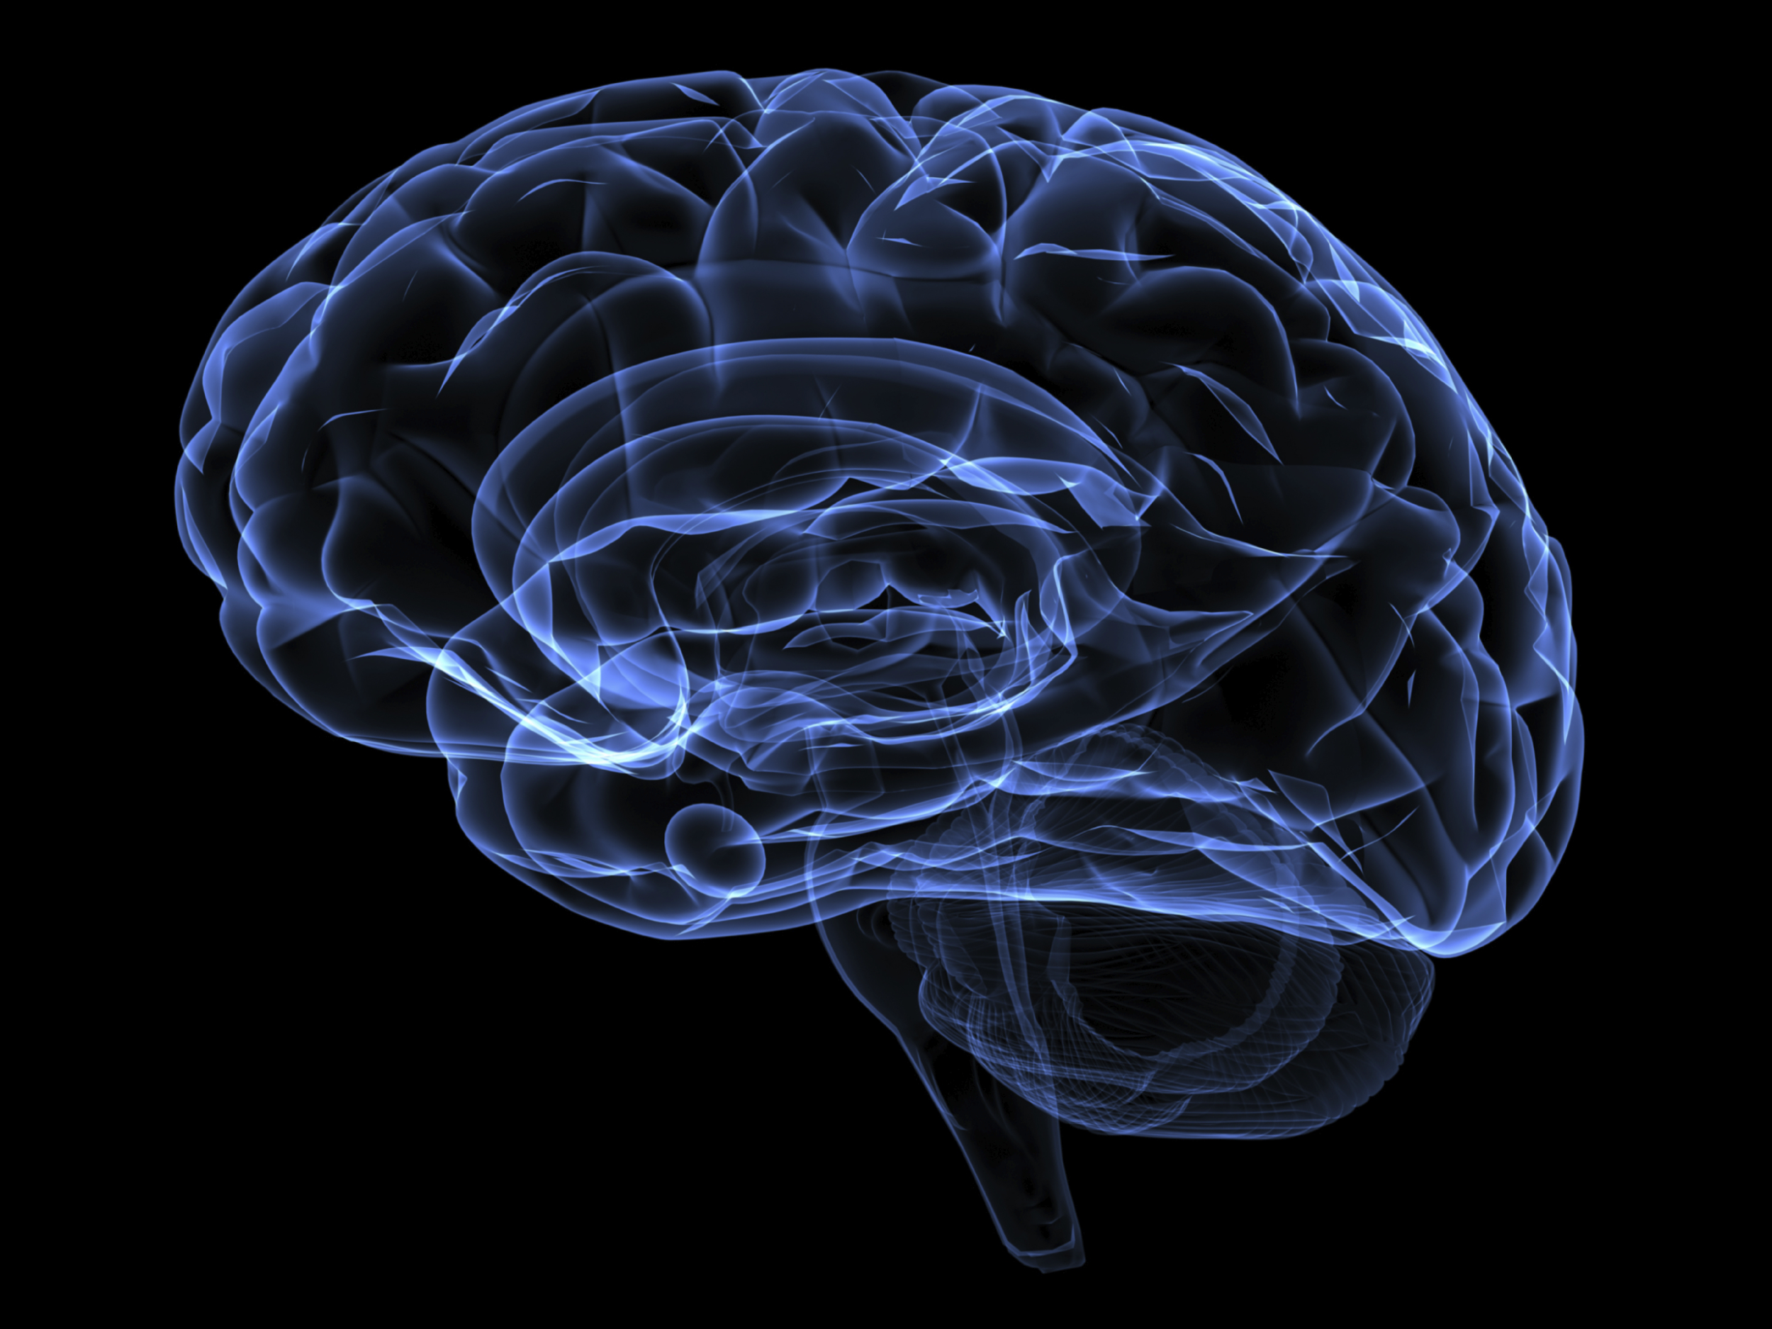
Advanced Methods in Neuroscience
Columbia University

Slide 2
Who are we?

Slide 3
Lisa Randolph
PhD student
Studies Alzheimer’s disease

Slide 4
Kelly Martyniuk
PhD student
Studies psychiatric diseases (anxiety, depression, PTSD)

Slide 5
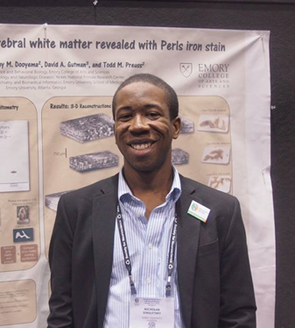
Nicholas Singletary
PhD student
Studies how reward and uncertainty motivate curiosity

Slide 6
How do I become a scientist?

Slide 7
How do I become a scientist?
Go to college (4 years)
Gain research experience in a lab (undergraduate or technician)
Go to graduate school (5-6 years for a PhD)
Lots of job opportunities
Academia: research or teaching at university
Industry: biotech or pharmaceutical company
Science policy
And more!

Slide 8
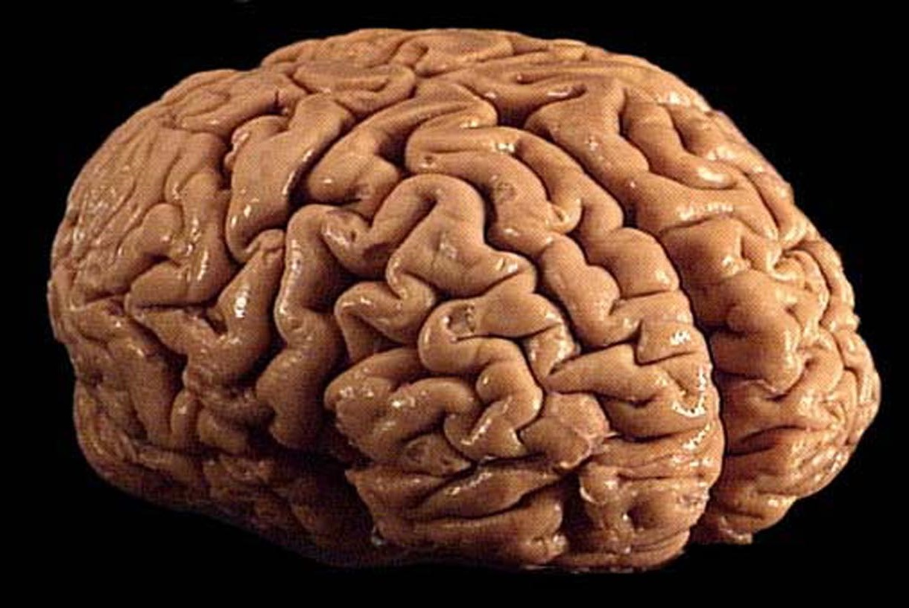
What does the brain do?
Notes:
ask them-- what does the brain do?
nervous system is responsible for many things-- controlling subconscious actions like breathing, walking, reflexes, digestion, etc.
Additionally the brain is necessary for more complex functions including feelings, emotions, language, memory.

Slide 9
Information
Out
senses
thought
mood
behavior
learning
Notes:
the brain takes in information about the surrounding world (through the 5 different senses: touch, sight, sound, smell, taste), processes it this information, and produces a behavior, or reaction.
to give you an example… you’re walking across a busy new york street and you hear shouting around you… this information is sent to your brain, processed as you look around to see where and what is the source of the shouting, it’s an oncoming bicyclist, and your brain sends signals to your legs and body to jump out of the way, to avoid being hit.
**this all happens so fast that you don’t realize how many complex mechanisms are going on.

Slide 10
How do we know what the brain does?
How do we study the brain?
Notes:
Ask them: HOW DO WE KNOW WHAT THE BRAIN DOES? Just by looking at the brain, we can’t tell what it’s function is.
the brain is comprised of specialized cells called NEURONS. As Nick wil soon tell us, neurons can have a variety of different shapes and structures that allow them to differentially processing information. And these neurons work together in complex networks to generate different behaviors.
For this class, we’ll talk about how we study the brain

Slide 11
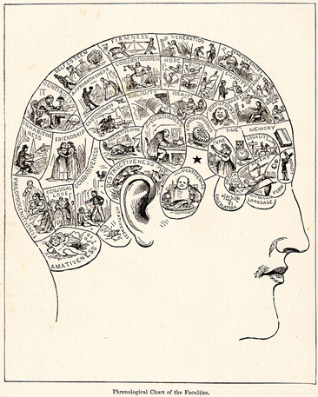
Neuropsychology: Phrenology
•Franz Josef Gall: 1796
•Certain brain areas have specific functions
•Popular in early 1800s
•On the right track, but got carried away
Notes:
Today, to be called a phrenologist is an insult, but sometimes in using this insult, we can forget that the overall idea that brain regions can act as functional modules actually turned out to be true.
Who has actually read a Sherlock Holmes story by Sir Arthur Conan Doyle?
However, aside from making unsupported claims, phrenology is also associated with a shameful history of supporting racism, social Darrwinism, and eugenics.

Slide 12
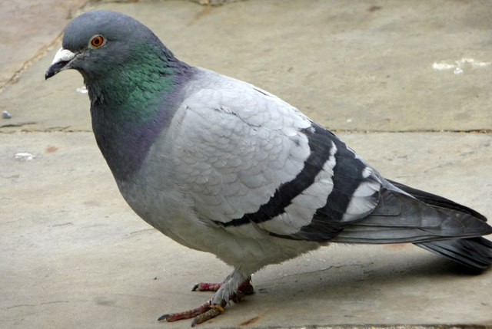
Neuropsychology: Lesion studies
•Jean Pierre Flourens: 1825
•Followed up on Gall’s studies
•Systematic lesions of pigeon and rabbit brains to study effect on behavior
Notes:
“By removing the cerebral hemispheres, for instance, all perceptions, motricity, and judgment were abolished. The removal of the cerebellum affected the animal's equilibrium and motor coordination, while the destruction of the brainstem (medulla oblongata) caused death. These experiments led Flourens to the conclusion that the cerebral hemispheres are responsible for higher cognitive functions, that the cerebellum regulates and integrates movements, and that the medulla controls vital functions, such as circulation, respiration and general bodily stability”
“On the other hand, he was unable (probably because his experimental subjects have relatively primitive cortices) to find specific regions for memory and cognition, which led him to believe that they are represented in a diffuse form around the brain. So, different functions could indeed be ascribed to particular regions of the brain, but that a finer localization was lacking.”

Slide 13
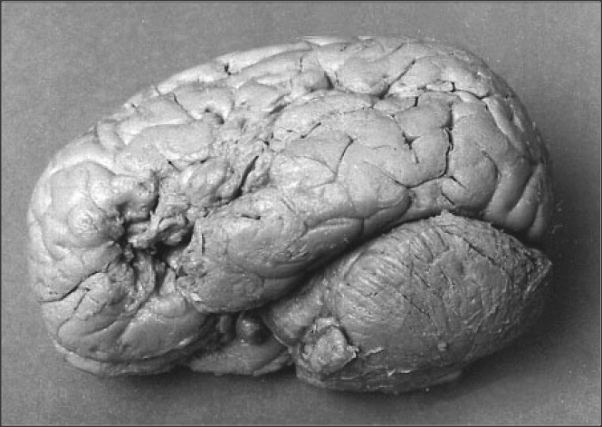
Neuropsychology: Injuries
•Paul Broca
•Patient Tan: Normal mental function and speech comprehension but could only say the word “tan”
•Broca predicted and found injury in left inferior frontal lobe
•Broca’s aphasia: difficulty producing speech despite normal comprehension
Notes:
A neurologist who had multiple patients who could understand language but could not speak. Following the death of these patient, Broca examined his brain and found lesions in the left frontal lobe in multiple patients who could understand language but could not speak.

Slide 14
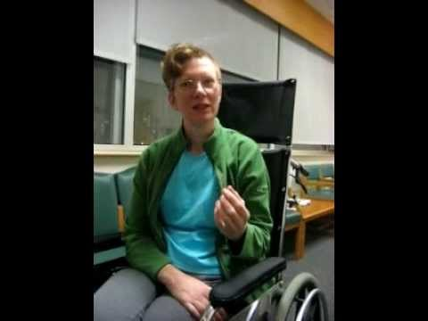
Notes:
Video of patient with Broca’s aphasia. Most commonly occurs as a result of a stroke

Slide 15
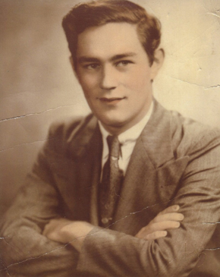
Patient H.M.
Henry Molaison
Severe seizures localized to medial temporal lobes
Treatment: remove his medial temporal lobes!

Slide 16
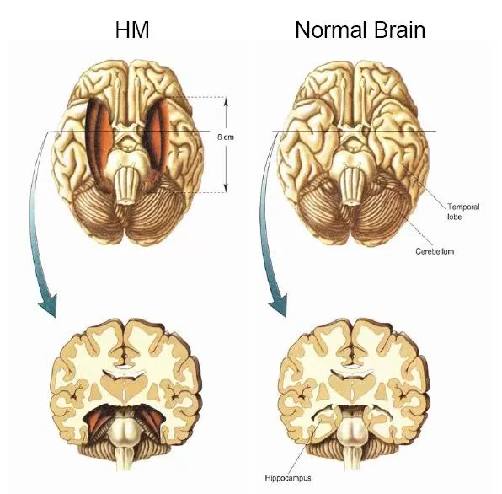
An intriguing result
Limited retrograde and severe anterograde amnesia
Hippocampus: consolidating declarative memory
No more seizures, though...

Slide 17
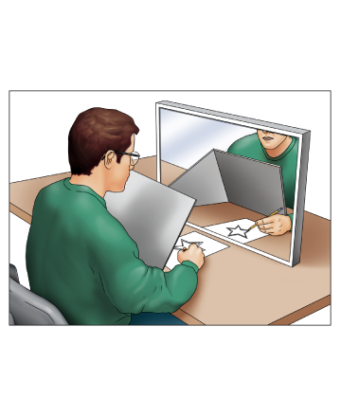
A very intriguing result
No major deficits in other areas
Other forms of memory seemed preserved, including procedural memories
Led to distinction between different memory systems

Slide 18
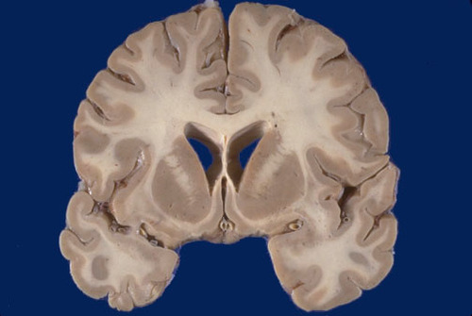
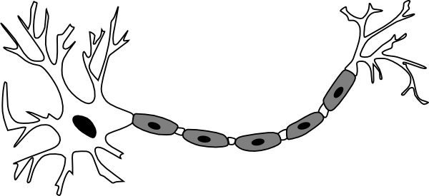
How do we know the structure of neurons?
?
Notes:
When look at brain cannot see individual cells. How to visualize??
Have to selectively color some, but not all, of the cells in brain tissue.

Slide 19
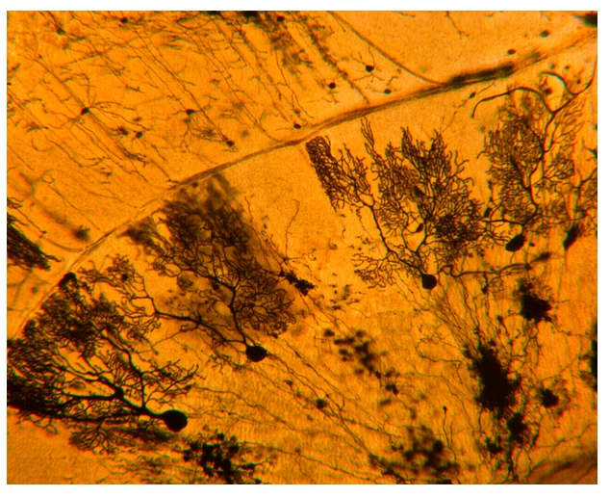
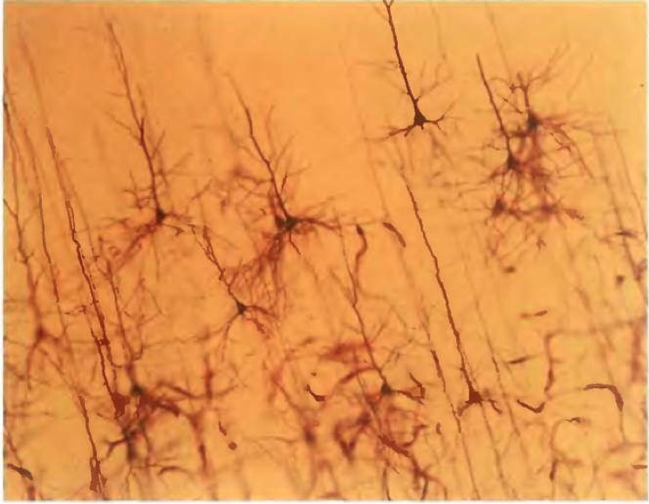
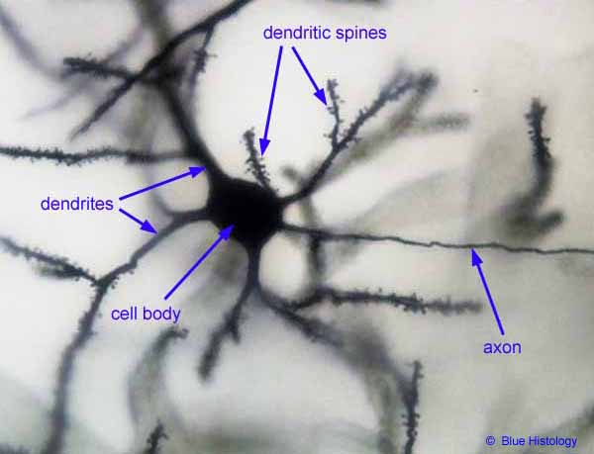
Golgi stain-early method to visualize neurons
Cerebellum
Cortex
Notes:
Useful because it completely stains random neurons
1873
When look at brain cannot see individual cells. How to visualize? Have to selectively color some, but not all, of the cells in brain tissue.
One early example of such a stain is the Golgi stain. By soaking brain tissue in a solution that contains silver– will cause stain of a small percentage of neurons become darkley colored in their entirtly. It stains neurons randomly, the reason of which we still do not know.
“In Golgi staining, fixed (~killed, for practical purposes) neurons are impregnated with chemicals that produce silver chromate crystals that appear as dark black deposits on a yellow background. It stains neurons randomly, the reason of which we still do not know; but for the ones that it does stain, it shows the entire neuron with exquisite detail.”
This stain allows you to see the complete structure of neurons—axons dendrites cell bodies
Based on this information about the structure of neurons, scientists of the day postulated that the long axons carried information between cells. They were right– good example of form informing function

Slide 20
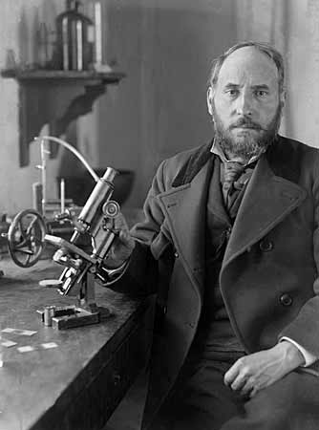
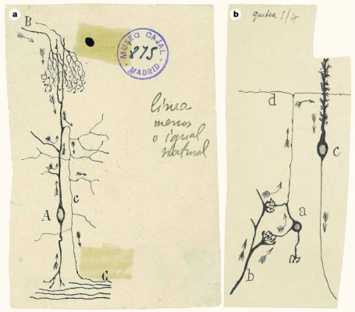
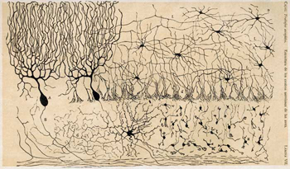
Santiago Ramon y Cajal: structure informs function
Notes:
Cajal famously used the golgi stain to analyze the structure of many brain regions. Many beautiful drawings.
Based on this information about the structure of neurons, cajal postulated that the long axons carried information between cells, information flowed from cell body through the axons. Can tell from the arros in the picture. He was right– good example of form informing function
Cajal and golgi got nobel prize for this work in 1906

Slide 21
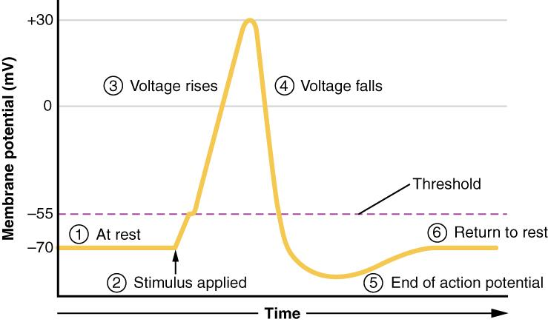
How do neurons communicate?
Signal-sending cell
Signal-receiving cell
Notes:
So anatomy and structure can tell you a lot about the brain, but cells are not static structure. Looking at a dead stained tissue doesn’t tell us how neurons work in a living animal.
it can’t tell you how neurons communicate with each other, when neurons are active. Neurons communicate through both electrical and chemical signals. the electrical signal is generated in the cell body (shown here) through what we call action potentials.
For neurons to pass electrical current, neurons must carry a voltage…. at rest (when the neuron is not active) the neuron stays at a voltage of around -70mv. APs occur when the neurons voltage increases (gets closer to 0) and it fires a fast spike (or a very fast/transient increase in voltage).... this signal is regenerated and maintained along the length of the axon (shown here) until it reaches the terminal where the electrical signal is converted into chemical signal. Signaling chemicals are released in the small gap between two neurons (synapse). The chemical signal travels across this very small gap and excites or inhibits (blocks the activity) of the other cell. This chemical signal in the next neuron is converted back to an electrical signal and the process starts over again

Slide 22
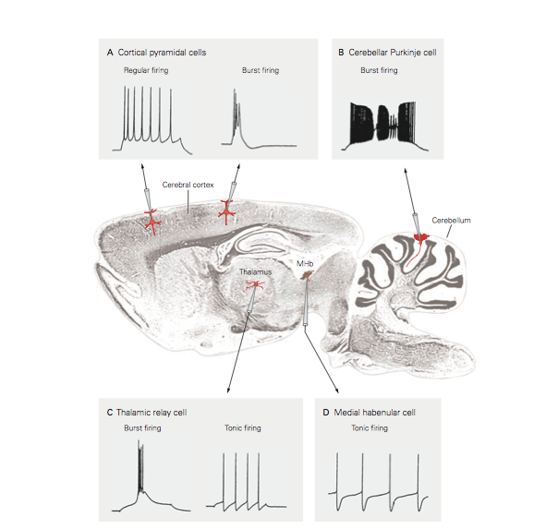
Neurophysiology- recording the electrical activity of neurons
Notes:
So if neurons use electrical signals to communicate, we can record these signals to understand how different neurons differentially process information.
To measure the electrical signals within neurons, neurophysiology is a great technique that allows for direct measurement of active and living neurons. Shown here is a section through the brain. Tiny glass electrodes with metal wires are placed in different brain regions to pick up the electrical signals of the neurons in that region. These signals are visualized here and as you can see, the electrical signals can look very different: they have different shapes, frequencies and durations. These differences represent different cell types that have different shapes (as we saw with the Ramon y Cajal) and perform different functions

Slide 23
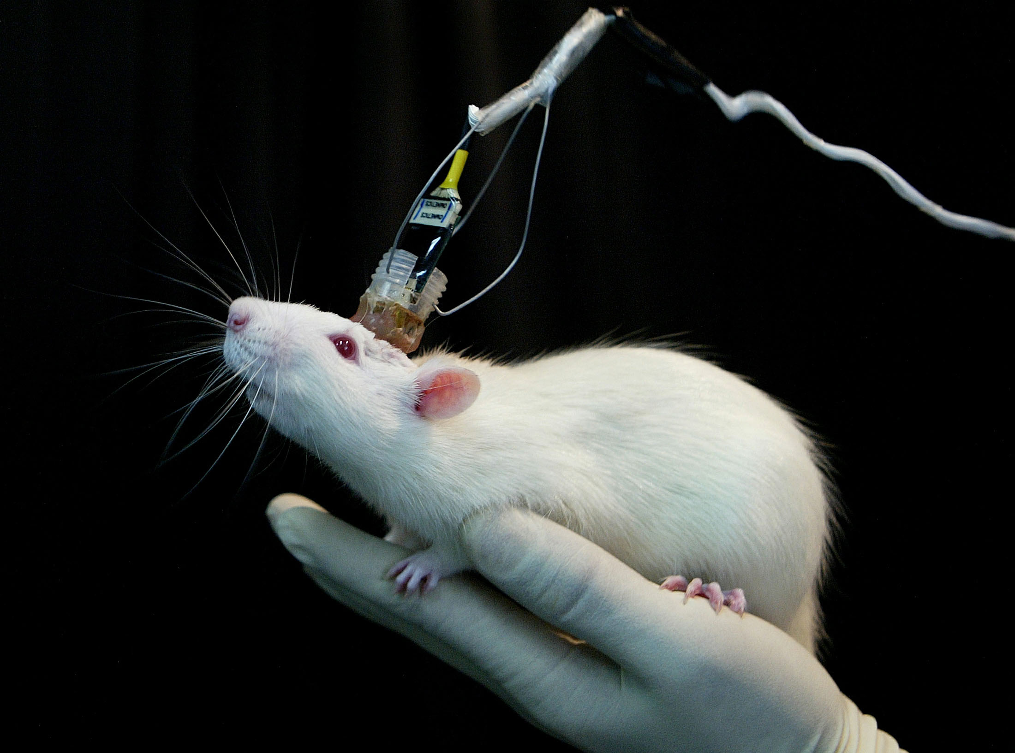
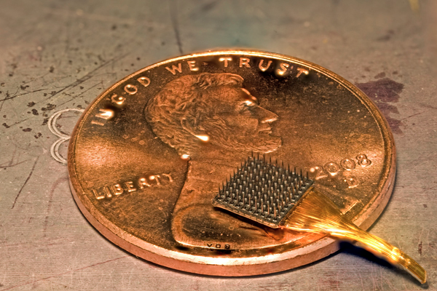
We can record the electrical signals of neurons in behaving animals!
Can investigate: which neurons are active during different behaviors?
Notes:
In addition to recording from single neurons in brain sections, we can study hundreds of neurons at one time in the intact brain while an animal performs a task. This allows us measure how a large populations of cells in different brain regions are working together in a network during different behaviors.
This rat has an array of electrodes implanted in its head.
We can record electrical activity of different brain areas in a behaving animal!
Can ask: which cells in which areas of the brain fire during various behaviors?

Slide 24
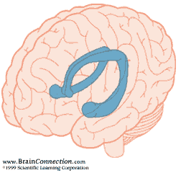
The Hippocampus
Important for memories about experienced events:
Episodic memory is the memory of autobiographical events (times, places, associated emotions, etc) that can be explicitly stated. It is the collection of past personal experiences that occurred at a particular time and place.
Notes:
Important role in the formation of new memories about experienced events (episodic or autobiographical memory). We know this from ablation studies in animals, and unfortunate injuries. H/M: patient hippocampi removed for epilepsy– could no longer form new memories about people places events etc
Episodic memory is the memory of autobiographical events (times, places, associated emotions, and other contextual who, what, when, where, why knowledge) that can be explicitly stated. It is the collection of past personal experiences that occurred at a particular time and place.

Slide 25
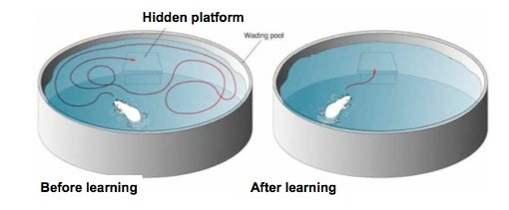
The hippocampus is essential for spatial memory
How does neural activity in the hippocampus help the rat remember where it is in space?
Let’s record from cells in the hippocampus as a rat navigates to find out
Notes:
One important aspect of memory in the hippocampus , and one that has been studied extensively, is spatial memory– remembering where things are, and how to navigate
Morris water maze
Can remember where platform is.
How does hippocampus do this? How does activity within the hippocampus help the rat remember where it is in space???
Let’s Record from hippocampus as a rat navigates to find out!

Slide 26
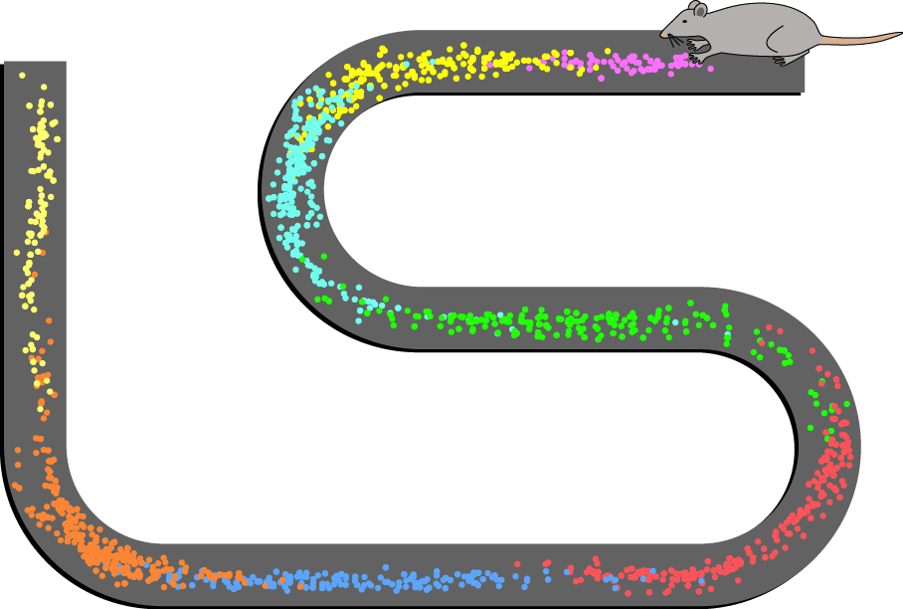
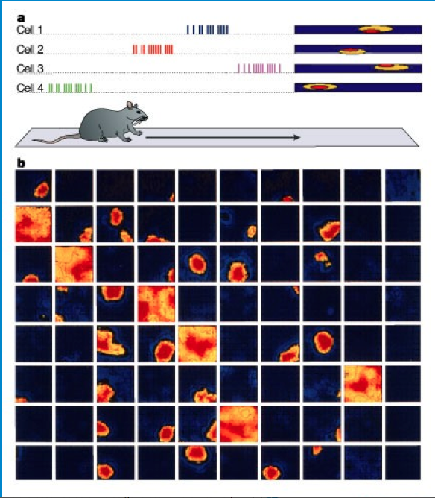
Neurophysiology example: recording neurons in the hippocampus in behaving rats
The neurons in the hippocampus are letting the rat know where it is in space
Notes:
So John O'Keefe recorded from the hippocampus, and found that different cells will fire very specifically when the rat is in a specific location in a box or maze.
Left figure: Spatial firing patterns of 8 place cells recorded from the CA1 layer of a rat. The rat ran back and forth along an elevated track, stopping at each end to eat a small food reward. Dots indicate positions where action potentials were recorded, with color indicating which neuron emitted that action potential.
Compare array to the figure on the right– each electrode in a different cell
this is only after a rat get’s to know an environment. First 10 minutes, no place cells. After 10 minutes, place cells will develop.
The neurons in the hippocampus are letting the rat know where it is in space.

Slide 27
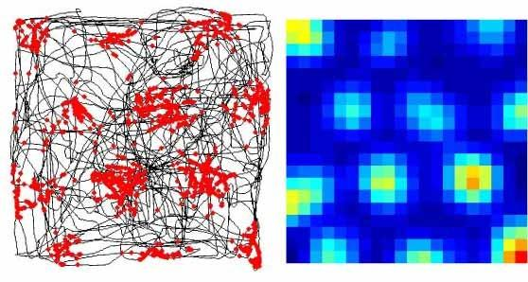
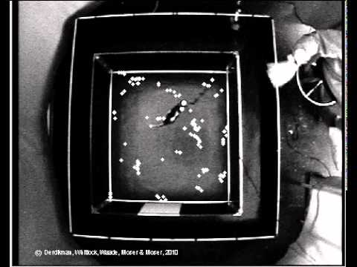
Grid Cells
Notes:
https://youtu.be/i9GiLBXWAHI

Slide 28
Neurophysiology example: recording neurons in the hippocampus in behaving rats
Nobel Prize (2014)
“For their discoveries of cells that constitute a positioning system in the brain”
– John O'Keefe – May-Britt and Edvard Moser

Slide 29
So far….
We have studied brain lesions to see which areas are essential for specific behaviors
We have stained the brain with chemicals to see its cellular structure
We have measured the activity of neurons with electrodes during behavior
How can we figure out which neurons are sufficient to drive certain behaviors?

Slide 30
So far….
We have lesioned the brain to see which areas are essential for specific behaviors
We have stained the brain with chemicals to see its cellular structure
We have measured the activity of neurons with electrodes during behavior
How can we figure out which neurons are sufficient to drive certain behaviors?
We have to activate neurons artificially
Notes:
How can we figure out which neurons are sufficient to drive certain behaviors? We would have to activate them artificially. For a long time this couldn’t be done, and it was hard to figure out cause and effect relationships except for simple lesion studies.

Slide 31
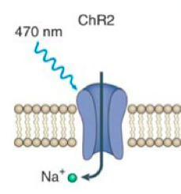
Optogenetics: activate neurons with light using channelrhodopsin
Blue light
Blue light causes channelrhodopsin--an ion channel--to open. This causes sodium to rush into the cell, resulting in an action potential
Neuron activated!
Notes:
A new technique that has become very popular in the last 10 or so years is optogenetics. This technique uses light-activated ion channels to allow us to directly manipulate neuronal activity.
A commonly used channel is called channelrhodopsin. Normally found in GREEN algae. Responsible for movement in response to light.
We can insert this channel into neurons in living animals using genetic engineering.
Blue light causes channelrhodpsin- an ion channel--to open- causing sodium to rush into the cell. If we insert it into neurons, it will cause an action potential when it is activated by blue light.
But how can we get light into the brain?

Slide 32
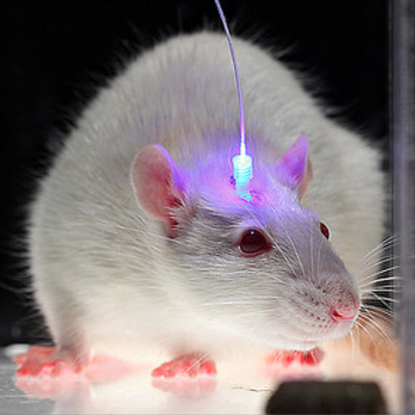
We can activate the neurons in a live animal by inserting this light directly into the brain
Notes:
We can then implant this blue light you see here, which shines directly into the brain of the animal, activating the neurons that we engineered to express channelrhodopsin.

Slide 33
Neuron expressing channelrhodopsin
Notes:
This light will then activate the neurons we are interested in, initiating an action potential. Does anyone know what will happen after that?
So the cell is not just sitting in isolation in the brain--it is connected to many other neurons.

Slide 34
Activated neuron
Connects to other neurons
Behavior
Notes:
These activated neurons can then send messages to other neurons in the brain, resulting in a change in behavior
Since channelrhodopsin is not found in the brain of mammals, this technique allows us to selectively activate only the neurons we have artificially inserted the channel into, while not activating the other neurons around it.
So while electrophysiology allows us to record neuronal activity while mice behave, optogenetics allows us to change neuronal activity and then observe how this changes behavior
This has been an incredible development in neuroscience - can now investigate cause and effect relationships between specific neurons and behavior

Slide 35
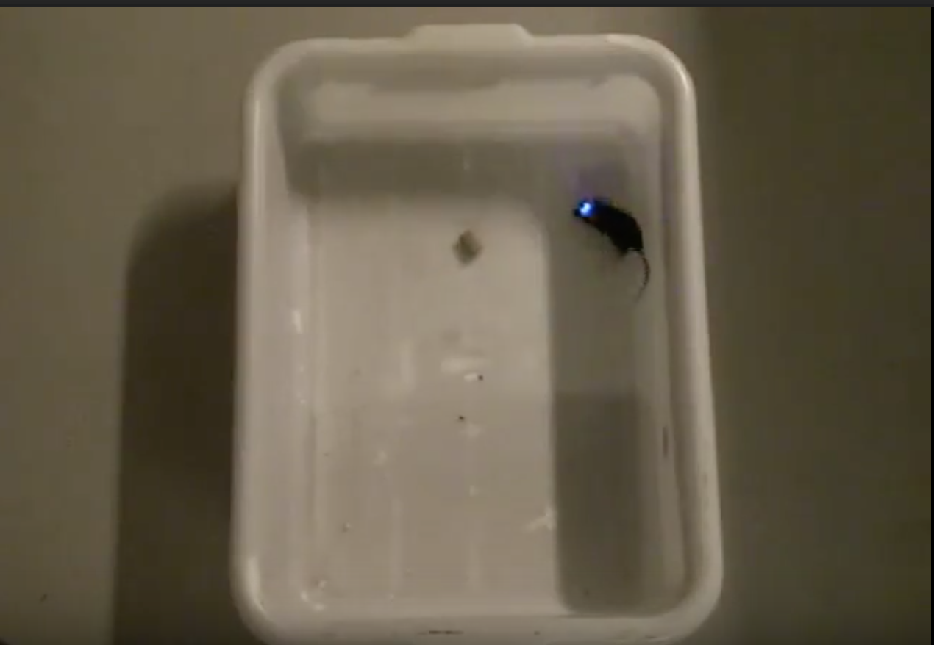
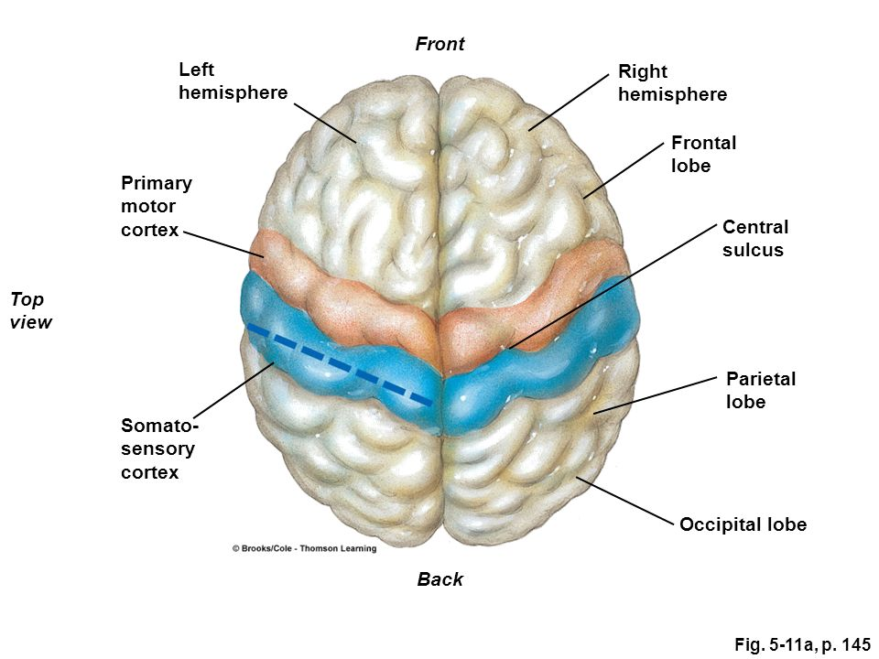
Activating specific neurons can change mouse behavior
http://www.nature.com/neuro/journal/v18/n9/fig_tab/nn.4091_SV1.html?cookies=accepted
https://www.youtube.com/watch?v=7Mmsah0v9Qc
Notes:
In this video, cells in the mouse’s right motor cortex are being activated with blue light. The motor cortex (show in diagrams) controls movement. In mice as well as in humans, the right side of the brain controls the muscles on the left side of the body, and vice versa. What do you think will happen when the right motor cortex is activated?
The other video (if time to show) shows a mouse with a particular pathway being activated that plays a role in feeding behavior (extended amygdalar hypothalamic)

Slide 36
Cool optogenetics experiments today
Memory storage - how can we weaken traumatic memories to help people with PTSD recover? (Christine Denny at Columbia!)
Seizures and how to stop them
Finding cells responsible for movement disruption in Parkinson’s disease
Neurodegenerative processes in Alzheimer’s, Huntington’s, as well as regeneration
Notes:
We can make really important breakthroughs using this technique, which might ultimately change how we understand the brain and treat these devastating diseases

Slide 37
Summary
Old days: lesion studies
Anatomy: Staining to investigate cellular structure of the brain
Neurophysiology: recording the electrical activity of neurons
Optogenetics: activating neurons in the brain with light
Notes:
While the first two techniques we talked about allowed us to make observations about the brain, they did not allow us to ask questions directly about the brain. With these newer techniques, we can now investigate cause and effect in a more direct manner, manipulating the brain in order to answer important questions about how the brain works.
We think this is a very exciting time to be in neuroscience! There are so many new and advanced techniques coming out now that allow us to study the brain in ways that were impossible only a few decades ago. But there is still so much to learn about the brain, and so many questions left to answer. So we think that now is a great time to get involved in neuroscience, because there is so much potential for exciting discoveries!

Slide 38
QUESTIONS? THANK YOU!

