Slide 1
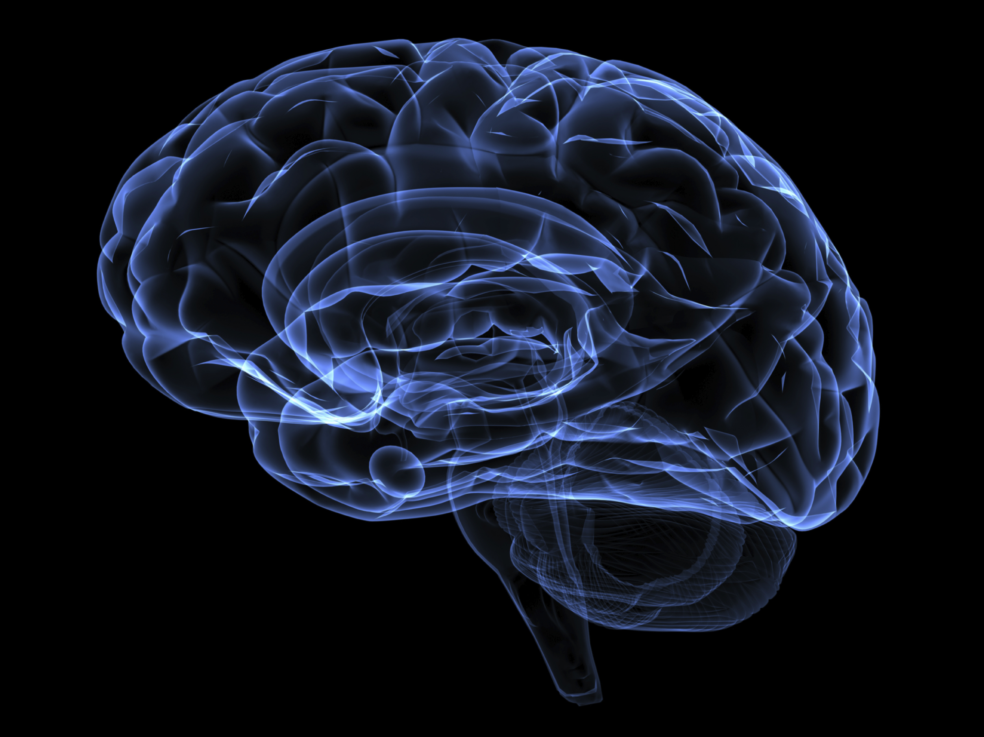
Advanced Methods in Neuroscience
Columbia University

Slide 2
Who are we?

Slide 3
Rebecca Vaadia
PhD student
Studies locomotion in Fruit Flies

Slide 4
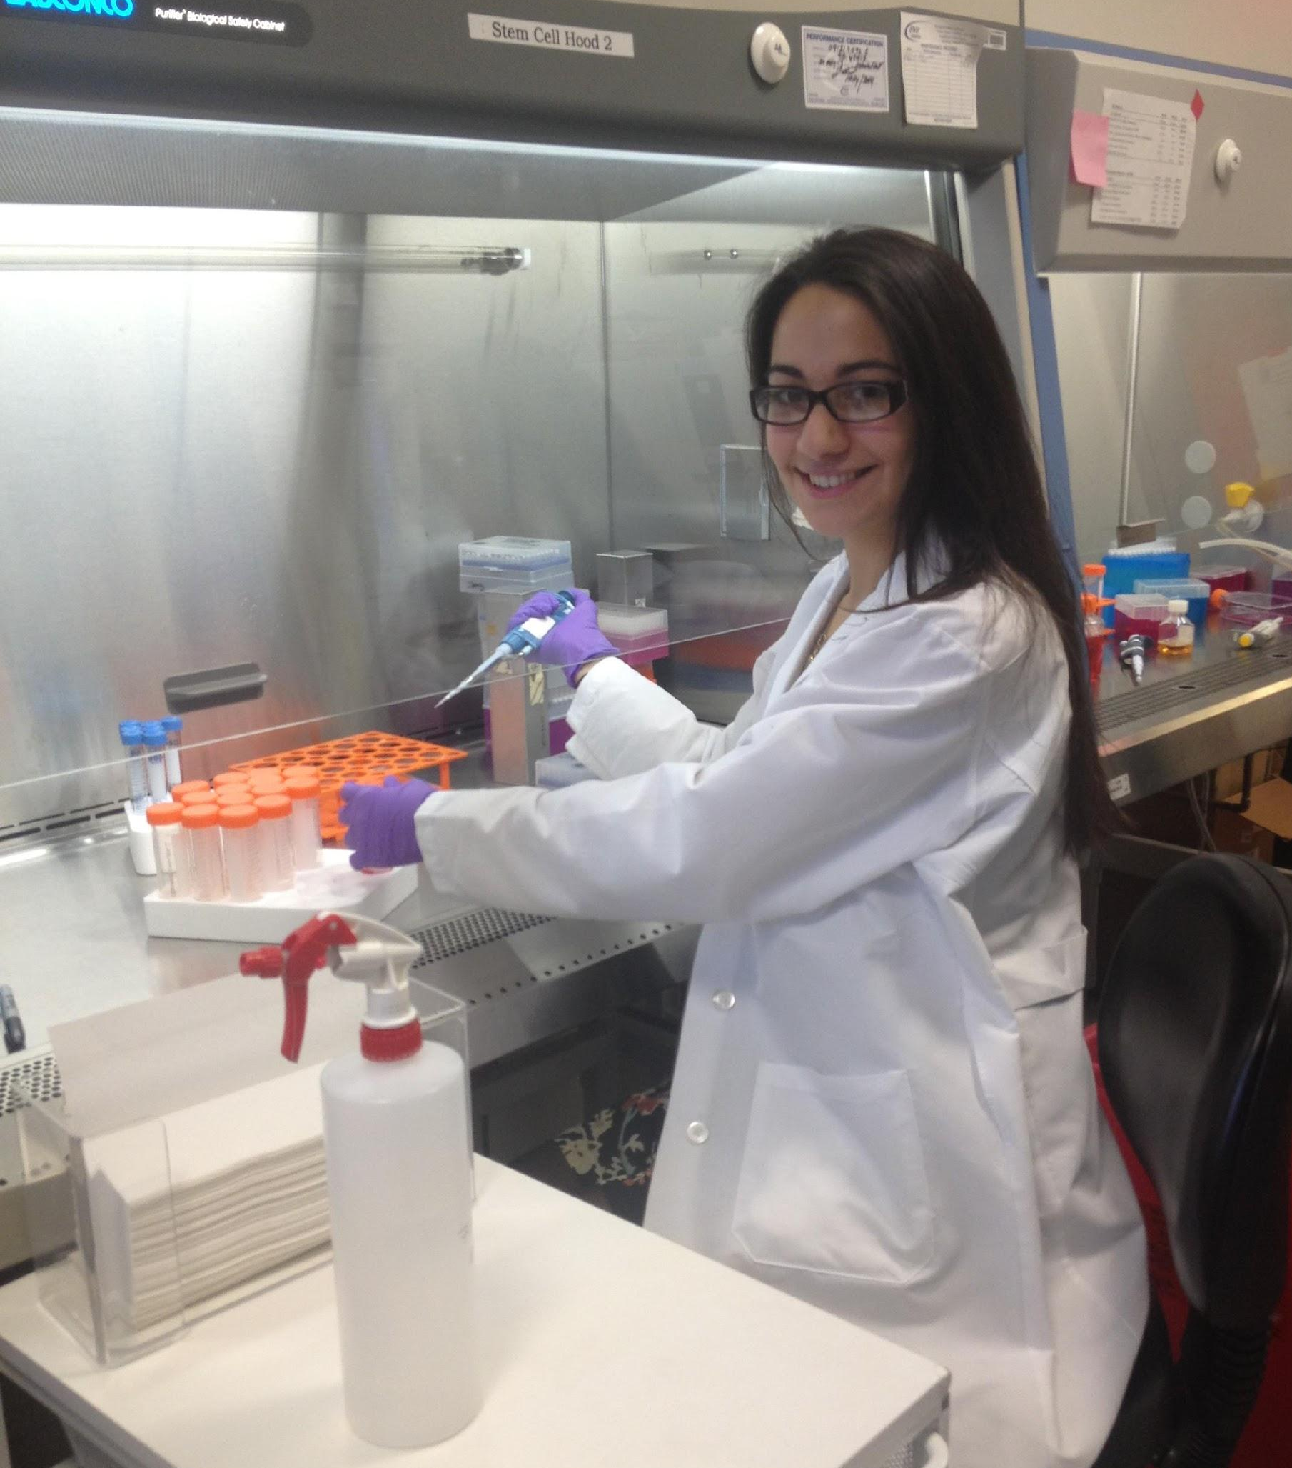
Kristin Politi
PhD student
Studies why motor neurons die in ALS (Lou Gehrig’s Disease)

Slide 5
Dave Doobin
PhD student
Studies how the outer layer of mammalian brains develop

Slide 6
Blair Jenkins
MD/PhD student
Studies the neurons in our skin that allow us to sense touch

Slide 7
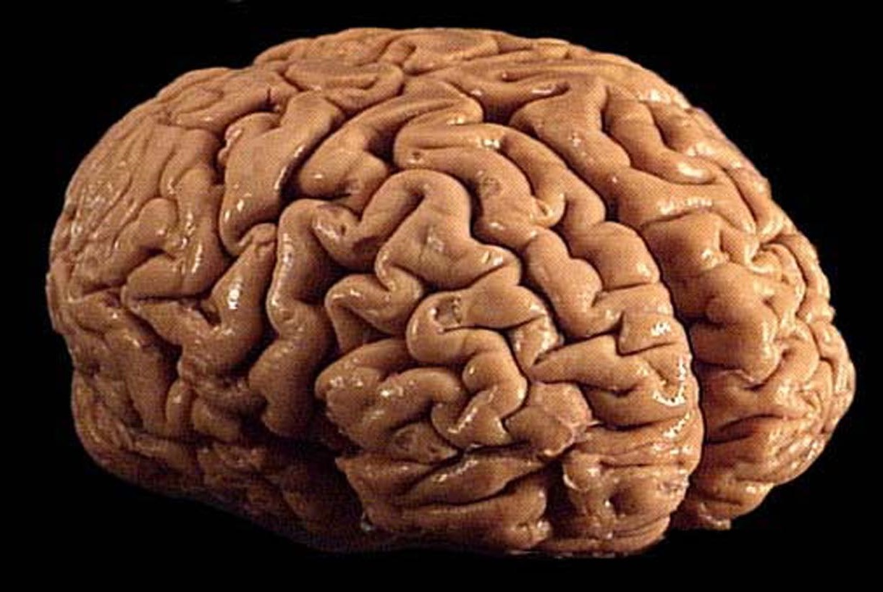
What does the brain do?
Notes:
ask them-- what does the brain do?
nervous system is responsible for many things-- controlling subconcious things like breathing walking, reflexes. complex things like feelings, emotions, language, memory.
BRAIN BANK here!

Slide 8
Information
Out
senses
thought
mood
Behavior
learning
Notes:
nervous system is responsible for many things-- controlling subconscious things like breathing walking, reflexes. complex things like feelings, emotions, language, memory.
takes in information, processes it, and then allows you to behave to react. you perceive heat and then pull your hand back. More complex-- you listen to someone talking, and then you talk back. that is all receiving a sensory input, processing it and then acting appropriately in response. heat is somewhat easy to imagine. one neuron senses pain-- sends signal back to brain-- brain processes that signal-- a few neurons talk to each other in the brain-- which eventually leads to a signal to a motor neuron that causes your muscle to move. language is much more complexand we don't understand exactly how it works, but similarly, brain processes auditory signal-- a few neurons talk to each other in the brain, processing it, which eventually leads to a signal to a motor neuron that causes your voice box to move.

Slide 9
How do we know what the brain does?
How do we study the brain?
Notes:
Ask them: HOW DO WE KNOW WHAT THE BRAIN DOES? Just by looking at the brain, we can’t tell what it’s function is. How do we know the things in you’ve learned in your textbook. (Use an example someone mentioned)
For this class, we’ll talk about how we study the brain

Slide 10
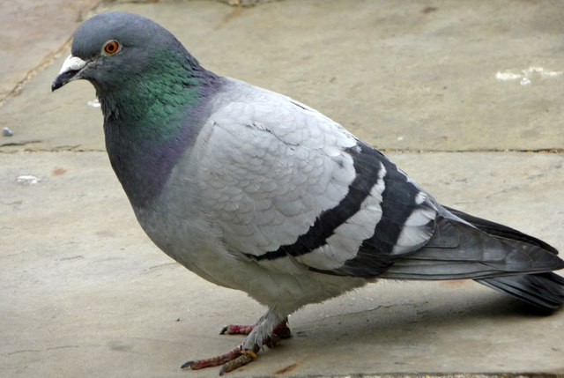
The Old Days- poke holes in the brain
Jean Pierre Flourens- 1825
Systematic lesions of cerebrum, cerebellum, brainstem.
Notes:
From wikipedia: “in 1825, Flourens pioneered the experimental method on 1825, Flourens pioneered the experimental method of carrying out localized lesions of the brain in living rabbits and pigeons and carefully observing their effects on motricity, sensibility and behavior. His intention was to investigate localisationism, i.e., whether different parts of the brain had different functions, carrying out localized lesions of the brain in living rabbits and pigeons and carefully observing their effects on motricity, sensibility and behavior. His intention was to investigate localisationism, i.e., whether different parts of the brain had different functions.”
“By removing the cerebral hemispheres, for instance, all perceptions, motricity, and judgment were abolished. The removal of the cerebellum affected the animal's equilibrium and motor coordination, while the destruction of the brainstem (medulla oblongata) caused death. These experiments led Flourens to the conclusion that the cerebral hemispheres are responsible for higher cognitive functions, that the cerebellum regulates and integrates movements, and that the medulla controls vital functions, such as circulation, respiration and general bodily stability”
“On the other hand, he was unable (probably because his experimental subjects have relatively primitive cortices) to find specific regions for memory and cognition, which led him to believe that they are represented in a diffuse form around the brain. So, different functions could indeed be ascribed to particular regions of the brain, but that a finer localization was lacking.”

Slide 11
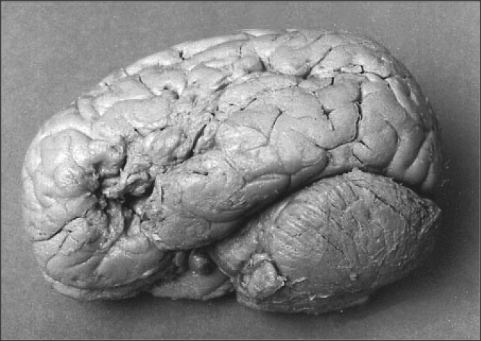
The Old Days- insights from unfortunate injury
Paul Broca’s patients: lesions in the left frontal lobe in patients who could understand language but could not speak.
Broca’s area determined to be essential for speech production
1861
Notes:
A neurologist who had multiple patients who could understand language but could not speak. Following the death of these patient, Broca examined his brain and found lesions in the left frontal lobe in multiple patients who could understand language but could not speak.

Slide 12
Video of Broca’s aphasia patient
https://www.youtube.com/watch?v=f2IiMEbMnPM

Slide 13
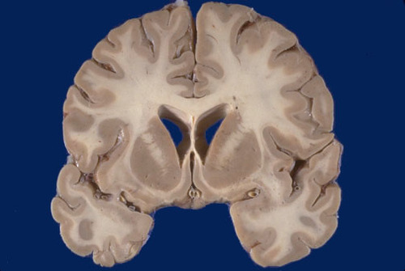
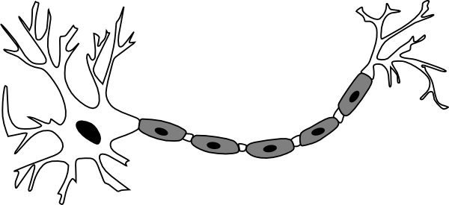
How do we know the structure of neurons?
?
Notes:
When look at brain cannot see individual cells. How to visualize??
Have to selectively color some, but not all, of the cells in brain tissue.

Slide 14
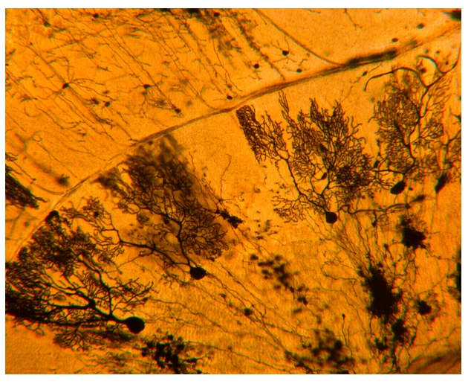
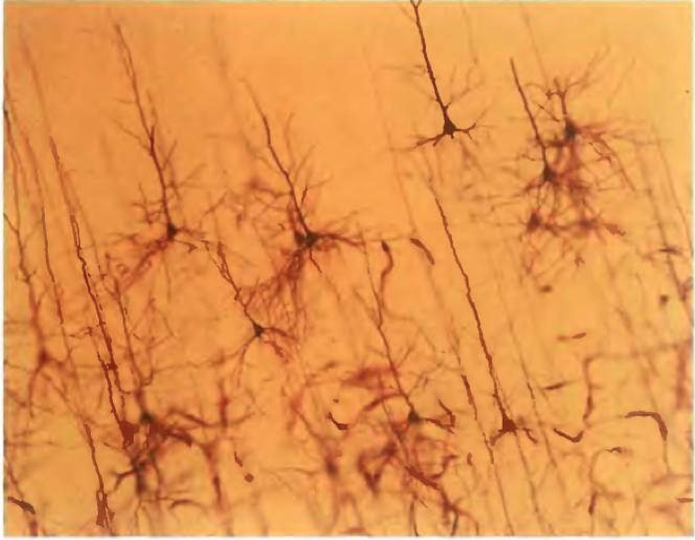
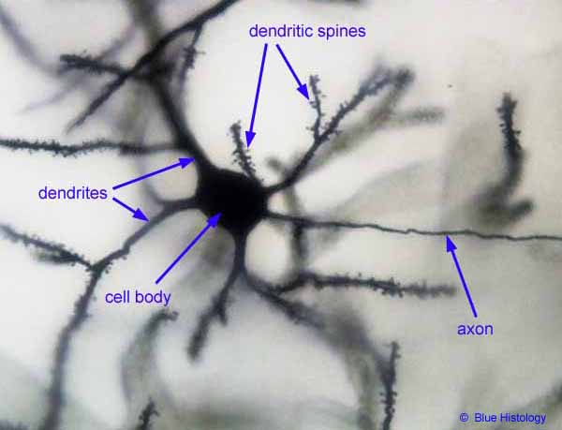
Golgi stain-early method to visualize neurons
Cerebellum
Cortex
Notes:
1873
When look at brain cannot see individual cells. How to visualize? Have to selectively color some, but not all, of the cells in brain tissue.
One early example of such a stain is the Golgi stain. By soaking brain tissue in a solution that contains silver– will cause stain of a small percentage of neurons become darkley colored in their entirtly. It stains neurons randomly, the reason of which we still do not know.
“In Golgi staining, fixed (~killed, for practical purposes) neurons are impregnated with chemicals that produce silver chromate crystals that appear as dark black deposits on a yellow background. It stains neurons randomly, the reason of which we still do not know; but for the ones that it does stain, it shows the entire neuron with exquisite detail.”
This stain allows you to see the complete structure of neurons—axons dendrites cell bodies
Based on this information about the structure of neurons, scientists of the day postulated that the long axons carried information between cells. They were right– good example of form informing function

Slide 15
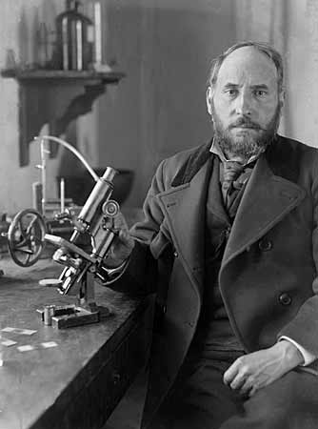
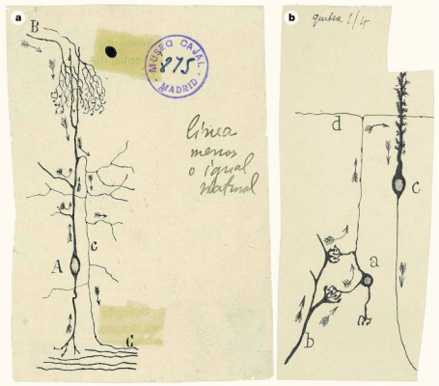
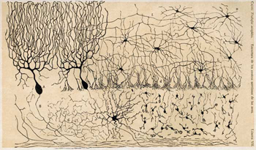
Santiago Ramon y Cajal: structure informs function
Notes:
Cajal famously used the golgi stain to analyze the structure of many brain regions. Many beautiful drawings.
Based on this information about the structure of neurons, cajal postulated that the long axons carried information between cells, information flowed from cell body through the axons. Can tell from the arros in the picture. He was right– good example of form informing function
Cajal and golgi got nobel prize for this work in 1906

Slide 16
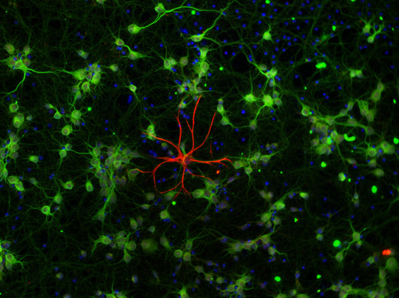
Modern methods can stain specific cell types- Immunohistochemistry
Notes:
Golgi stains stain randomly. Let’ say you want to se where neurons of a particular neurotransmitter type are, or any specific molecule.
Neurons with a specific molecule are stained in green
In red is a glial cell– molecule specific to glia

Slide 17
How do we know how neurons communicate?
Signal-sending cell
Signal-receiving cell
Notes:
So anatomy and structure can tell you a lot about the brain, but cells are not static structure. Looking at a dead stained tissue doesn’t tell us how neurons work in a living animal.
it can’t tell you how neurons communicate with each other, when neurons are active. To investigate that, you need to record electrical potentials from neurons with metal wires– electrodes.

Slide 18
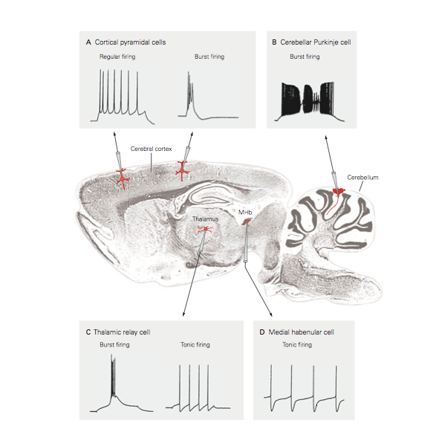
Neurophysiology- recording the electrical activity of neurons
Notes:
So anatomy and structure can tell you a lot about the brain, but it can’t tell you how neurons communicate with each other. How can we investigate how neurons communicate with each other?
You all know that neurons communicate to each other via action potentials– electrical signals due to the opening and closing of ion channels and the flow of ions
To investigate that, you need to record electrical potentials from neurons with metal wires– electrodes.
Figure– different kinds of action potentials in different areas of the brain-=- different neurons in different areas of the brain communicate differently.

Slide 19
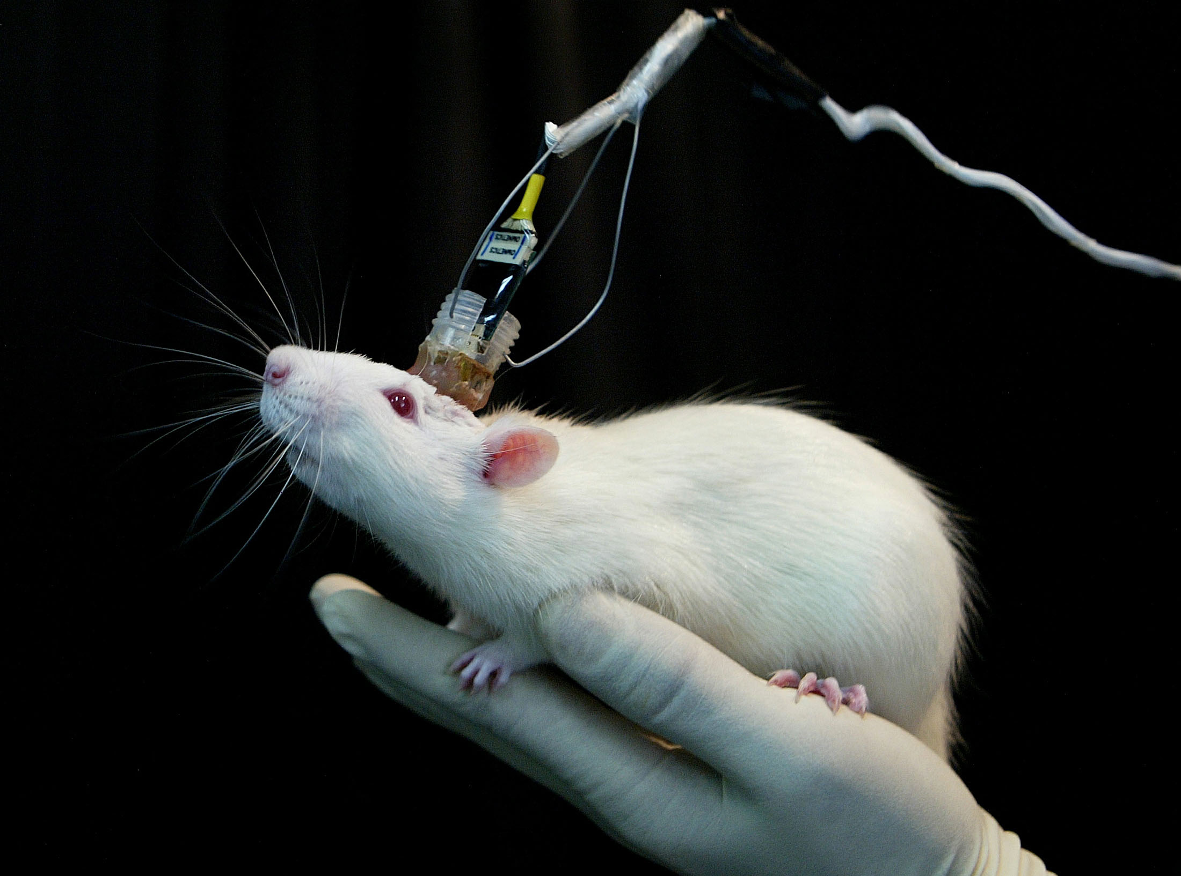
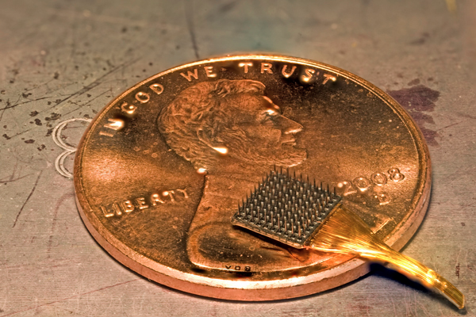
We can record the electrical signals of neurons in behaving animals!
Can investigate: which neurons are active during different behaviors?
Notes:
This rat has an array of electrodes implanted in its head.
We can record electrical activity of different brain areas in a behaving animal!
Can ask: which cells in which areas of the brain fire during various behaviors?

Slide 20
Neurophysiology example: recording neurons in the hippocampus in behaving rats
Nobel Prize (2014)
“For their discoveries of cells that constitute a positioning system in the brain”
– John O'Keefe – May-Britt and Edvard Moser

Slide 21
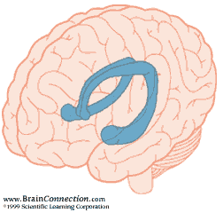
The Hippocampus
Important for memories about experienced events:
Episodic memory is the memory of autobiographical events (times, places, associated emotions, etc) that can be explicitly stated. It is the collection of past personal experiences that occurred at a particular time and place.
Notes:
Important role in the formation of new memories about experienced events (episodic or autobiographical memory). We know this from ablation studies in animals, and unfortunate injuries. H/M: patient hippocampi removed for epilepsy– could no longer form new memories about people places events etc
Episodic memory is the memory of autobiographical events (times, places, associated emotions, and other contextual who, what, when, where, why knowledge) that can be explicitly stated. It is the collection of past personal experiences that occurred at a particular time and place.

Slide 22
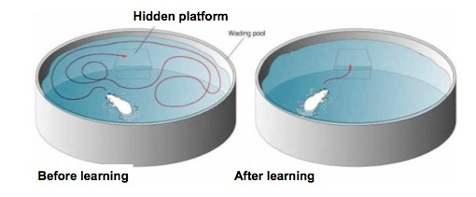
The hippocampus is essential for spatial memory
How does neural activity in the hippocampus help the rat remember where it is in space?
Let’s record from cells in the hippocampus as a rat navigates to find out
Notes:
One important aspect of memory in the hippocampus , and one that has been studied extensively, is spatial memory– remembering where things are, and how to navigate
Morris water maze
Can remember where platform is.
How does hippocampus do this? How does activity within the hippocampus help the rat remember where it is in space???
Let’s Record from hippocampus as a rat navigates to find out!

Slide 23
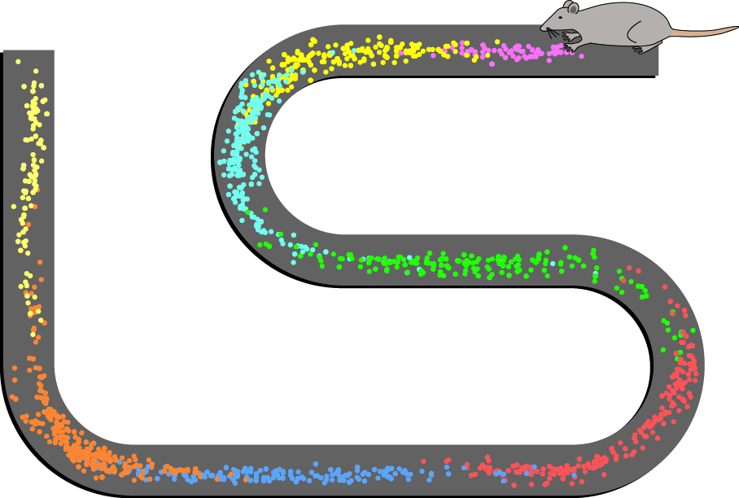
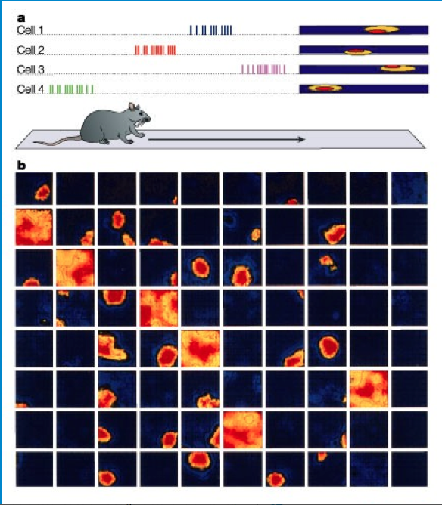
Neurophysiology example: recording neurons in the hippocampus in behaving rats
The neurons in the hippocampus are letting the rat know where it is in space
Notes:
So John O'Keefe recorded from the hippocampus, and found that different cells will fire very specifically when the rat is in a specific location in a box or maze.
Left figure: Spatial firing patterns of 8 place cells recorded from the CA1 layer of a rat. The rat ran back and forth along an elevated track, stopping at each end to eat a small food reward. Dots indicate positions where action potentials were recorded, with color indicating which neuron emitted that action potential.
Compare array to the figure on the right– each electrode in a different cell
this is only after a rat get’s to know an environment. First 10 minutes, no place cells. After 10 minutes, place cells will develop.
The neurons in the hippocampus are letting the rat know where it is in space.

Slide 24
Video on place cells
https://www.youtube.com/watch?v=PGHRDcPKio8

Slide 25
So far….
We have lesioned the brain to see which areas are essential for specific behaviors
We have stained the brain with chemicals to see it’s cellular structure
We have measured the activity of neurons with electrodes during behavior
How can we figure out which neurons are sufficient to drive certain behaviors?

Slide 26
So far….
We have lesioned the brain to see which areas are essential for specific behaviors
We have stained the brain with chemicals to see it’s cellular structure
We have measured the activity of neurons with electrodes during behavior
How can we figure out which neurons are sufficient to drive certain behaviors?
We have to activate neurons artificially
Notes:
How can we figure out which neurons are sufficient to drive certain behaviors? We would have to activate them artificially. For a long time this couldn’t be done, and it was hard to figure out cause and effect relationships except for simple lesion studies.

Slide 27
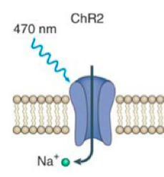
We can artificially activate neurons with light using channelrhodopsin
Blue light
Blue light causes channelrhodpsin- an ion channel--to open- causing sodium to rush into the cell, and then an action potential
Neuron activated!
Notes:
Normally found in GREEN algae. Responsible for response to light
Blue light causes channelrhodpsin- an ion channel--to open- causing sodium to rush into the cell, and then an action potential

Slide 28
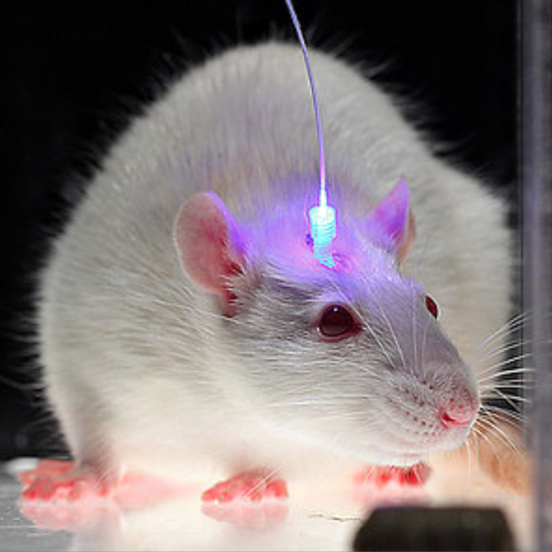
Genetic engineering allows researchers to put channelrhodopsin in specific neurons of an animal
Notes:
When genetically engineer an animal to express channel rhodopsin in specific neurons, can shine blue light on those neurons, which will activate them, then can see how the animal behaves
This has been an incredible recent tool- can now investigate cause and effect- activate a neuron, and see what happens to behavior.

Slide 29
Neuron expressing channel rhodopsin

Slide 30
Activated neuron
Connects to other neurons
Behavior

Slide 31
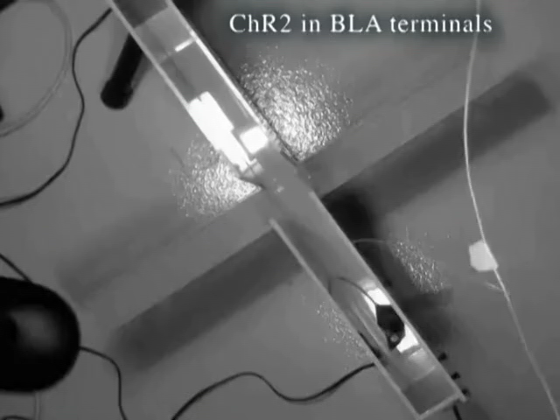
Activating specific neurons causes mice to be less anxious/more adventurous
http://www.nimh.nih.gov/videos/press/tye-deisseroth-supplementary.mp4
Notes:
.

Slide 32
Summary
Old days: lesion studies
Anatomy: Staining to investigate cellular structure of the brain
Neurophysiology: recording the electrical activity of neurons
Optogenetics: activating neurons in the brain with light

Slide 33
QUESTIONS? THANK YOU!

